Slide 2
MIDI: Controlling the Sound

Slide 3
Lesson Objectives
Define MIDI.
Describe examples of uses of MIDI in music production today.
Create original music using online MIDI sequencer.
Share original music with peers.

Slide 4
Lesson Introduction
Let's watch this example of a project made with a MIDI.
Notes:
Reminder: Please preview the video prior to showing the class

Slide 6
Let's Learn More
In small groups or independently, read one of the articles below.
Article 1 or Article 2
As you read, seek the answers below.
What does MIDI stand for?
Does MIDI make sound?
Describe the role of MIDI.
In what year were the first devices released that used MIDI?
What are some modern applications of MIDI?
Be prepared to share your findings with the class.
Notes:
Note: More examples of where MIDI is used today: In notation programs like Finale, Dorico and Musescore; in all DAW sequencers like Logic Pro, Soundtrap, Pro Tools; in all electronic pianos, and all virtual instruments. In other words, a TON!

Slide 7
Let's Read!
Notes:
Note: More examples of where MIDI is used today: In notation programs like Finale, Dorico and Musescore; in all DAW sequencers like Logic Pro, Soundtrap, Pro Tools; in all electronic pianos, and all virtual instruments. In other words, a TON!

Slide 8
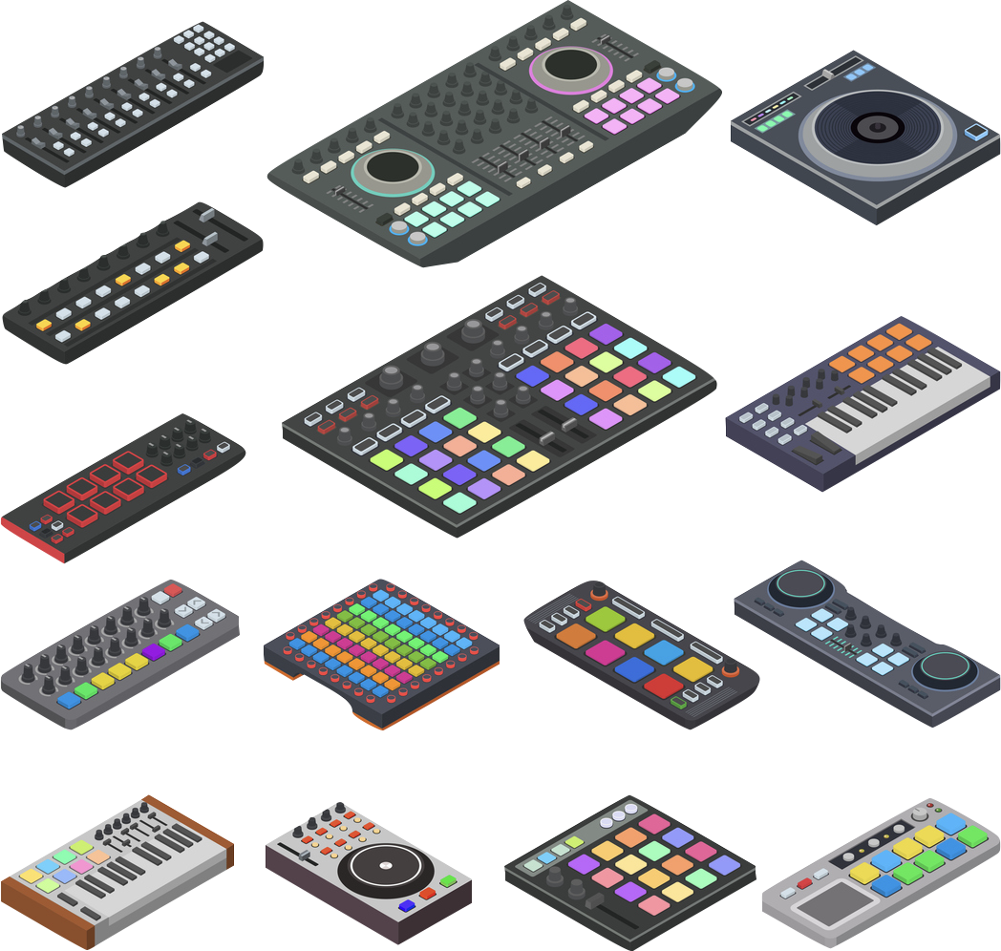
Article Recap
What Does MIDI stand for?
MIDI, or “Musical Instrument Digital Interface,” is a system or computer language that is used to control the actions of an electronic instrument such as a synthesizer. MIDI controllers can look like piano keyboards, but they can also be digital drum sets, electronic wind instruments, guitars, computer or smartphone apps, or nearly anything else that can send an electronic signal.

Slide 9
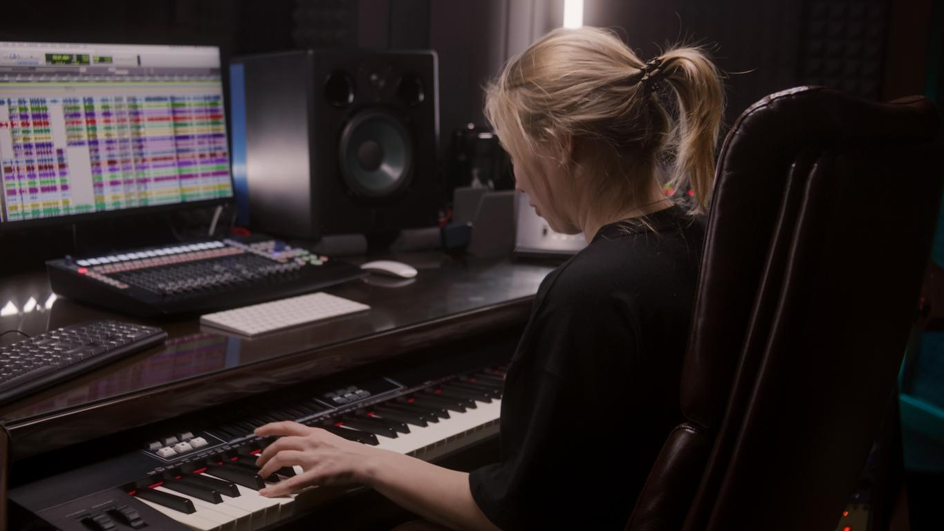
Article Recap
Does MIDI make sound?
MIDI doesn’t make sound on its own. Instead, it is a language that is used to send instructions to an instrument or computer so it knows which sound to produce!
Did you know? MIDI can used for projects other than just music making. It can control stage lights, fountain and light shows, and much, much more!

Slide 10
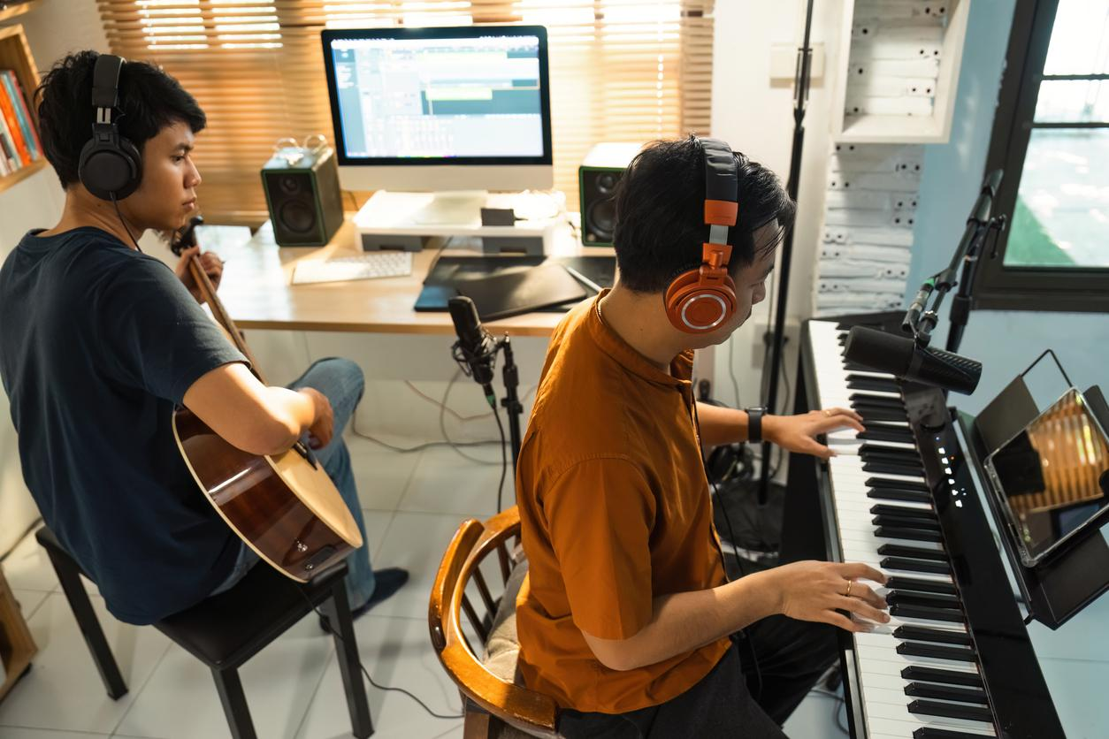
Article Recap
What are some modern applications of MIDI?
MIDI is used in so many applications! Notation programs like Noteflight, Dorico, and Musescore all use MIDI. Sequencers such as Logic Pro, Soundtrap, and Pro Tools all use MIDI! And, all virtual instruments utilize MIDI.
This is truly a development that changed the world of music!

Slide 11
Let's Create!
Select a Midi Sequencer from the choices below
Online Sequencer or Beepbox.co
Compose a single note melody by clicking into the piano roll.
For the remainder of the time, create a short piece of music. Be sure it includes...
A clear melody/accompaniment texture
ABA form
Be prepared to share your creations with the class.

Slide 12
Consider a Career in Music!
What careers are related to the lesson we just completed?
Music Production for video games, movies, podcasts
Composer/Songwriter
Recording engineer
Theatre stage manager
Sound engineer
Software Developer
Salesperson
Manufacturer

