Slide 2
Music Match Makers

Slide 3
Lesson Objectives
Identify the various types of instrumental models for brass and woodwind instruments.
Describe the ways in which instruments can be manipulated to suit a players’ needs.
Identify an artist with an iconic instrument preference.
Develop a slideshow detailing information about their selected artist and their “match.”

Slide 4
Lesson Introduction
Look at these two trumpets.
What differences do you notice?
Notes:
Note that differences may not be readily apparent to the naked eye.
Yamaha Corporation YTR-233OC Bb Trumpet, 2020
Yamaha's YTR-2330 is designed for beginning trumpeters. Its no-frills construction from yellow brass ensures a lightweight instrument at an approachable price point.
Yamaha Corporation YTR-8335IIS Bb Trumpet, 2020
Part of Yamaha's Xeno Series, the YTR-8335IIS targets professional trumpeters. It prioritizes tone quality, projection, and intonation.

Slide 5
Which instrument do you think is a student instrument and which one do you think is for a professional?
Notes:
Yamaha Corporation YTR-233OC Bb Trumpet, 2020
Yamaha's YTR-2330 is designed for beginning trumpeters. Its no-frills construction from yellow brass ensures a lightweight instrument at an approachable price point.
Yamaha Corporation YTR-8335IIS Bb Trumpet, 2020
Part of Yamaha's Xeno Series, the YTR-8335IIS targets professional trumpeters. It prioritizes tone quality, projection, and intonation.

Slide 6
Why would two similar instruments
have such different uses?

Slide 7
Finding Your Match
Today you will be learning about different instruments in the woodwind and brass family and how there are variations within individual instruments that make it possible for a variety of people to perform.
Then, you will apply that knowledge to learn about historical “matches” between artists and instruments.

Slide 8
There’s an instrument for everyone
For a variety of reasons, like budget or skill level, the right instrument for one musician might not be the right instrument for another.
To make sure that nearly anyone who wants to make music can make music, manufacturers (instrument builders) design instruments to meet a variety of needs.

Slide 9
There’s an instrument for everyone
To make sure that nearly anyone who wants to make music can make music, manufacturers (instrument builders) design instruments to meet a variety of needs.
Manufacturers of brass and woodwind instruments, which are played by musicians of all ages and abilities, have made this possible by defining clear categories of instruments meeting a range of players.

Slide 10
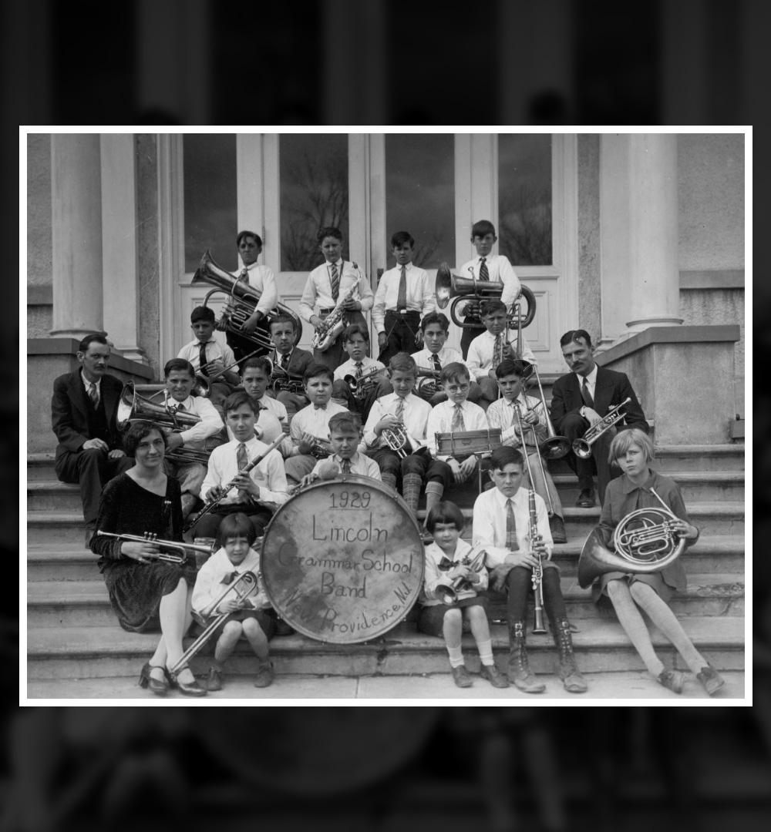
Brass and Woodwinds
The rise and growth of the American brass and woodwind industry and the proliferation of bands have been intimately connected since the late 19th century.
With community bands, college bands, elementary school bands, amateur and hobbyist bands, and more, makers have seen an expanding market but also an explosion in skill levels, physical abilities, and aspirations. This has led many makers to develop, in addition to their top-of-the-line instruments, ranges of products that address the specific needs of different players.

Slide 11
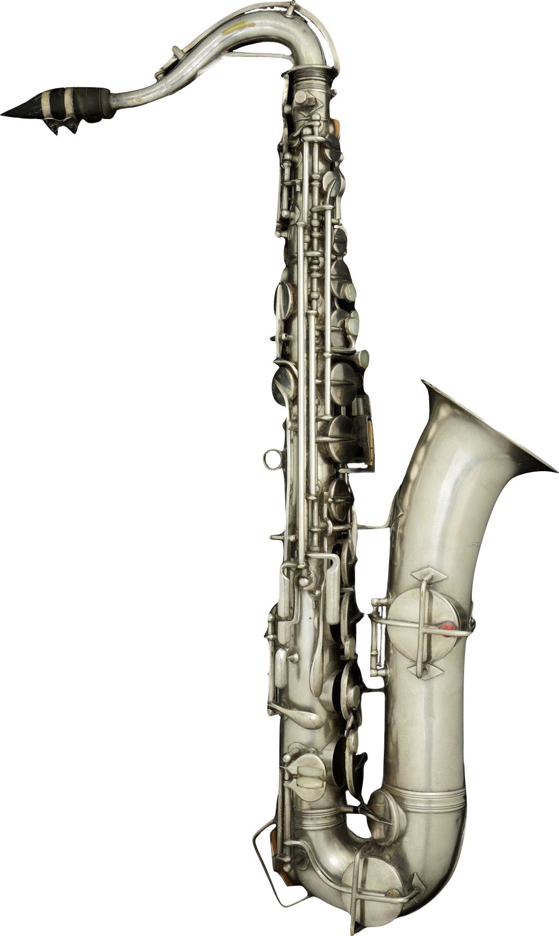
Brass and Woodwinds
While manufacturers define their ranges differently, many offer variations on “beginning,” “intermediate,” and “professional” models. Some go further with levels like “step-up” and “semi-pro” to add more options for advancing players or differentiate at the high-end with “custom” and “artist” lines. Yamaha’s lineup of trumpets, for example, spans seven categories.
Notes:
Yamaha Corporation YTR-8335IIS Bb Trumpet, 2020
Holton C Melody Saxophone, 1920

Slide 12
Brass and Woodwinds
Differences between categories include variations to almost every component to create specific combinations of weight, ease of playing, responsiveness, clarity of tone, and more, giving almost any player the opportunity to find an instrument suited to their music making.

Slide 13
Different Materials
Brass and woodwind instruments have traditionally been made primarily from brass and wood, with some exceptions (notably the flute, often made from silver, gold, and other metals).
Notes:
Artley Flute Company Symphony Flute, c. 1940
The Artley Flute Company was founded in the 1930s by cousins Hube and Don Artley, veterans of the Elkhart, Indiana instrument industry. The company's innovative manufacturing techniques led to more affordable instruments, making them popular among student musicians.

Slide 14
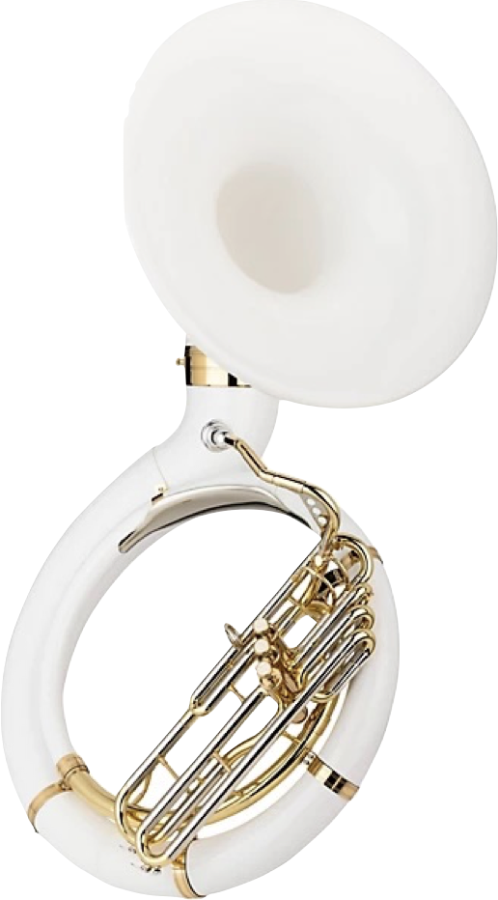
With long histories of manufacture and refinement resulting in incredible instruments, these materials continue to factor heavily in the contemporary brass and woodwind family.
However, newly developed and exotic materials, particularly plastics pioneered in the middle of the 20th century, proved to have significant advantages in certain situations.

Slide 15
In 1948, the Selmer Company released the first commercially successful clarinet made from molded plastic, called the Bundy Resonite.
The plastic clarinet, while having a different tone quality than a wooden instrument, was more durable, easier to maintain, and could be made more affordably – all benefits for student musicians and those in marching bands who might perform in a variety of climates.
Notes:
Selmer Bundy Resonite Bb Clarinet, 1948
The rapid pace of scientific development during World War II led to, among other things, a new class of plastic called acrylonitrile butadiene styrene or simply ABS. Among its myriad uses – ABS is rigid, durable, and easily molded – the Selmer company recognized its value as the basis for a plastic clarinet. By the end of the 1940s, Selmer had developed the Resonite clarinet, made from an ABS formulation, which retailed for $125. Its price, playability, and endorsement from musicians like Benny Goodman helped to make it a huge commercial success.

Slide 16
C.G. Conn released a fiberglass Sousaphone in 1962, taking advantage of that material’s significantly lighter weight – the final instrument was about half as heavy as a traditional brass Sousaphone, making it easier for many musicians to play.
Notes:
This sousaphone is an Eastman EPH395 Series Fiberglass BBb Sousaphone

Slide 17
New Techniques
The world of manufacturing was revolutionized in the 1950s and 60s with the development of computer numerical control (CNC), a technique for precision automation of tools based on computer input. CNC manufacturing allowed for higher accuracy, faster output, and lower cost.

Slide 18
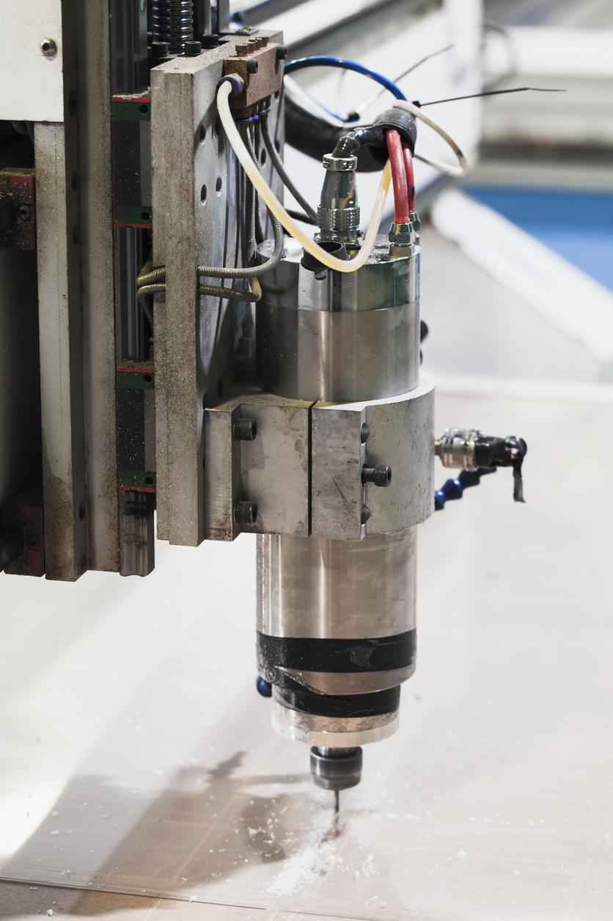
Computer Numerical Control
Since the latter 20th century, many manufacturers of brass and woodwind instruments have incorporated CNC into their production lines to varying degrees.
Among them, Conn-Selmer has used CNC techniques across a number of its product lines to various benefits. In advanced-and professional-level instruments, CNC allows for the creation of parts that would not otherwise be possible to manufacture, such as the one-piece valve casings found on Vincent Bach trumpets.
In student-and intermediate-level instruments, CNC is used to consistently create precision parts at low cost, ensuring that the instruments remain affordable for many musicians.

Slide 19
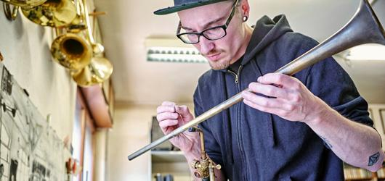
Hand-Machining
While CNC has been widely adopted, hand-machining remains a significant manufacturing technique in brass and woodwind instruments.
Rather than one replacing the other, most makers see CNC as a means to supplement traditional techniques for improved consistency, reliability, and, for many products, affordability and access.

Slide 20
Imani Winds
Watch the Imani Winds video. As we watch...
List all the instruments you recognize and describe how they sound.
Which instrument are you most curious about and why?

Slide 22
Research Prompt
In small groups or independently, find a famous artist and the signature instrument that they play.
Research and develop a slideshow on your artist choice. Be sure to include the following..
Name of artist and instrument they play
Biographical information
Detailed information about the instrument they choose
Video of the artist performing on the instrument
Why you believe this artist loves this instrument

Slide 23
Wrap-Up
Share your slideshow.

Slide 24
Consider a Career in Music!
What careers are related to the lesson we just completed?
Instrument Manufacturer
Performer
Marketing Specialist at a Retailer
Engineer
Research and Development
Artist Relations Manager

