Slide 2
Bringing Instruments to Market

Slide 3
Lesson Objectives
Explain the connection between creating and marketing instruments.
Identify some of the top successes in the music products industry.
Create and design a promotional brochure for a newly designed instrument idea.

Slide 4
Launching Something New
Today we are exploring the concept of introducing a new instrument into the marketplace.
Starting with an idea, makers move through research, prototyping, testing, manufacturing, and more before launch is possible.
Once a product hits the market, it can completely change the landscape of music making.

Slide 5
Have you ever seen this instrument before?
Notes:
Chapman Stick, c.1986
In 1969, guitarist Emmett Chapman developed a technique of tapping the strings of an electric guitar with both hands. To explore and extend the technique further, he designed an invented a new instrument - the Chapman Stick. The "Stick," as it's often called, came to market in 1975 and was adopted by musicians including Alphonso Johnson and Tony Levin. The original 10-string instrument has been joined by 8-string and 12-string models and maintains a prominent role in contemporary music.

Slide 6
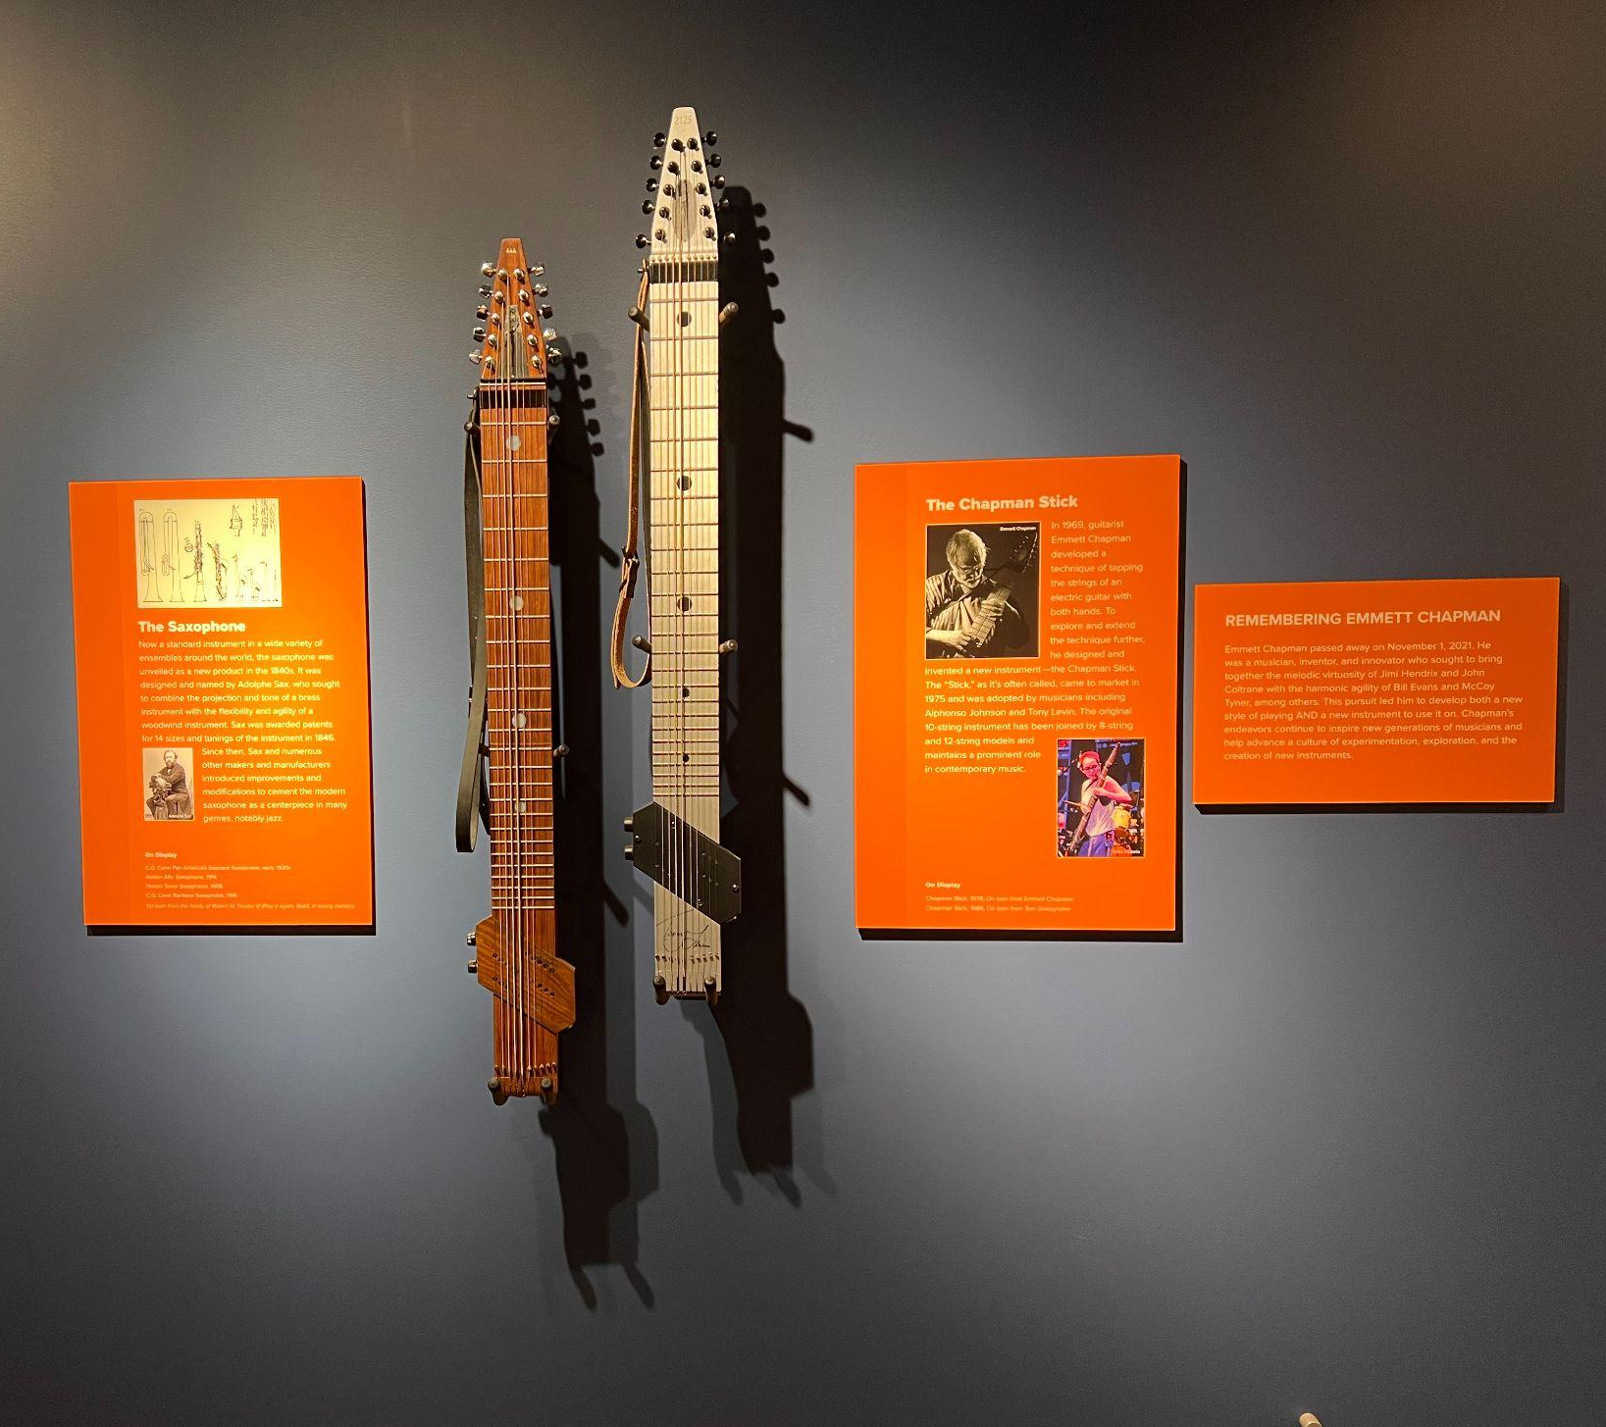
Chapman Stick
The Chapman Stick came to market in 1975 and was enthusiastically adopted by some musicians.
Now, while not totally mainstream, the Chapman stick holds an important specialized place in the music industry.
Notes:
In 1969, guitarist Emmett Chapman developed the technique of tapping the strings of an electric guitar with both hands. To explore and extend the technique further, he designed and invented a new instrument: the Chapman Stick. The “Stick,” as it’s often called, came to market in 1975 and was adopted by musicians including Alphonso Johnson and Tony Levin. The original 10-string instrument has been joined by 8-string and 12-string models and maintains a prominent role in contemporary music.

Slide 7
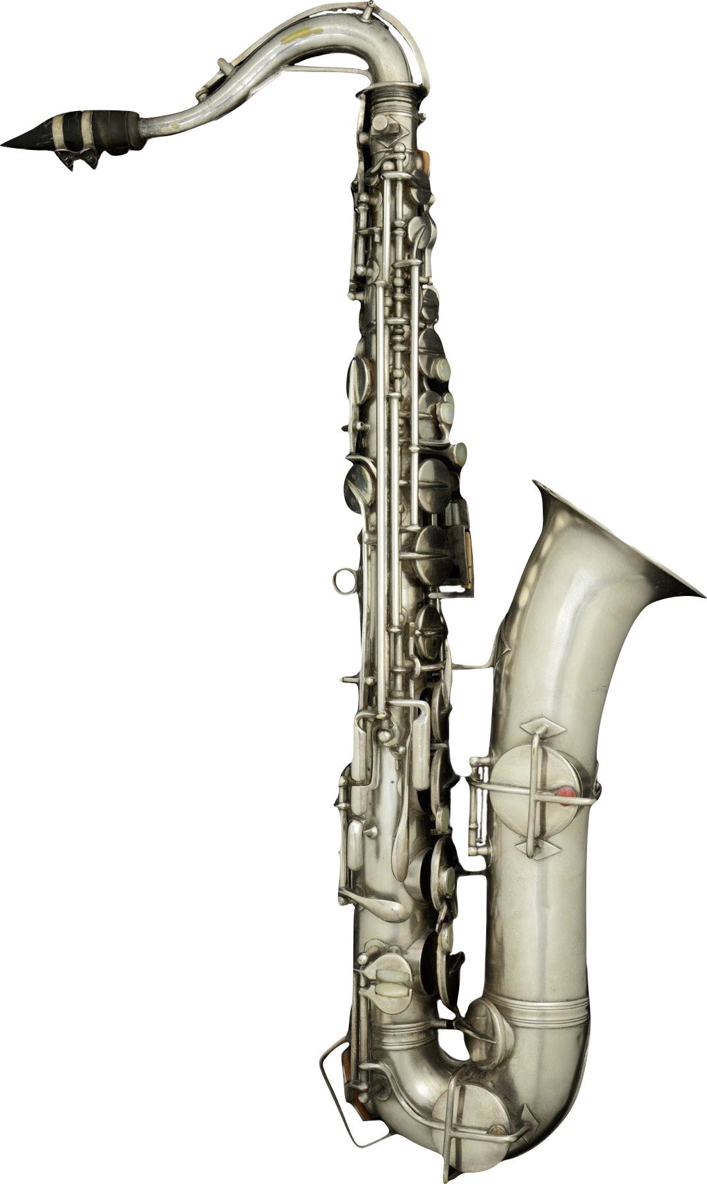
Have you seen this instrument before?
Notes:
Holton C Melody Saxophone, c. 1920
Frank Holton, a trombonist who had played in John Philip Sousa's band, founded an instrument manufacturing company in Chicago in 1896. Frank Holton & Company moved headquarters to Elkhorn, Wisconsin, in 1918 and produced a full line of brass and woodwind instruments, including this C melody saxophone.

Slide 8
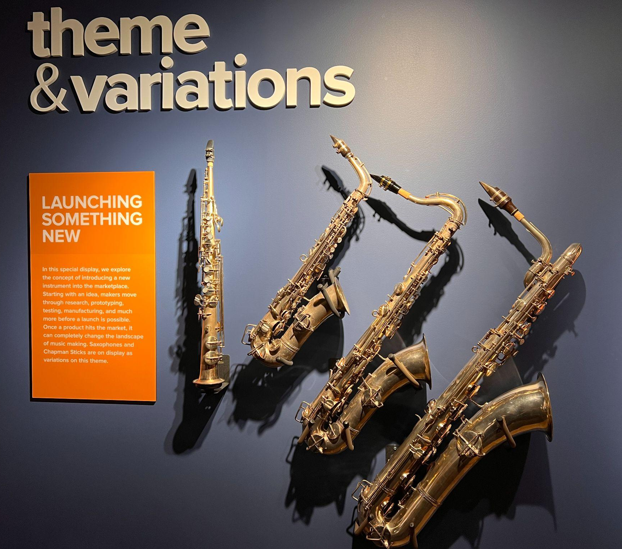
Saxophone
The saxophone was unveiled as a new product in the 1840s and despite its initial lack of success grew in popularity and now plays an important role in our musical landscape.
Notes:
The saxophone, now a standard instrument in a wide variety of ensembles around the world, was unveiled as a new product in the 1840s. It was designed and named by Adolphe Sax, who sought to combine the projection and tone of a brass instrument with the flexibility and agility of a woodwind instrument into a new integral member of the orchestra. Sax was awarded patents for 14 sizes and tunings of the instrument in 1846. Since then, Sax and numerous other makers and manufacturers have introduced improvements and modifications to cement the modern saxophone as a centerpiece in many genres, notably jazz.

Slide 9
Saxophones
Though Adolphe Sax designed and received patents for seven different sizes of saxophone, the soprano, alto, tenor, and baritone instruments have become the standard “quartet” most often used.
The higher-pitched sopranino and lower-pitched bass and contrabass saxes are much less common.
Saxophones are most typically pitched in Eb or Bb, depending on their size.
(Sax received patents for tunings in F and C, but those never gained the same popularity.)
In the standard quartet, the soprano and tenor saxes are in Bb, separated by an octave, and the alto and baritone saxes are in Eb, also separated by an octave.

Slide 10
Launching Something New
Starting with an idea, makers move through research, prototyping, testing, manufacturing, and more before a launch is possible.
Once a product hits the market, it can completely change the landscape of music making.

Slide 11
Let's Brainstorm
What popular instruments do you know of that exist today?

Slide 12
Create Your Own Instrument
You will create your own new instrument idea and work on a marketing campaign to convince others that this instrument should be widely used by the public.
Alone or in a small group, use the guiding worksheet to research and create a visual prototype of your instrument through a drawing or design software.
Next, create a brochure detailing your instrument. Be sure to include...
How it sounds
A case for why the viewer should purchase this instrument.

Slide 13
Wrap-Up
Answer the Exit Ticket Question on your worksheet.

Slide 14
Consider a Career in Music!
What careers are related to the lesson we just completed?
Instrument Manufacturer
Marketing
Luthier
Instrument Maker
Product Design and Development

