Slide 1


Slide 2
“I Will Survive!”: Ingenuity in the Music Industry

Slide 3
Lesson Objectives
Identify a challenging historical moment for the music products industry.
Create innovative solutions for specific, historical-based prompts.
Develop a slideshow “pitch deck” detailing group ideas.
Articulate how retailers innovated in the face of economic challenges.
Apply lesson content to problems in other disciplines.

Slide 4

Are musical instruments important to the world?

Slide 5

What would the world be like without musical instruments?

Slide 6
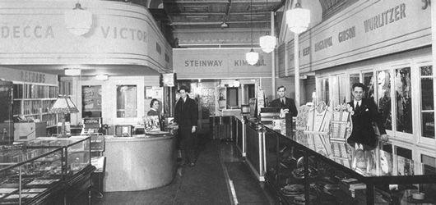
Providing the world with musical instruments through stores is important but hasn’t always been easy at certain times in history.
Notes:
Music Store Interior from the 1930s

Slide 7
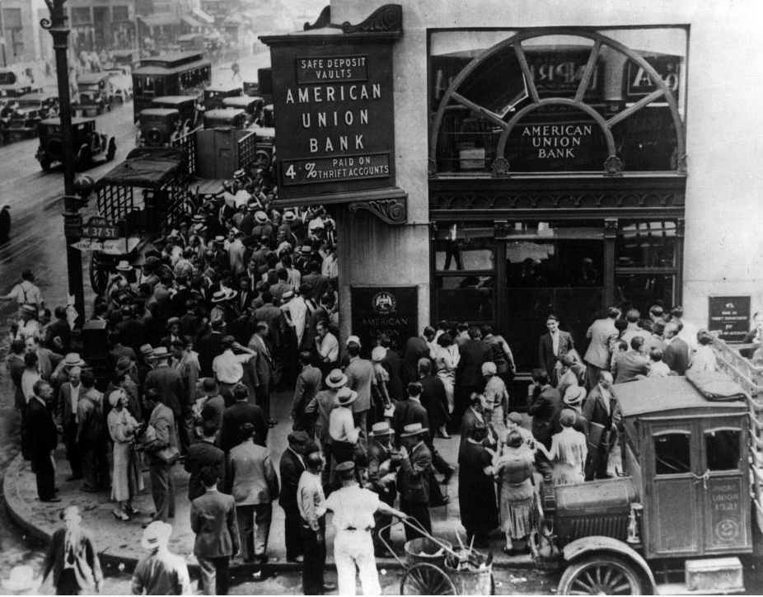
Today we will go back to the 1930s and 40s when our world went through hardship (The Great Depression) and a world war (World War II).
Notes:
American Union Bank

Slide 8
Save the Music Industry
MISSION: Work collaboratively to “save the music industry.”
  Each team will have 20 minutes to develop a strategic plan that they will share with the rest of the class.

Slide 9
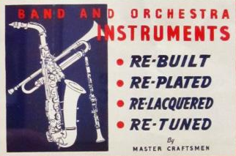
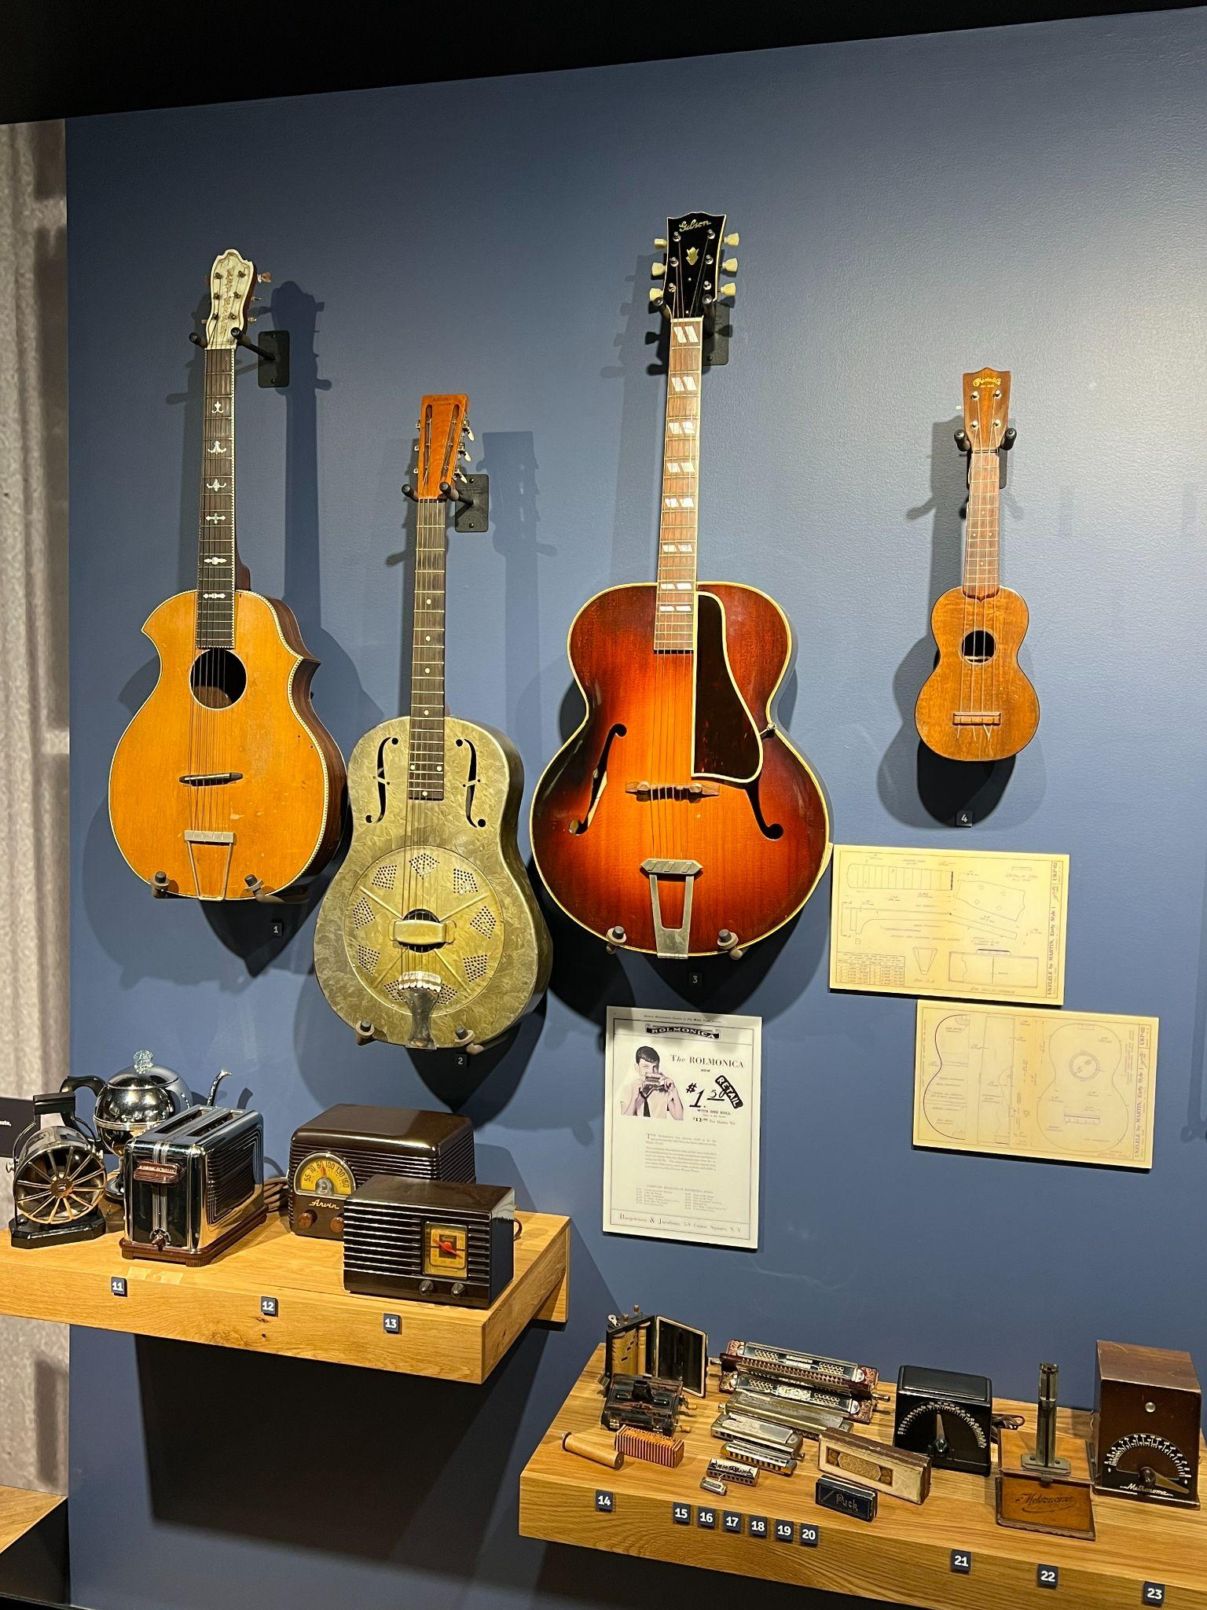
Mission #1
The country is at war and musical instrument manufacturing is suspended. As a music retailer, you are panicked.
You can’t get any new inventory for your store but you need to keep sales up so you can survive the war!
What could you sell?
What services could you offer?
How would you adjust your focus to keep folks coming in the door of your store?
Notes:
Selmer Bargain Flyer
Crisis and Creativity display: The Museum of Making Music

Slide 10
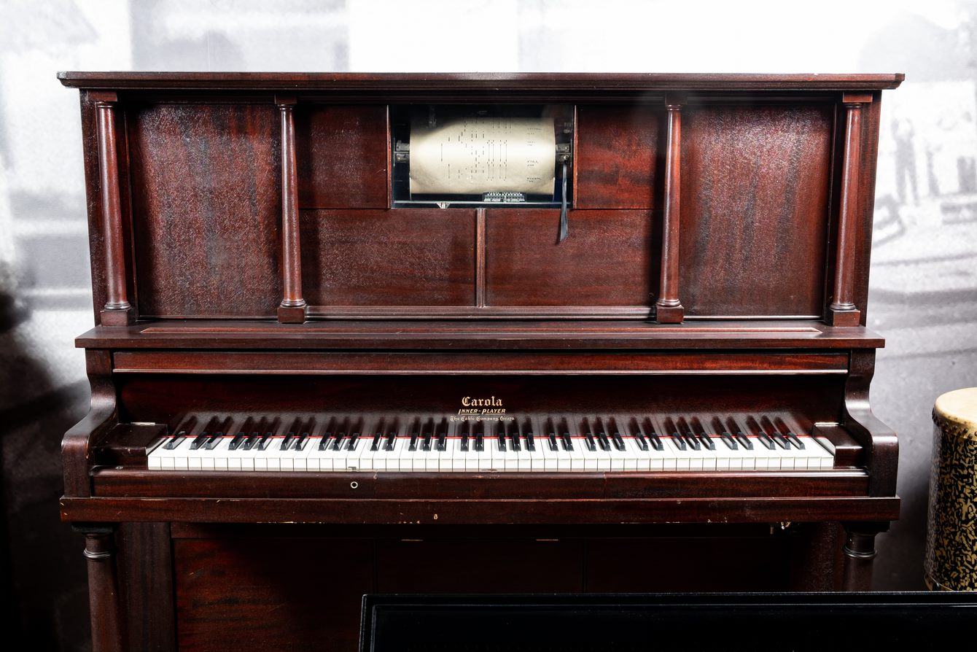
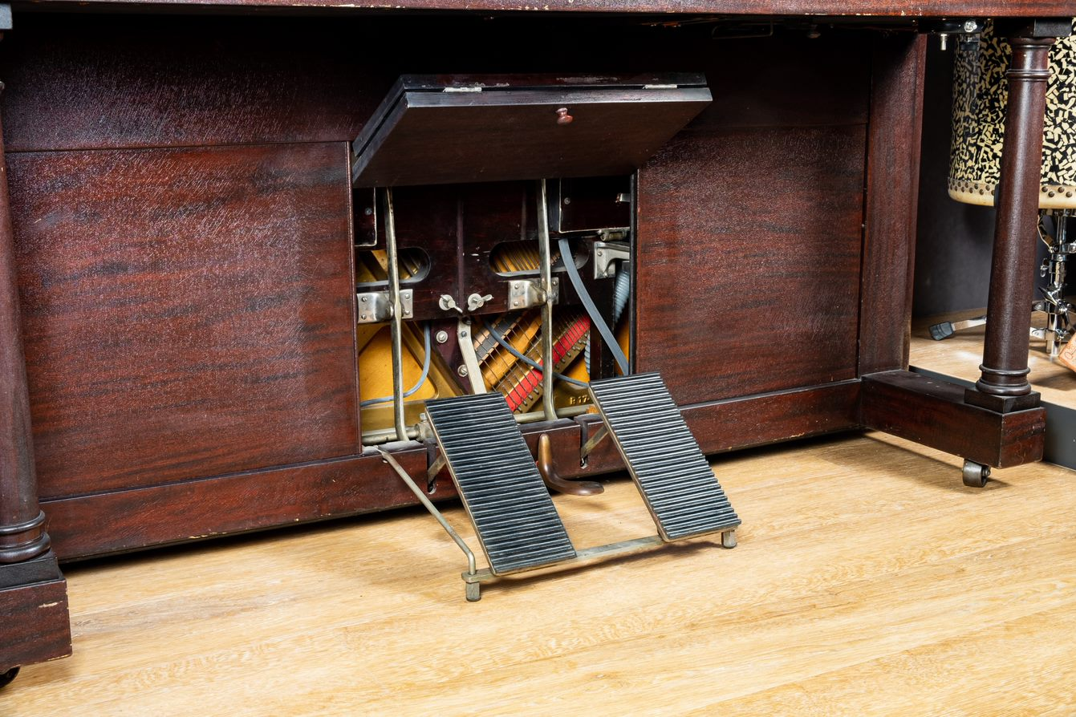
Mission #2
You’re an instrument maker and your biggest seller is something called the “Player Piano:” an instrument that can play itself and provide wonderful background music for parties!
But, with the new invention of an electric radio, instrument sales are down and you’re stuck.
How can you use electricity to your advantage and not lose your business?
Notes:
Carola Inner Player Piano, 1908
The “inner player piano,” later simply “player piano,” was a single instrument combining the piano player mechanism directly into the cabinet of the piano itself. The Buffalo Convention of 1908, a meeting of the major player piano manufacturers, led to the standardization of two different formats for piano rolls: 65-note and 88-note. Before long, player pianos overtook push-up players in popularity and, by the early 1920s, were being sold at a rate of more than 200,000 per year.

Slide 11
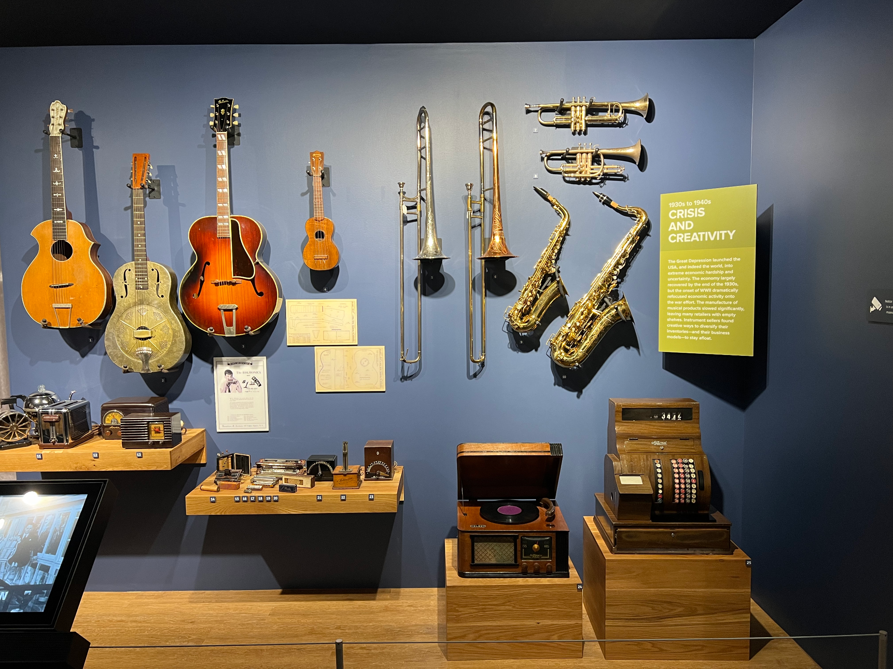
Mission #3
The economy is not doing well. You are a music retailer and selling new guitars is how you’ve stayed in business!
But, many people are saying that “buying new” is out of the question. How can you pivot to keep your business running if you can’t sell new instruments?
Notes:
Crisis and Creativity display: The Museum of Making Music
The Great Depression launched the US, and indeed the world, into extreme economic hardship and uncertainty. The conspicuous consumption of the 1920s disappeared and consumer confidence plummeted. Through a few stops and starts, the economy largely recovered by the end of the 1930s. The entrance of the US into WWII as a result of the bombing of Pearl Harbor, however, saw a dramatic refocusing of almost all economic activity onto the expanding war effort. The manufacture of musical products slowed dramatically, and factories retooled to produce components for military operations. Sellers of instruments found creative ways to diversify their inventories – and their entire business models – and made every effort to stay afloat.

Slide 12
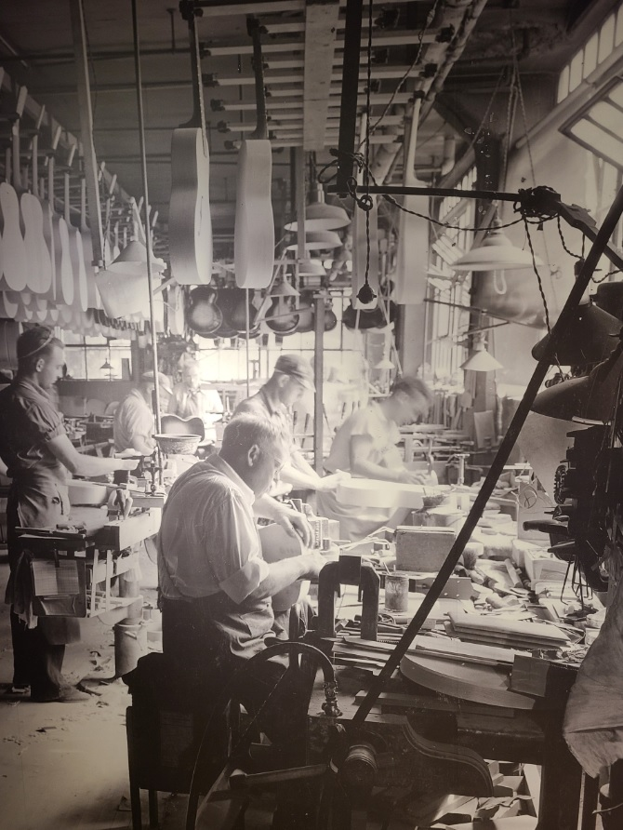
Mission #4
The country is at war and most of the men who run your guitar manufacturing plant have gone to war. Without your workforce, there’s a chance that your plant will cease to exist.
How can you ensure that the plant continues running?
Notes:
Gibson, Inc. Interior, Kalamazoo, Michigan, 1936
Photo courtesy of Kalamazoo Public Library’s Local History Collection

Slide 13
Solutions
Missions and real-world applications

Slide 14
Solution #1
The manufacture of musical instruments was largely suspended during
World War II. This left many retailers unable to secure new inventory for their stores, and as a result some offered novel products and services to get by.
Some stores added repair and refinishing departments, both to help customers keep their instruments playing and to improve older instruments for resale. Sherman Clay, in San Francisco, bought used records in good condition – and even picked them up from sellers’ homes – to build up an inventory of 40,000 records for resale. Others, including Jenkins Music in Kansas City, brought any and every product – including furniture, appliances, and house goods – into their stores to sell.
With a shortage of fashionable new spinet pianos, at least one company, MirrApiano, modified older upright pianos with mirrors to make them appear smaller and more stylish; thousands of these pianos were sold during the war.

Slide 15
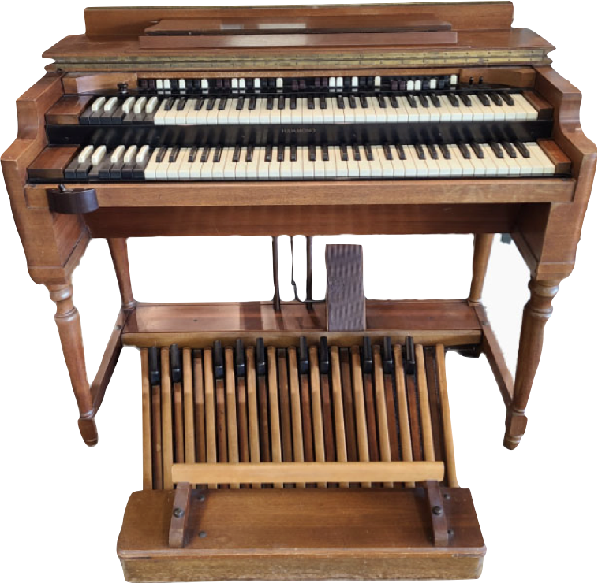
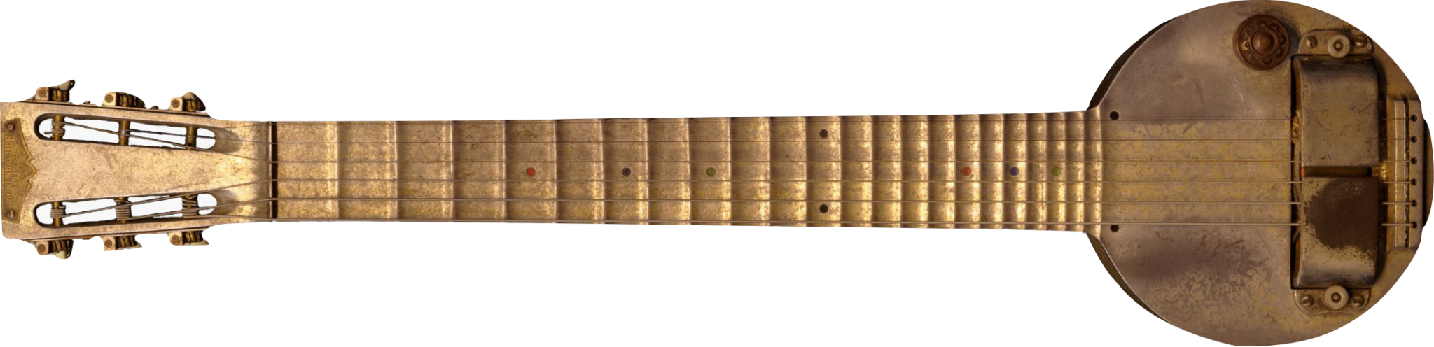
Solution #2
Already in a weakened position, many piano manufacturers merged or went bankrupt, and dealers were left without new products to sell. But while electricity contributed to the industry’s crash, it also provided some of its few bright spots in the 1930s: the Hammond Model A organ, released in 1935, and the electric guitar, which first found commercial traction with Rickenbacker’s A-22 “Frying Pan” model in the early 30s.
The success of both instruments contributed to a growing feeling of optimism across the industry later in the decade.
Notes:
Hammond Model A Organ, c. 1935
Rickenbacker Frying Pan, mid-1930s
Rickenbacker’s A-22 “Frying Pan,” released in 1932, was the first commercially available electric guitar to enjoy some success. It was designed to allow Hawaiian or steel guitar players to keep up with the volume of a large ensemble. Its aluminum construction, though fairly durable, also proved to be temperamental: the body would expand and contract going from the case to a hot stage and back, causing the instrument to go out of tune.

Slide 16
Solution #3
The onset of the Great Depression following the Stock Market Crash of 1929 upended the US, and later the global, economy. As banks failed and sources of capital dried up, production across all industries slowed dramatically.
Unemployment soared to a peak of 25% in 1933. Those who were fortunate enough to remain employed often faced severe pay cuts – up to 75%. As a result, musicians and consumers became extremely cost-conscious and hesitant to purchase anything new, including musical instruments.
Used instruments continued to sell, though, which inspired some creative sales strategies. George Bundy, manager of the H&A Selmer store in New York, claimed that “even if you showed them a new horn, you had to tell them that it was used or they would walk out the door.”

Slide 17

Solution #4
"Kalamazoo Gals" is the nickname given to the women who kept the Gibson Guitar Factory in production while the men were off fighting WWII.
To quote author John Thomas, “Women Kept Gibson Guitar Playing During WWII.”
Notes:
Kalamazoo Gals
Photo: John Thomas

Slide 18
Save the Music Industry
You will have 20 minutes to complete the following tasks:
  Read through your mission cards.
  Devise strategic plans by answering the questions on your worksheets.
  Create a two-slide pitch deck detailing your strategic plan.

Slide 19
Save the Music Industry
Let's Share!
One ambassador from each group will come forward.
Read your group's mission card and strategic plan.
As each group shares, consider whether the group effectively completed their mission. (i.e. Would the student-created solution have worked? Why/Why not?)

Slide 20
Wrap-Up
Did we save the music industry?
Why/Why not?

Slide 21
Consider a Career in Music!
What careers are related to the lesson we just completed?
Music Store Owner
Instrument Salesperson
Marketing Manager
Accountant
Store Designer
Human Resources

Slide 22


