Slide 2
Global Reverberations of
Music and Music Makers

Slide 3
Lesson Objectives
Describe examples of how cross-cultural connections influence the development of an instrument over time, using accordions and mandolins as the focus.
Explain the differences between various kinds of accordions and mandolins.
Connect instrument knowledge with the development of other music genres or other instruments.

Slide 4
Introduction
How would you describe the oldest cell phone you can think of?
What were its capabilities?
Now think of the newest cell phone models and what they can do.

Slide 5
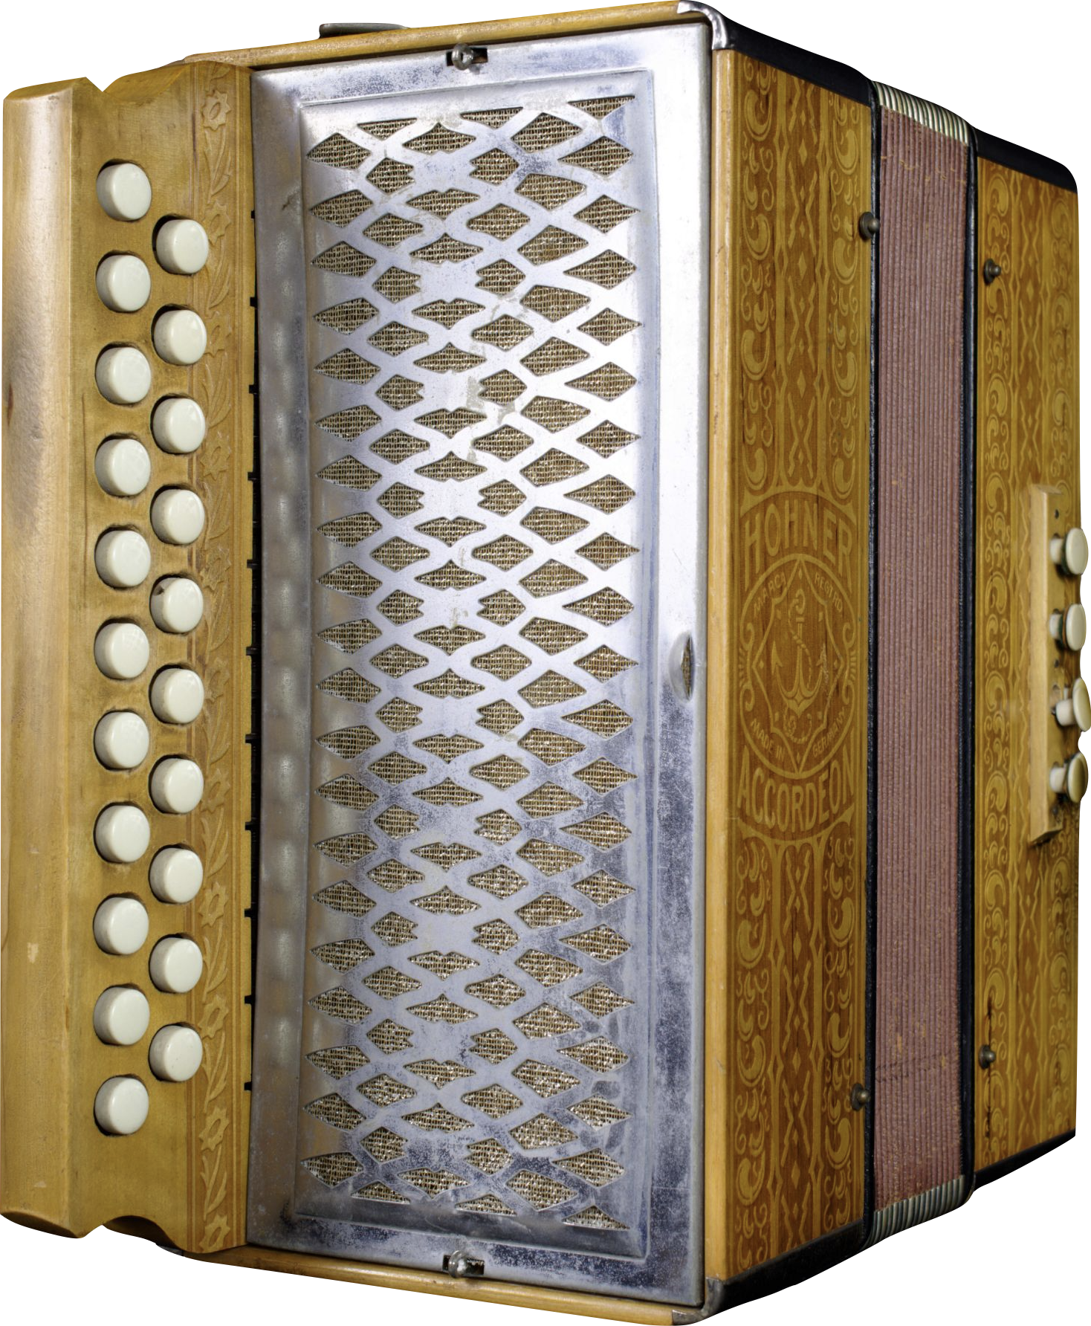
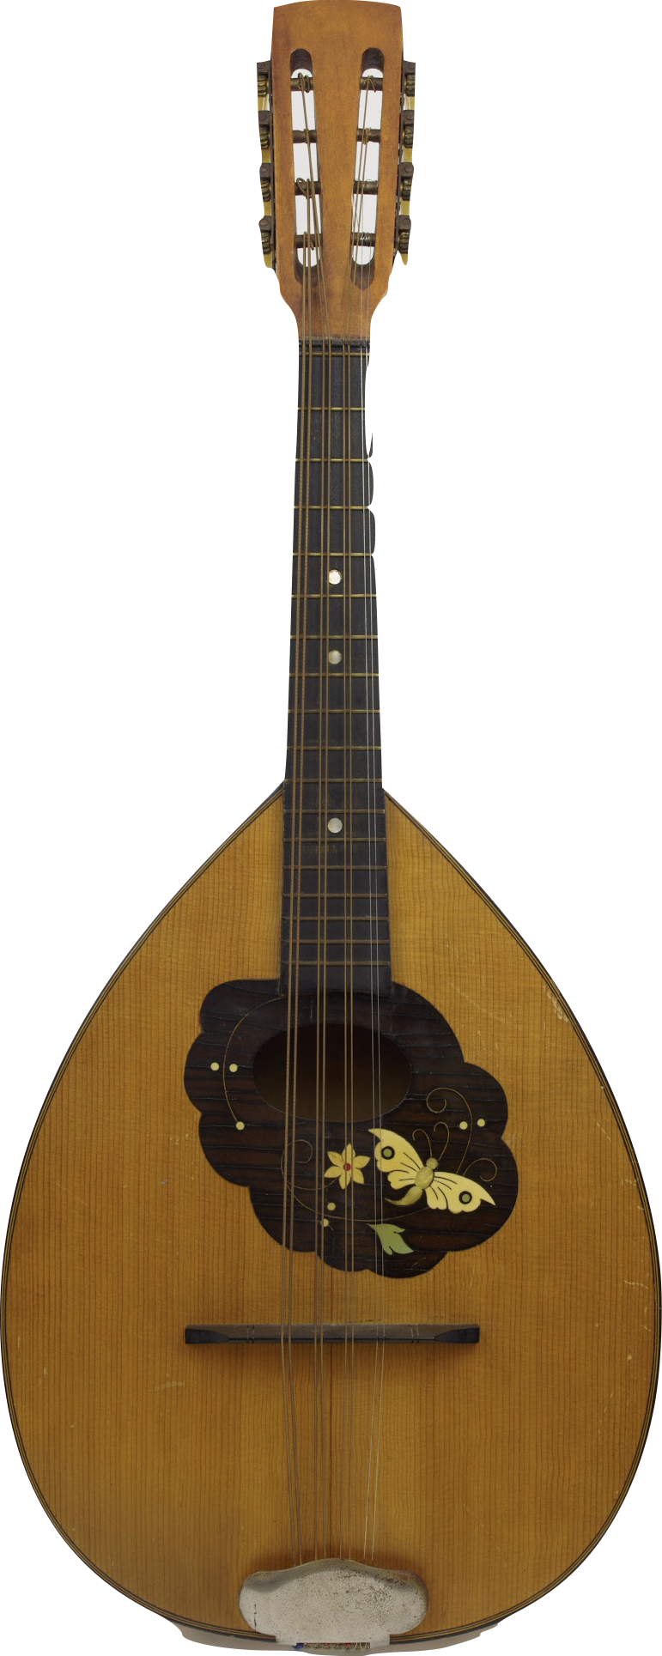
Development over Time
Just as technology such as cell phones have developed over time, so have musical instruments.
Today we’ll focus on the mandolin and the accordion and their development.
Notes:
Hohner, Inc. Vienna Pokerwork Button Accordion, c.1900
This compact two-row button accordion features 8 bass keys and ornate patterns pressed into the wood case. Hohner continues to make Pokerwork-style accordions to this day under the Vienna model name.
Unknown Octave Mandolin, 1900s
The mandolin craze of the late 19th and early 20th centuries saw the rise of mandolin orchestras – collections of musicians playing different instruments in the mandolin family. This typically included the mandolin, mandola, octave mandolin, and mandocello. The octave mandolin, appropriately, is tuned one octave below the mandolin. This particular instrument features a flat back, a style popular with German makers in the latter 19th century.

Slide 6
People on the Move
People moving from place to place bring expressive symbols and tools--including musical instruments–to maintain connections to old homes.
European migrants in the 19th century carried accordions and mandolins, among other instruments, to the USA.
These instruments were adapted to suit new environments, audiences, and players.

Slide 7
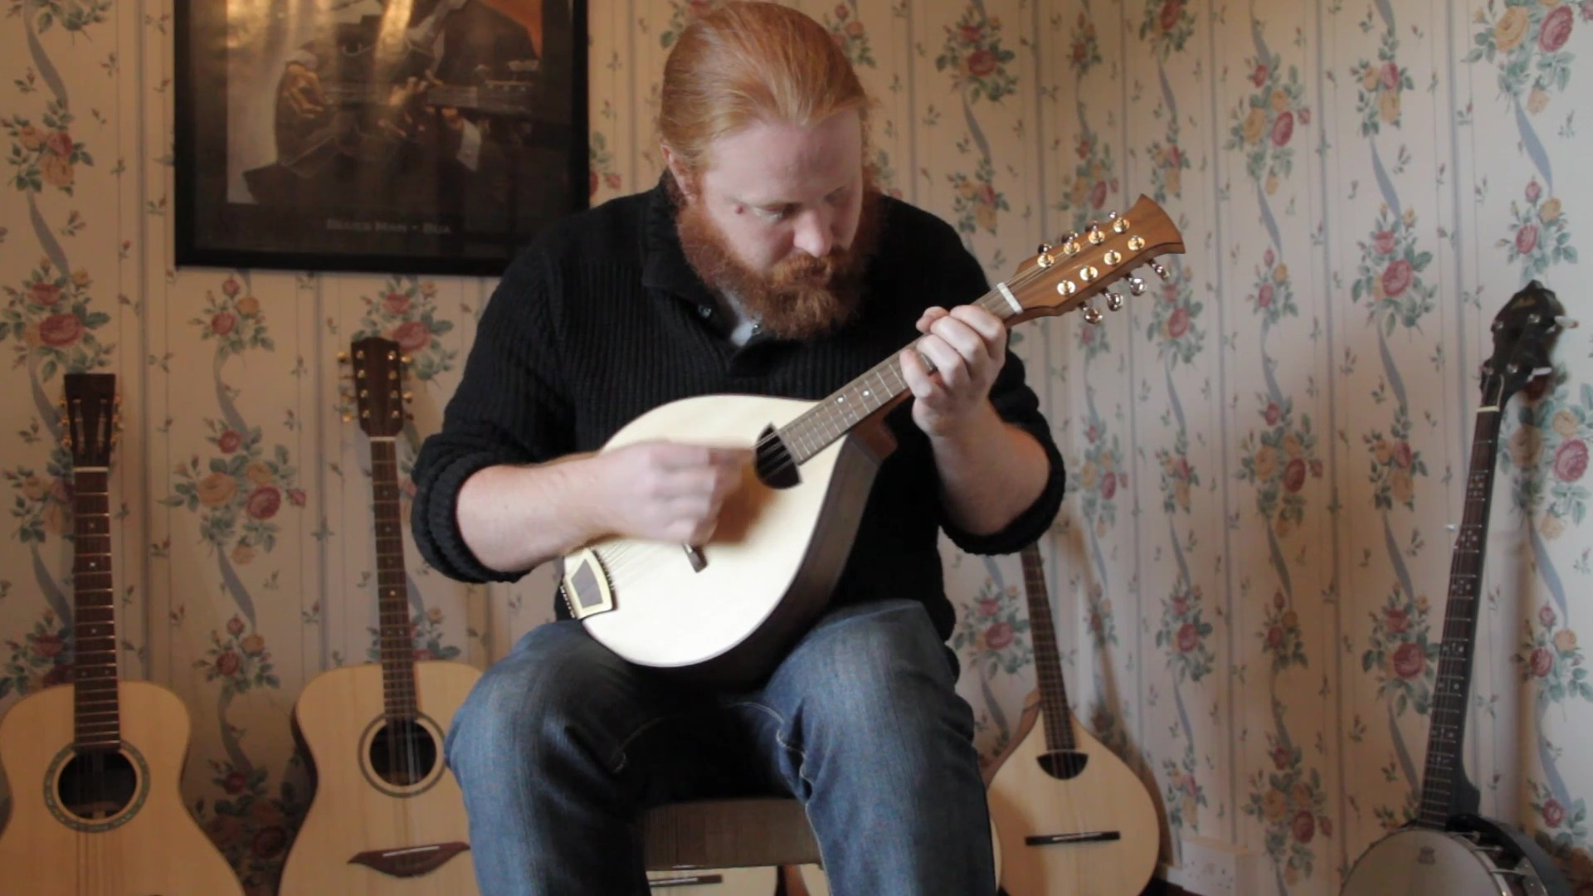
Musical Examples: Mandolin

Slide 9
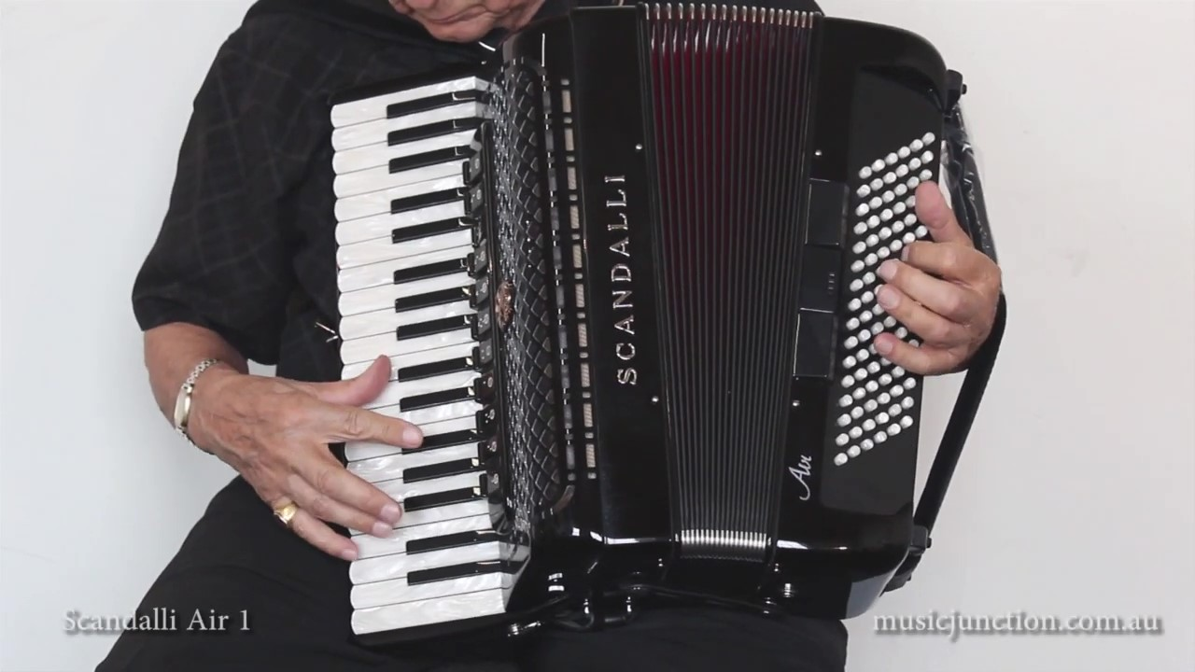
Musical Examples: Accordion

Slide 11
Stories: People on the Move
Split into groups of 3.
Pull up a copy of "Stories - People on the Move" .
Annotate your paragraph, finding information that describes the influence of that instrument's development.

Slide 12
Artifacts: People on the Move
In your small group, pull up the copy of “Artifacts-People on the Move”.
Annotate what you discover about each instrument.
Highlight or circle key observations in the development of instruments and take notes on possible theories on the instrument based on the time when the instrument was created.
Consider “why” questions and write down possible cultural reasons for the adjustments made to the instruments.

Slide 13
Let's Share!
Each group will share their findings.
As each group shares, create one question about their findings.
Be prepared to ask the group when they are finished sharing.

Slide 14
Let's Create!
Work individually to pick a music genre below
Pop
Bluegrass
Rock
Zydeco
Create a three-slide presentation on its development based on the influence of a variety of cultures and the rise of technology.
Be sure to save your slides and be prepared to share them next class.

Slide 15
Wrap-Up
Grab a sticky note.
On your sticky note, answer the two questions below.
“How did accordions and mandolins make their way across the ocean to the U.S.?”
“What was the most interesting part of this lesson to you?”
When finished, put your sticky note on the board.

Slide 16
Consider a Career in Music!
What careers are related to the lesson we just completed?
Instrument Manufacturer
Music Historian
Engineer
Product Designer
Marketer
Factory Worker
Factory Floor Manager
Repair Tech
Retailer/Music Store Owner

