Slide 2
Making Music Anywhere

Slide 3
Lesson Objectives
Explain the meaning of the acronym DAW.
Identify different types of microphones and their polar pattern.
Define multitrack recording, audio, loops, and MIDI.
Explain how technological advances impact an industry, particularly the music products industry.

Slide 4
Lesson Introduction
What is your favorite song?

Slide 5
Today we will learn how songs like these were created using multitrack recording on a DAW. What does D-A-W stand for?
Notes:
Digital Audio Workstation

Slide 6
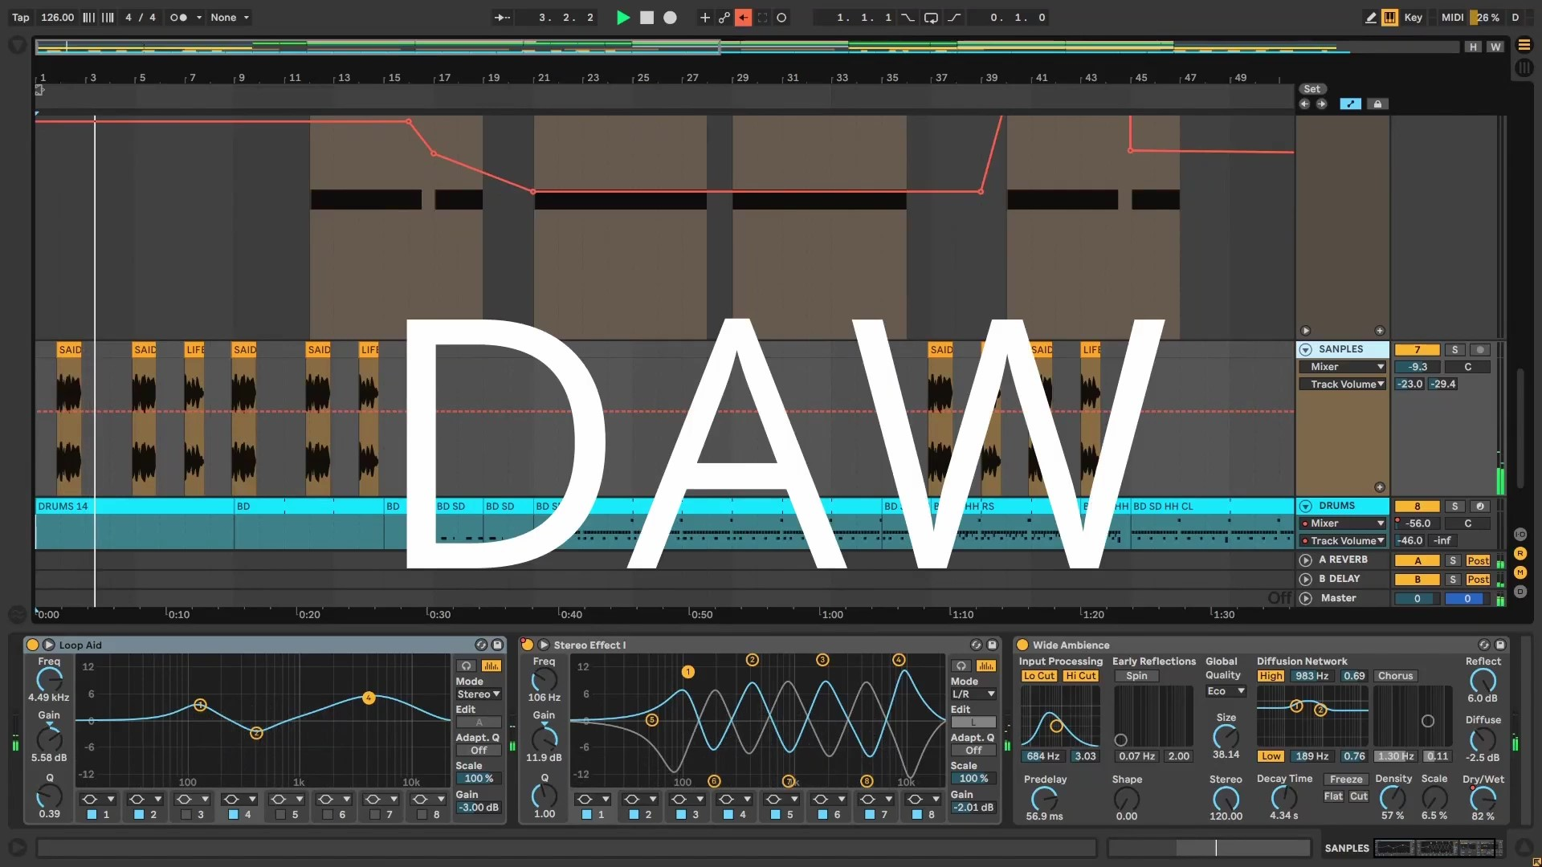
What is a DAW?

Slide 8
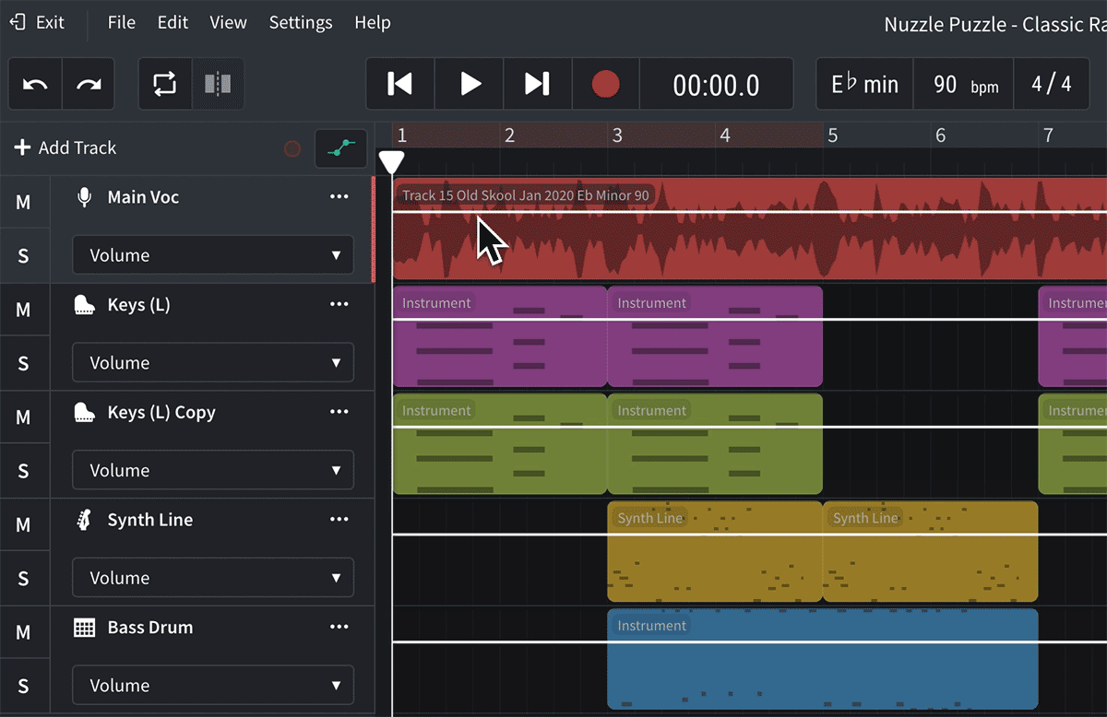
Let’s look at a multi-track recording in a DAW
DAWs allows artists and producers to record music using multiple tracks (tracks in recording terms are parts), hence the term multitrack recording.

Slide 9
What are the different sound sources in recording?
Loop
MIDI (Musical Instrument Digital Interface)
Microphones

Slide 10
Loop
A loop is a repeating section of a sound that creates a continuous musical texture.

Slide 11
MIDI: Musical Instrument Digital Interface
MIDI allows electronic musical instruments, computers, and other devices to communicate with one another.

Slide 12
Microphones
Microphones are instruments for converting sound waves into electrical energy variations which may then be amplified, transmitted, or recorded.

Slide 13
How Does It Work?
You need a MIDI controller or drum machine to communicate with the MIDI, and an audio interface to record audio.

Slide 14
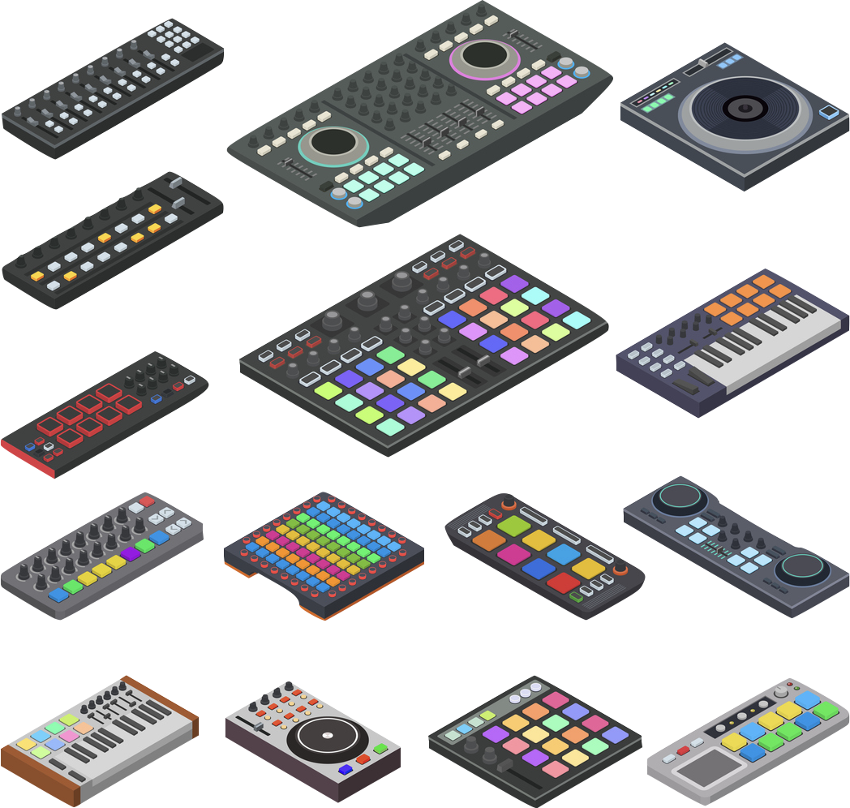
MIDI Controllers
Controllers can look like piano keyboards, but they can also be digital drum sets, electronic wind instruments, guitars, computer or smartphone apps, or nearly anything else that can send an electronic signal.

Slide 15
Microphones and Polar Patterns
Complete Guide to Microphone Polar Patterns

Slide 16
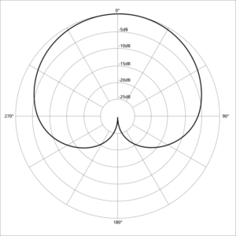
Cardioid Polar Pattern

Slide 17
Cardioid Polar Pattern
Cardioid is also known as “kidney” or “heart” and is often what people are referring to when using the term “unidirectional.”
The cardioid pattern is the most common polar pattern.
Picks up sound from the direction it is facing.
The cardioid pattern is the most common polar pattern.

Slide 18
Shure SM57 and SM58
Shure SM57
Shure SM58

Slide 19
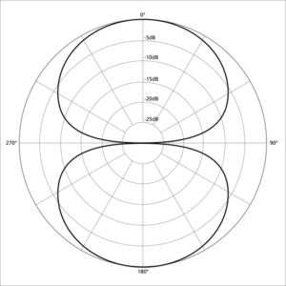
Bidirectional Polar Pattern

Slide 20
Bi-Directional
The bidirectional (figure-8) microphone polar pattern is equally sensitive to sounds from the front and the back with a ring of silence at its sides. Bidirectional mics are the truest form of pressure-gradient mics and exhibit the most proximity effect. Nearly all ribbon mics are bidirectional.
Most ribbon mics are bidirectional

Slide 21
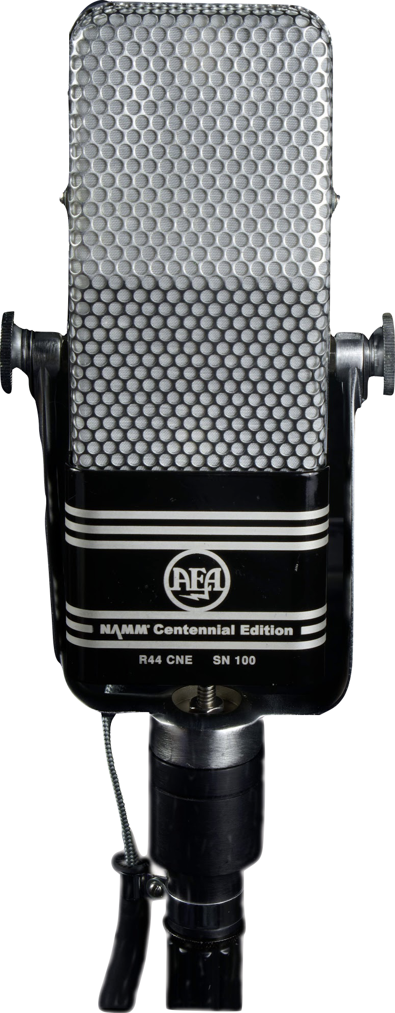
Bi-Directional Polar Pattern
AEA R84
Examples of Bi-Directional Microphones
Royer R-121
AEA R84

Slide 22
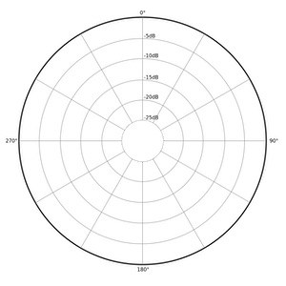
Omni-Directional

Slide 23
Omni Directional
A microphone with an omnidirectional polar pattern, in theory, is equally sensitive to sound in all directions. It is the polar pattern of the pressure principle.

Slide 24
Group Activity – Creating Music Using Loops
Before we start, let's cover some basics…
How to open the program.
How to find the loops.
How to filter through.
How to place on the timeline.
How to change the tempo.

Slide 25
Group Activity – Creating Music Using Loops
In groups, create a track using only loops in
Soundtrap or Bandlab
Remember to...
Use at least four loops
Make your song 30 seconds long

Slide 26
Wrap-Up

Slide 27
Consider a Career in Music!
What careers are related to the lesson we just completed?
Music Producer
DJ
Sound Designer
Music Engineer
Artist
Podcaster
Retailer (online and brick & mortar)
Product Manufacturer

