Slide 2
MIDI Playground

Slide 3
Lesson Objectives
Select a MIDI file of personal interest and import it into a DAW.
Remix the MIDI file in a variety of ways based on interpretive decisions:
Edit the virtual instruments assigned to a track (timbre)
Change the BPM (tempo)
Change the loudness of each track (dynamics)
Describe the changes you made and how it affects the mood of the song using the musical terms timbre, tempo, and dynamics.

Slide 4
What is MIDI?
MIDI, or Musical Instrument Digital Interface, lets machines talk about music.
In the same way that printed sheet music is a set of instructions telling a musician what to play—this note for this long and this loud, then that note, and so on—MIDI is a set of instructions letting machines understand what we want them to do and how to do it.

Slide 5
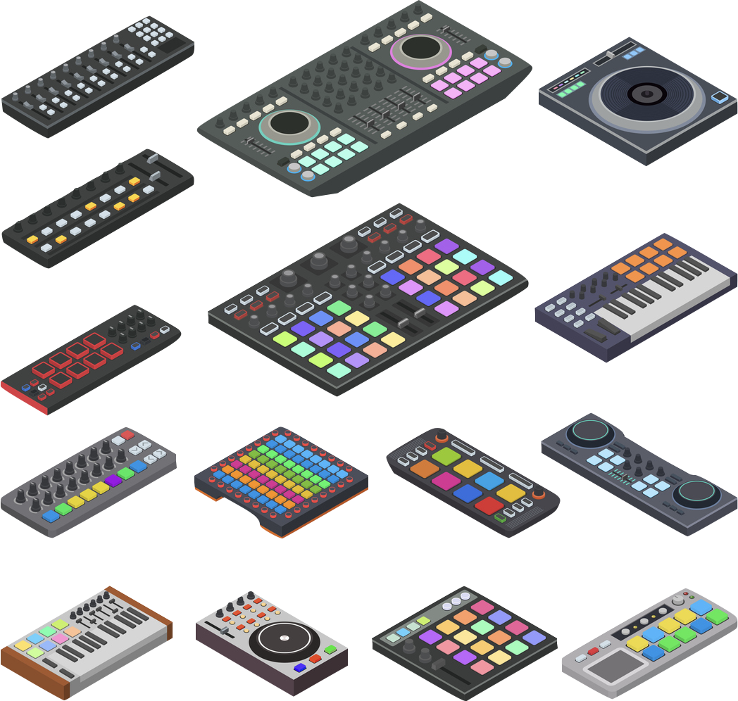
What is MIDI?
At its most basic, MIDI lets a controller—a device that a musician interacts with—send instructions to a synthesizer—a device that makes sound using electricity.
Controllers can look like piano keyboards, but they can also be digital drum sets, electronic wind instruments, guitars, computer or smartphone apps, or nearly anything else that can send an electronic signal.

Slide 6
What is MIDI?
Synthesizers aren’t the only things that can get MIDI instructions. Computers can get and store instructions for editing or playback; recording devices can get instructions that keep them synchronized; lighting equipment, cameras, fountains, pyrotechnics, and more can get instructions telling them what to do and when.

Slide 7
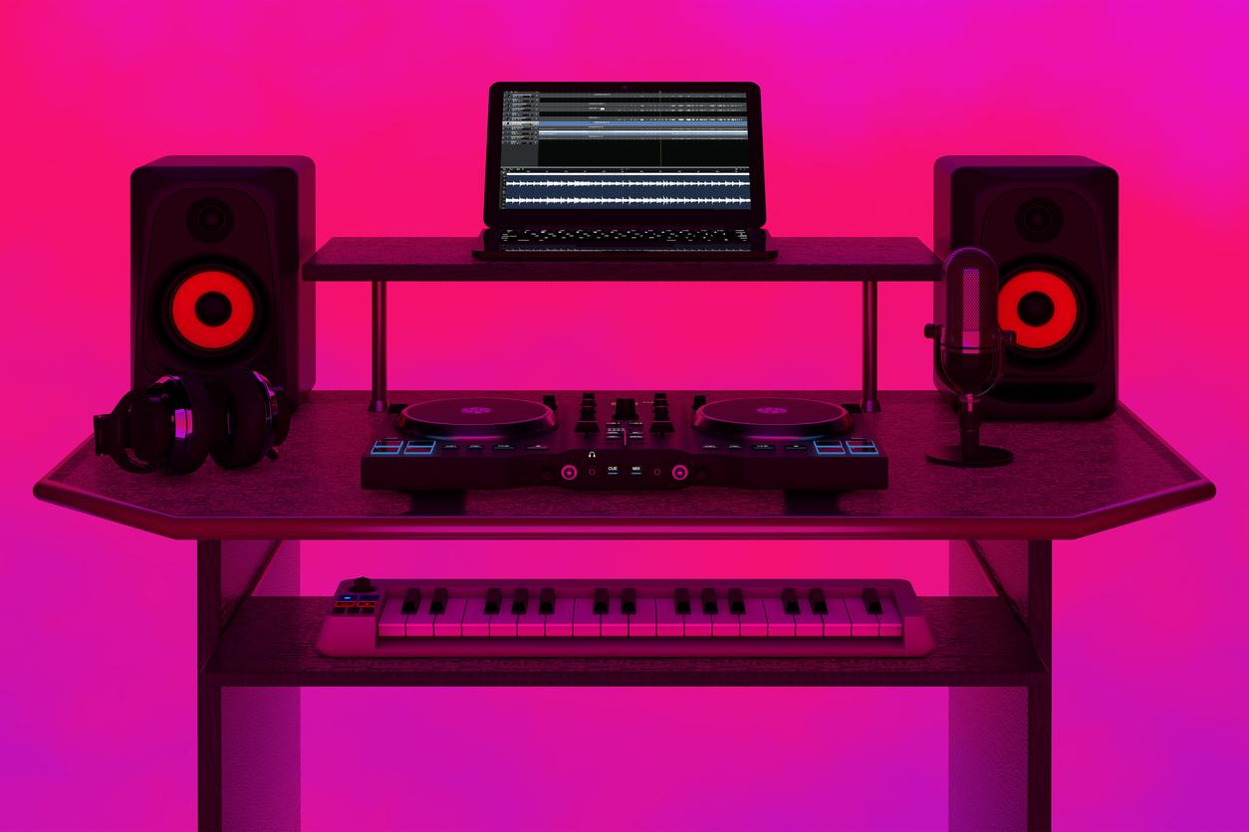
What is MIDI?
And while its first instructions were sent over a specialized cable, MIDI now also travels via USB, Bluetooth, Wi-Fi, and the internet to allow musicians and devices to communicate almost anywhere across the globe.
More than anything else, MIDI has enabled people to create new music, art, and experiences using new and traditional instruments and devices.

Slide 8
The MIDI Timeline

Slide 9
Playing with MIDI
Today we’re going to explore importing our own MIDI files and experimenting with timbre, tempo, and dynamics.

Slide 10
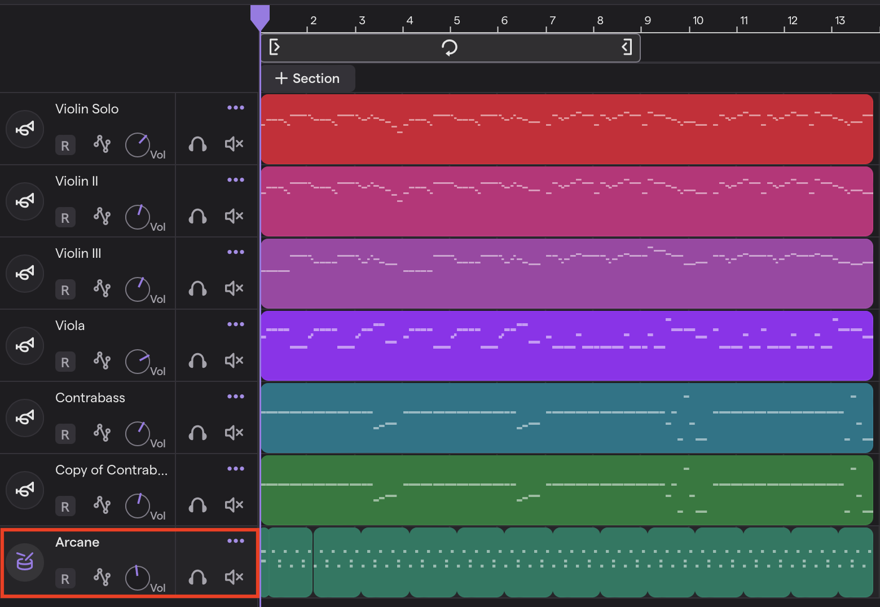
Here’s a MIDI file of
Vivaldi’s Spring, with an added drum loop on the last track.

Slide 11
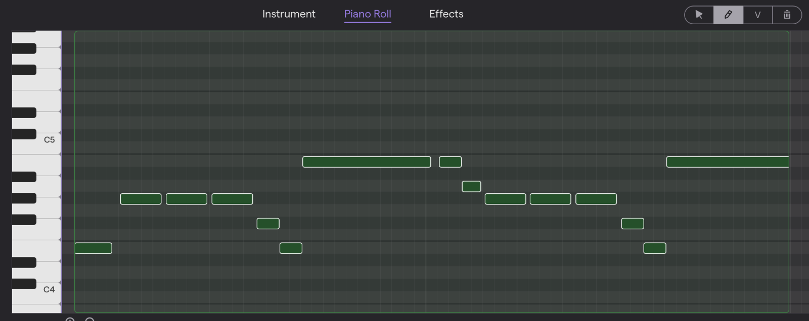
Duplicate the melody track and open a phrase in a piano roll. This is the opening phrase of the Violin 1 part to Vivaldi’s Spring, MIDI Piano Roll.

Slide 12
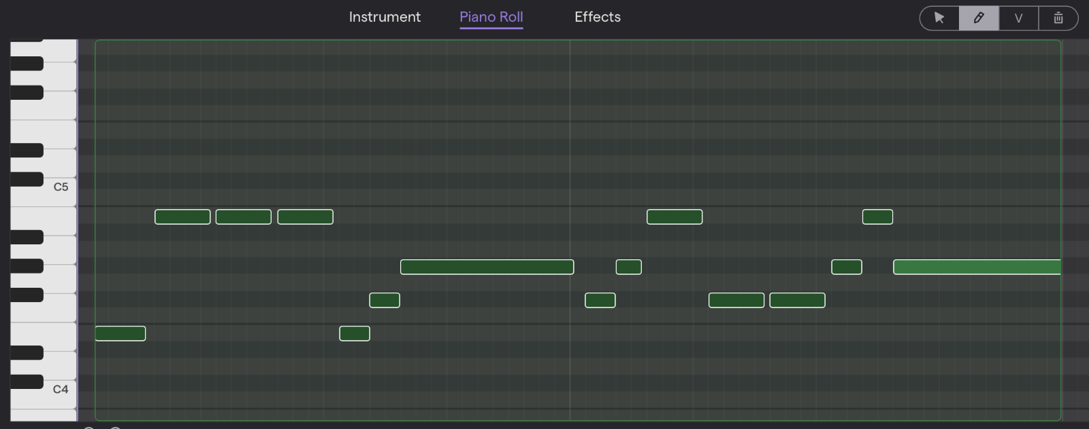
This is the same section with the pitches changed.
If a loop has A, C, D, and E in it, stay on those notes when changing the pitches. This will help the new phrase blend and sound good with the existing song structure.

Slide 13
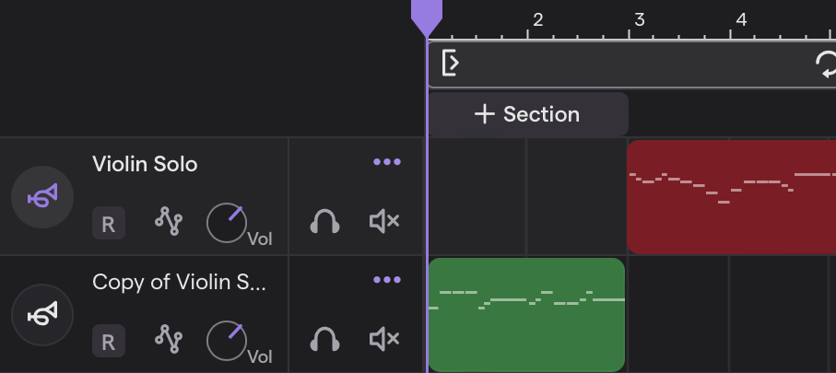
Substitute the remixed phrase and hear a new version of the song.
Because the rhythm is the same, but the pitches are different, it creates a pleasing alternative melody.

Slide 14
Your turn to create
Take notes in your worksheet,
so your group can share your choices!

Slide 15
Consider a Career in Music!
What careers are related to the lesson we just completed?
Sound Engineer
Music Producer
Composer / Film Scorer
Foley Artist
DJ

