Slide 2
Music at Home

Slide 3
What do you and your family do
together at home for fun?
Share with your neighbor

Slide 4
How does your family engage in
music at home?
Give a “thumbs up” if your family does the following:
Sing together
Dance together
Play instruments together

Slide 5
Give a “thumbs up” if your family likes to
listen to music together at home.
What kind of music does your family listen to?
How does your family listen to music at home?

Slide 6
Imagine it’s 200 years ago…
How do you think people went to work?
How do you think people spoke with a friend who lived far away?

Slide 7
What do you think families did for fun at home?
Imagine they wanted to dance.
How would they listen to the music?

Slide 8
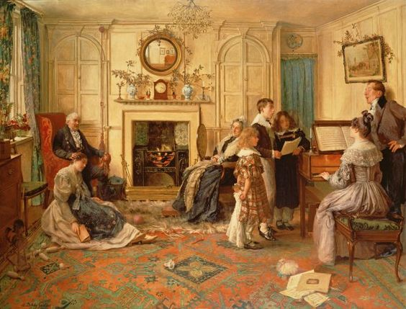
Describe to a neighbor what you see in the painting, “Home Sweet Home”.

Slide 9
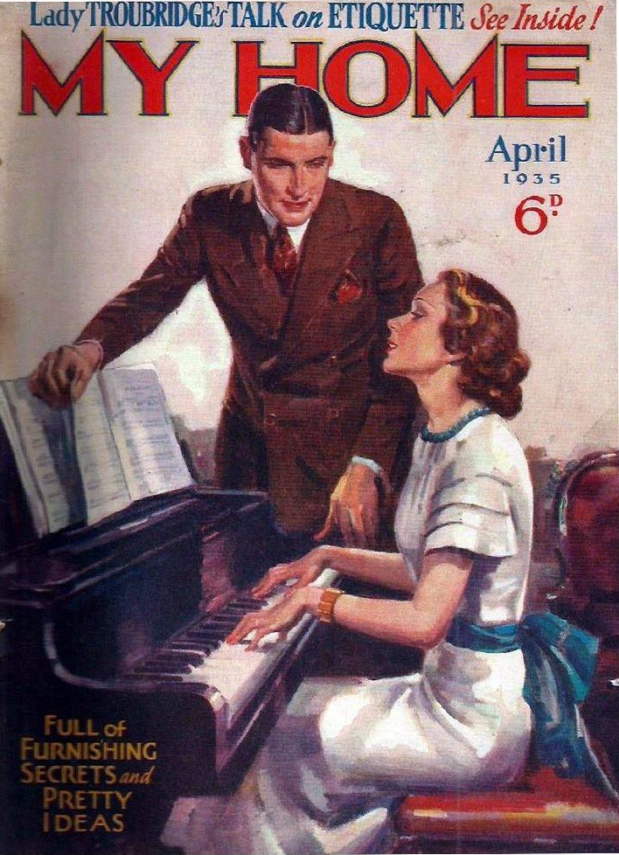
The Piano
A long time ago, families would spend time together by gathering around the piano and listening to a family member play. Families would sing, dance, and have parties centered around the piano as a main source of entertainment and fun!

Slide 10
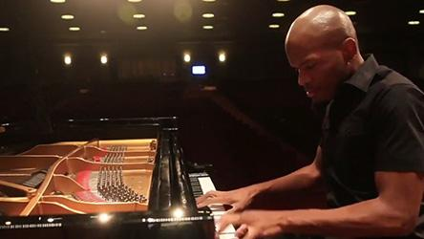
The Piano
Listen and “air play” along with pianist, Joshua White.

Slide 12
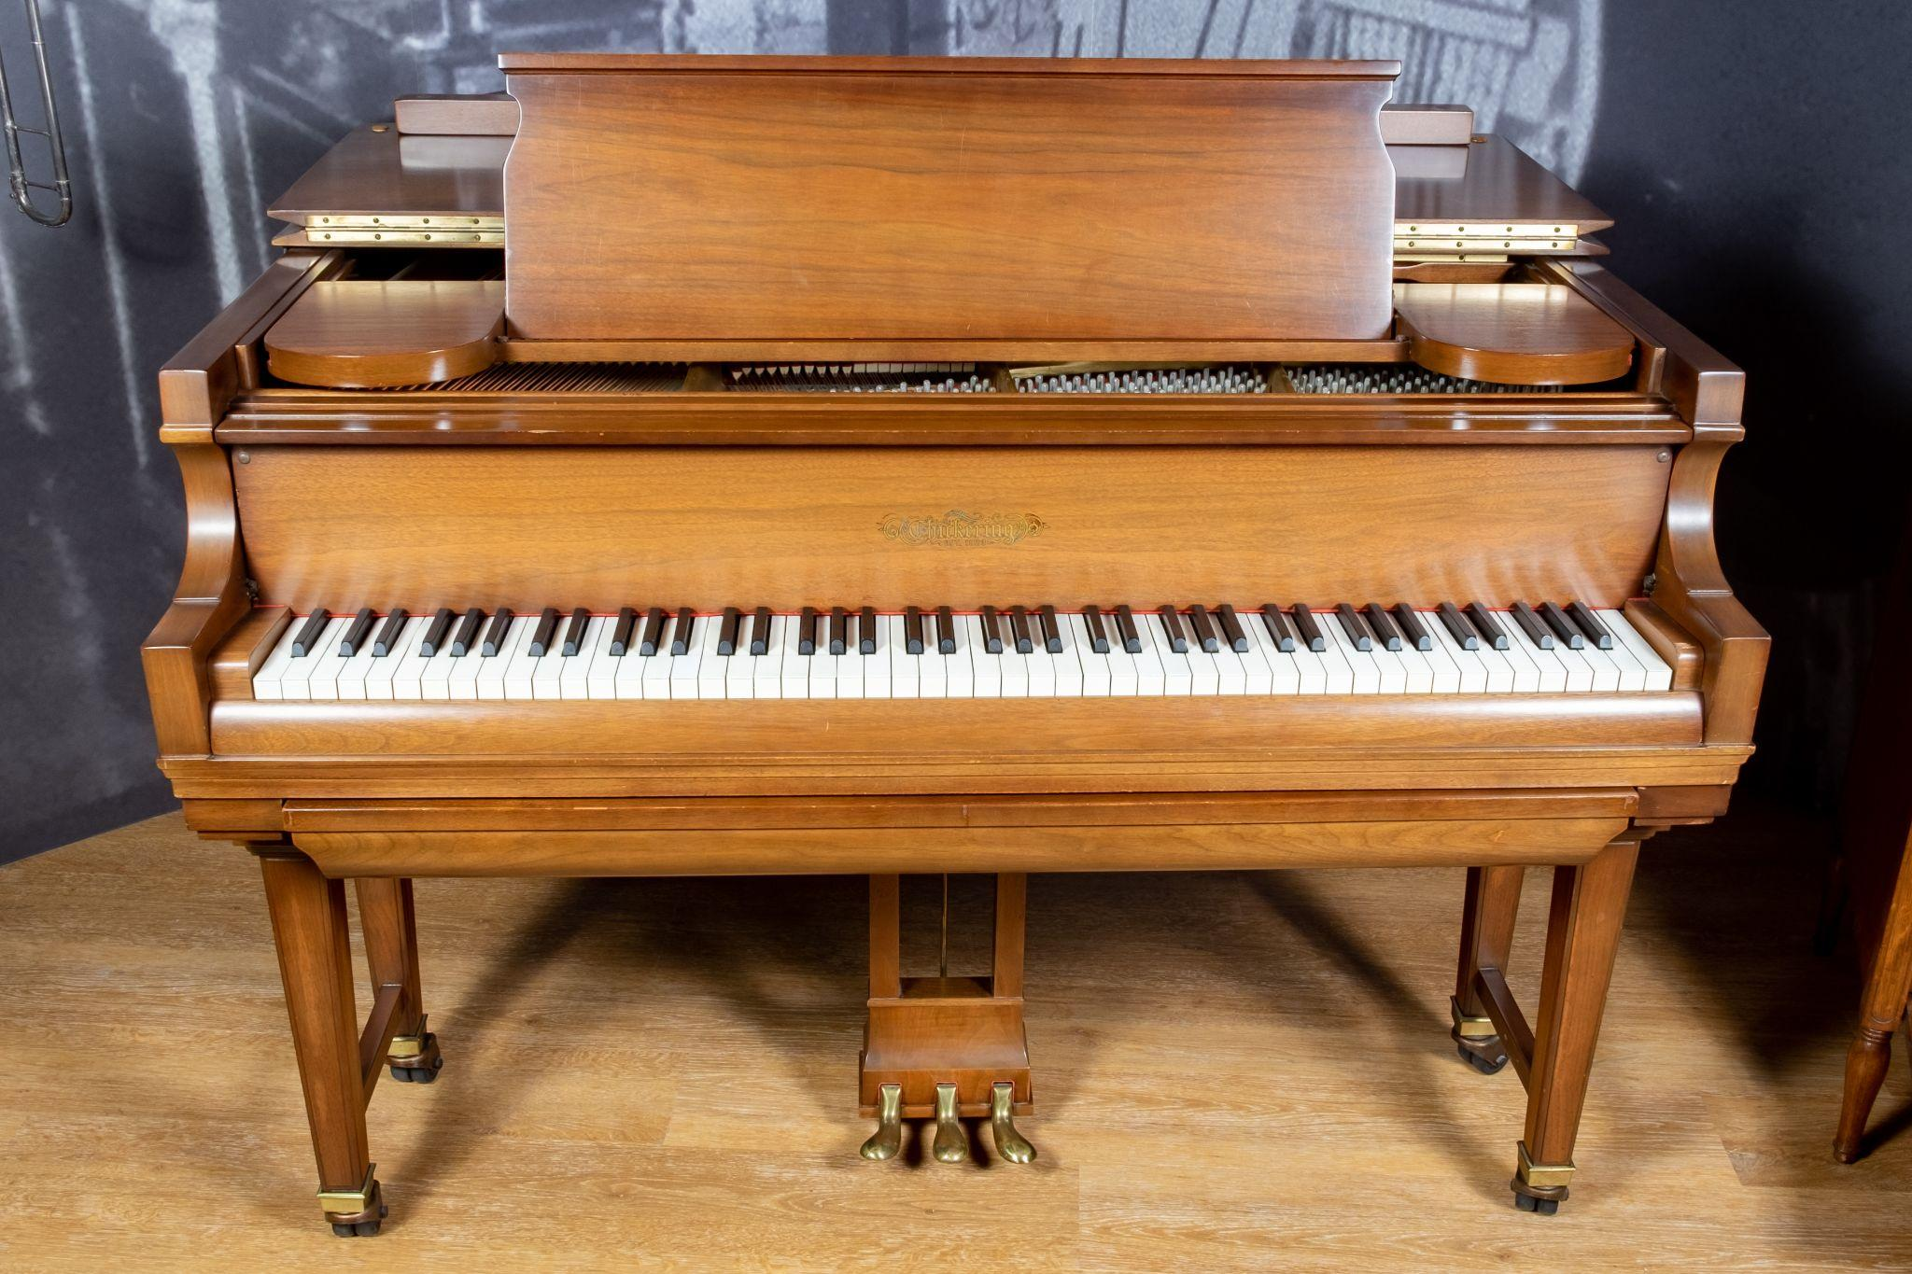
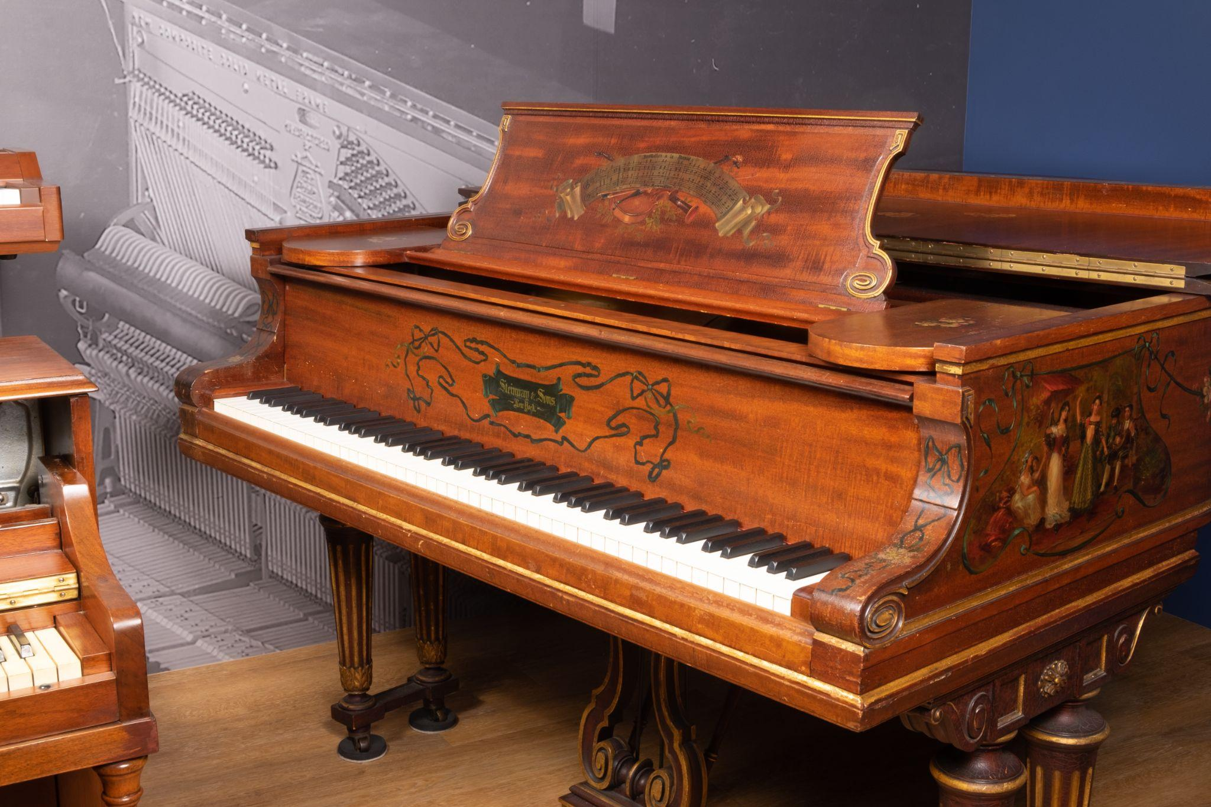
Pianos a long time ago
Owning a piano used to show that a family had a lot of money. If a family could buy a piano and had room for it, it meant they were rich.
What do you notice about the size and type of pianos in homes today compared to the older grand pianos that we see in the picture? How are they different?
Notes:
Chickering & Sons Model 304 Ampico Reproducing Baby Grand Piano, 1923
Marketed as a way to bring performers into the home, the reproducing piano was designed to be able to reproduce musical nuances, notably tempo and dynamics, that were not available with standard player pianos. Despite a higher price tag, the reproducing piano’s musical capabilities helped it become very popular.
Steinway & Sons Model B Grand Piano, 1902
An “art case” piano is one that features some combination of intricate carvings, paintings, exotic inlays, and more in its case, while still being built around a manufacturer’s “standard” piano mechanisms. This piano features hand-painted floral decorations and depictions of folk musicians and dancers around the case, including a large image on the lid of a group of dancers around a maypole. The instrument is signed on the plate by Henry Z. Steinway, former president of Steinway & Sons and founding president of the Museum of Making Music.

Slide 13
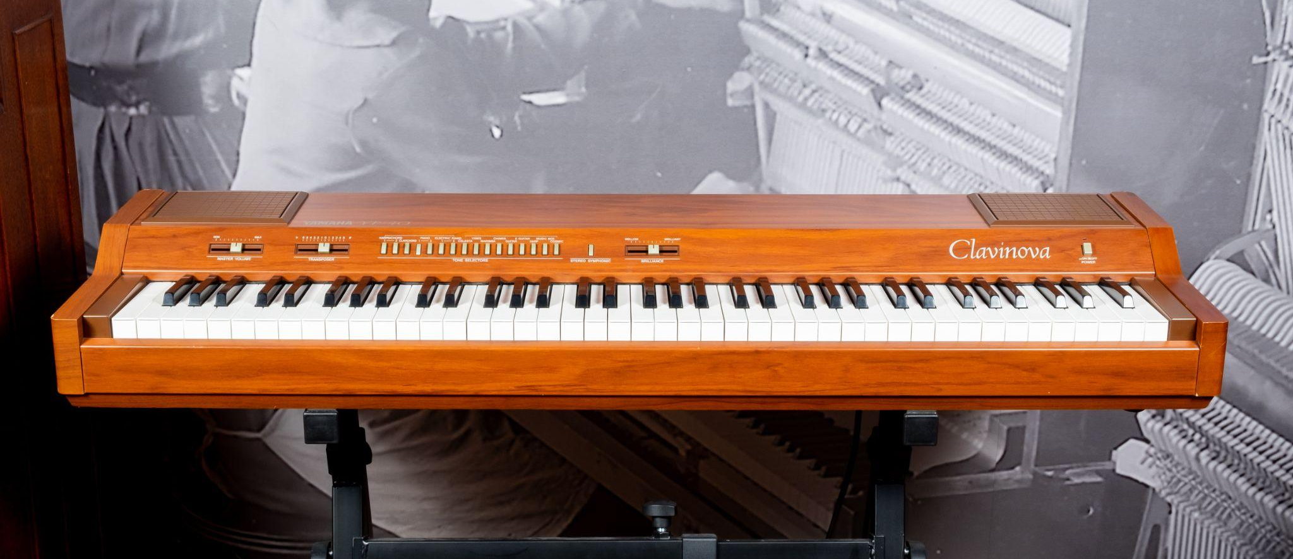
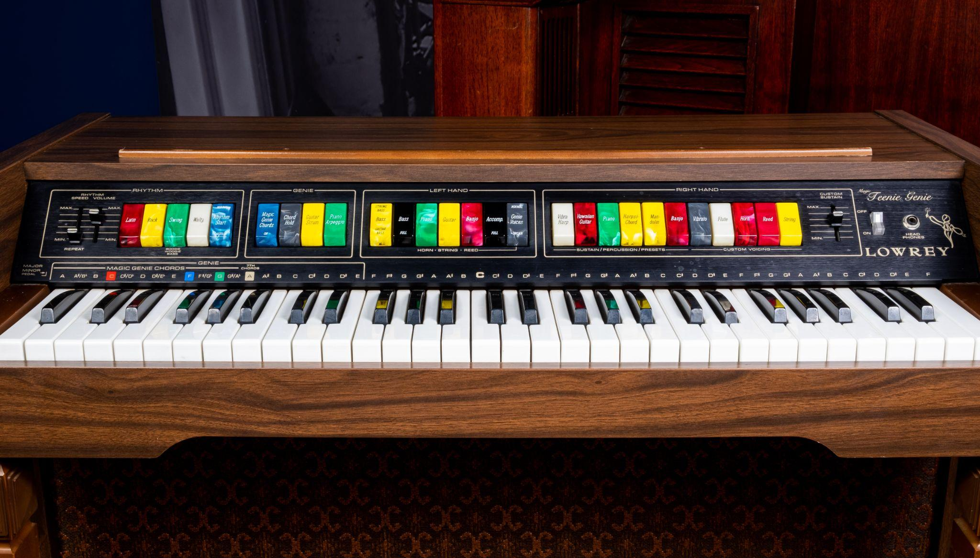
Pianos in the Modern Home
Since the birth of the music products industry in the late 1800s and early 1900s, pianos have had an important place in the home.
As time went by, people changed their homes.
To fit smaller homes and apartments, piano makers created smaller pianos.
They also added fun things like music players and teaching tools to pianos for more enjoyment at home.
Notes:
Yamaha Corporation YP-40 Clavinova Digital Piano, 1983
Yamaha’s Clavinova series of digital pianos, first introduced in 1983, was developed with the goal of delivering the experience of an acoustic piano in a much smaller instrument. The initial YP models, with the YP-40 positioned at the top of the range, used then-new frequency modulation (FM) synthesis and a reverberation effect to create a variety of realistic keyboard sounds. Subsequent Clavinova models have seen significant new features, including weighted keys, digital samples, song recording and playback, built-in lessons, and even internet connectivity for a range of functionality. The Clavinova was included in Time Magazine’s 2016 list of “Most Influential Gadgets of All Time.”
Lowrey TG-1 Magic Teenie Genie Organ, 1974
Released in 1974 during the explosive home organ boom, the Lowrey Magic Teenie Genie had an array of features designed to have a novice player making music as quickly as possible. Along with several rhythmic patterns and an arpeggiator, the organ’s “Genie” function provided automatic accompaniment in a variety of styles. Lowrey released a number of organs with the Genie feature, from the beginner level like this example through more advanced models.
Yamaha Corporation DX7, 1983
With an expansive range of sounds created with frequency modulation (FM) synthesis and an affordable price, Yamaha’s DX7 was the first synthesizer to sell more than 100,000 units. Its high-quality presets, created by musicians including Don Lewis, Gary Leuenberger, and Dave Bristol, let players jump into making music – including a huge number of hit songs in the 1980s – without needing to program the instrument themselves.

Slide 14
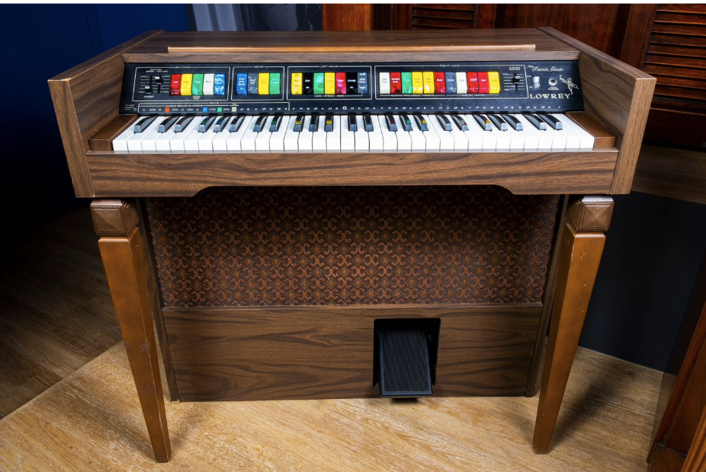
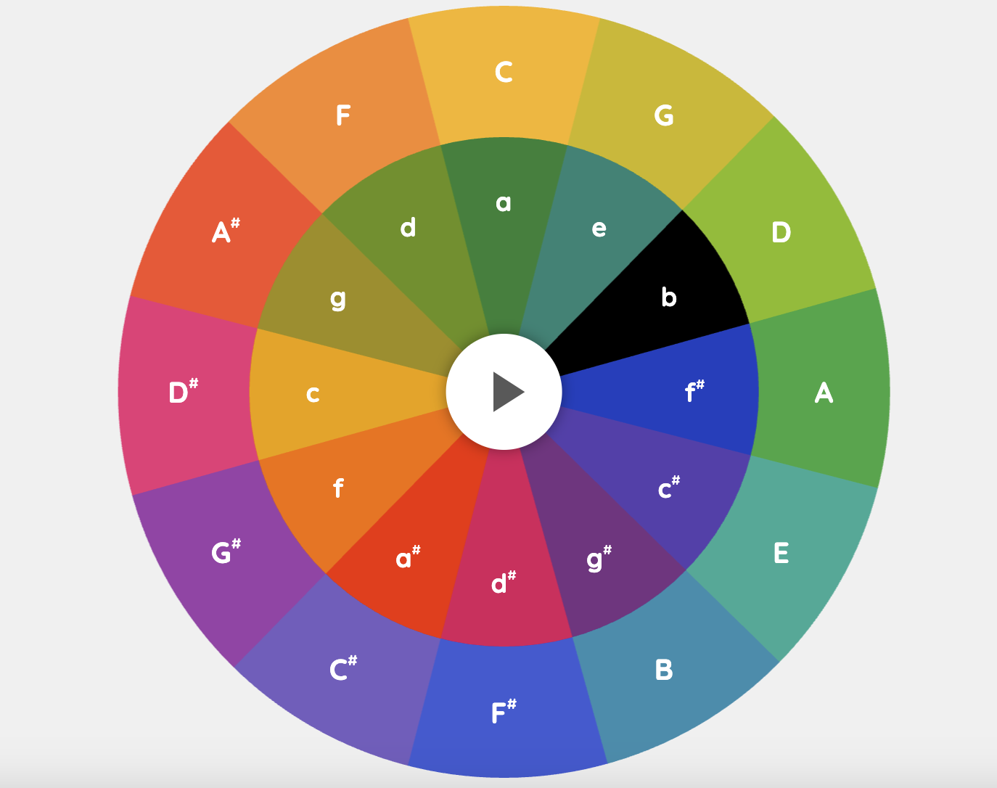
The Electric Organ
Before we had keyboards like we do now, there were other kinds that came before them.
In the 70’s, the electric organ became a popular instrument to have at home. There was a special organ called the Lowrey Magic Teenie Genie. What a fun name!
It was made for beginners to start playing cool sounding music right away, without having much skills. The organ had cool features like rhythmic patterns and something called an arpeggiator. The "Genie" function even helped play music along with you in different styles. Lowrey made various organs with the Genie feature, from simple ones like this to more advanced models.
You can explore with this fun arpeggiator here!
Notes:
Google chrome music lab arpeggios virtual instrument-https://musiclab.chromeexperiments.com/Arpeggios/
Lowrey TG-1 Magic Teenie Genie Organ, 1974
Released in 1974 during the explosive home organ boom, the Lowrey Magic Teenie Genie had an array of features designed to have a novice player making music as quickly as possible. Along with several rhythmic patterns and an arpeggiator, the organ’s “Genie” function provided automatic accompaniment in a variety of styles. Lowrey released a number of organs with the Genie feature, from the beginner level like this example through more advanced models.

Slide 15
The Electric Organ
Listen to Corey Henry rock this organ solo out his song,
“Love Will Find A Way” with his band Corey Henry and Funk Apostles.

Slide 16
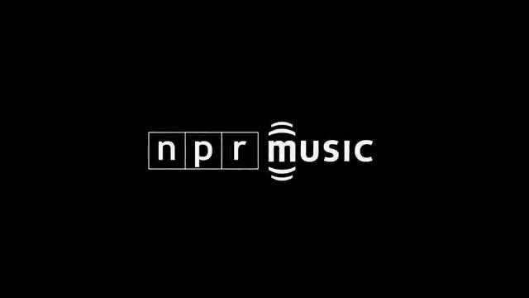

Slide 17
The Keyboard
Today, many families enjoy making music at home using modern keyboards. Keyboards are like pianos but smaller and often electronic. They come with exciting features like different sounds and rhythms, making it super fun to create music. Families can have their own mini-music studio right at home!
What kind of musical instruments or devices do you have at home that you use to make music with your family?
How is making music today similar and/or different from the past?
Notes:
Yamaha Corporation DX7, 1983
With an expansive range of sounds created with frequency modulation (FM) synthesis and an affordable price, Yamaha’s DX7 was the first synthesizer to sell more than 100,000 units. Its high-quality presets, created by musicians including Don Lewis, Gary Leuenberger, and Dave Bristol, let players jump into making music – including a huge number of hit songs in the 1980s – without needing to program the instrument themselves.

Slide 18
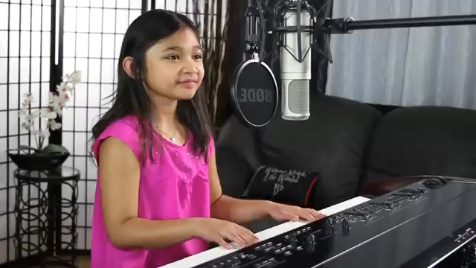
The Keyboard
Do you recognize this song played by nine year old Angelica Hale? Also listen carefully to her keyboard.
What sound is it making?

Slide 19
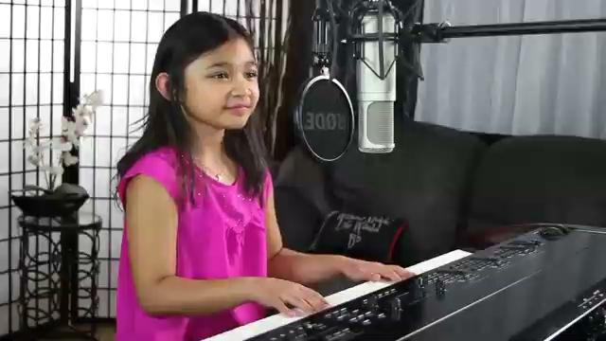

Slide 20
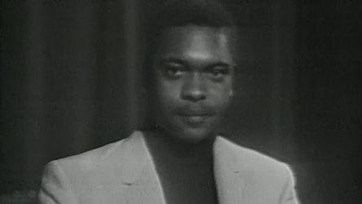
Meet Booker T. and the MGs!
They are a r&b/funk band from the 70’s.
One of their famous songs is called "Green Onions".
Imagine you're in a happy place, maybe dancing at a party or playing in the sun.
That's what "Green Onions" feels like – full of fun and good vibes!
Listen and let the music take you on a joyful adventure!
What instruments do you see and hear?
What instrument do you hear that we talked about earlier?

Slide 22
Your Turn!
You are going to join this funk band and play some ostinatos!
An ostinato is a pattern that repeats.
An ostinato is a pattern that repeats.
An ostinato is a pattern that repeats.
An ostinato is a pattern that repeats.
An ostinato is a pattern that repeats.
An ostinato is a pattern that repeats.
Choose the claves or shakers and play the corresponding ostinato pattern! Remember ostinatos are a pattern that repeats, so keep the groove 🎵going!
claves
shakers

Slide 23
claves
shakers

Slide 24
Name that Instrument
When you hear each of the samples, decide which instrument you hear.
Hold up the number of fingers!
Piano
Electric Organ
Keyboard
Booker T. Jones: NPR Music Tiny Desk Concert
Schumann - Album for the Young
Dan Boughton - Beat It (Cover)
Notes:
Electric organ
NPR Music. (2011, May 2). Booker T. Jones: NPR Music Tiny Desk Concert [Video]. YouTube. https://www.youtube.com/watch?v=g5VNwWw53yU
Piano
Silver Burdett Making Music, Grade 5. Schumann_Album for the Young
Keyboard
Boughton, D. (2019, November 4). Michael Jackson - Beat It - Keyboard Cover - Dan Boughton [Video]. YouTube. https://www.youtube.com/watch?v=HCC5gIIfYJY

Slide 25
Consider a Career in Music!
What careers are related to the lesson we just completed?
Piano/Organ/Keyboard Manufacturer
Retailer
Piano, Organ, Keyboard Teacher
Piano, Organ, Keyboard Performer
Engineer
Marketer

