Slide 2
How to Create and Market Instruments

Slide 3
Lesson Objectives
Understand ways to market a new product by explaining its cultural and historical background for performance purposes.
Explain how new musical instruments are made and then launched into the marketplace while exploring both successful and unsuccessful launches.
Demonstrate your knowledge of how learning about musical instruments in music class and entrepreneurship in social studies work hand in hand with one another.

Slide 4
Today, we are going to learn what it means
to bring an instrument to market.

Slide 5
What are some instruments that you
think were effectively launched?
(What instruments do a lot of people have?)
Notes:
Ideas include drums, keyboards, electric guitar, etc.

Slide 6
Fill out your "Marketing Think Sheet"
and share your answers.

Slide 7
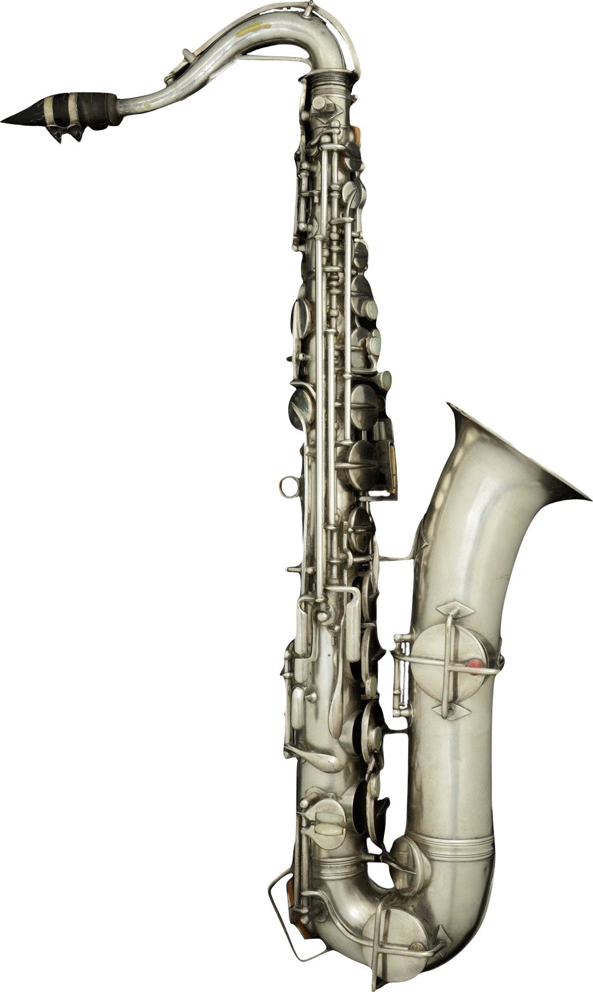
Now, it's your turn to create a slideshow to examine two instruments that had challenges and successes when they went to market.
Some of you will research the saxophone.
Notes:
Holton C Melody Saxophone, c. 1920
Frank Holton, a trombonist who had played in John Philip Sousa's band, founded an instrument manufacturing company in Chicago in 1896. Frank Holton & Company moved headquarters to Elkhorn, Wisconsin, in 1918 and produced a full line of brass and woodwind instruments, including this C melody saxophone.

Slide 8
Others of you will research the Chapman Stick.
Notes:
Chapman Stick, 1986 This Chapman Stick, #2125, is signed by its former owner, Tony Levin. A prolific performer and recording artist, Levin has toured worldwide and played on over 500 albums. The Stick is made of polycarbonate, a plastic that provides rigidity and stability across a wide range of climates.

Slide 9
Day Two

Slide 10
Today, we are going to continue researching
our instruments and finalizing our
slideshow presentations.

Slide 11
Share

Slide 12
Reflect
What is something new you learned about marketing an instrument?
How would you handle a failure if your instrument launch wasn’t successful?
While learning about entrepreneurship in social studies, what skills applied to this lesson?

Slide 13
Consider a Career in Music!
What careers are related to the lesson we just completed?
Entrepreneur
Marketing Coordinator
Music Producer
Instrument Manufacturer
Instrument Maker
Retailer
Distributor

