Slide 2
Beyond the Instruments

Slide 3
Lesson Objectives
Describe instruments that took on meaning beyond their original intent.
Connect instrumental advances with artistry, sanctuary, and change.
Develop lyrics for a song on a personal topic of interest.

Slide 4
What is something that bothers you that
you would like to see change?

Slide 5
Share

Slide 6
What songs or artists do you know that discuss important issues?

Slide 7
Share

Slide 8
Beyond the Instruments
Music and musical instruments are filled with layers upon layers of rich meaning that are built up by everyone who participates in the music making process – performers, listeners, producers, engineers, makers, retailers, and countless more.

Slide 9
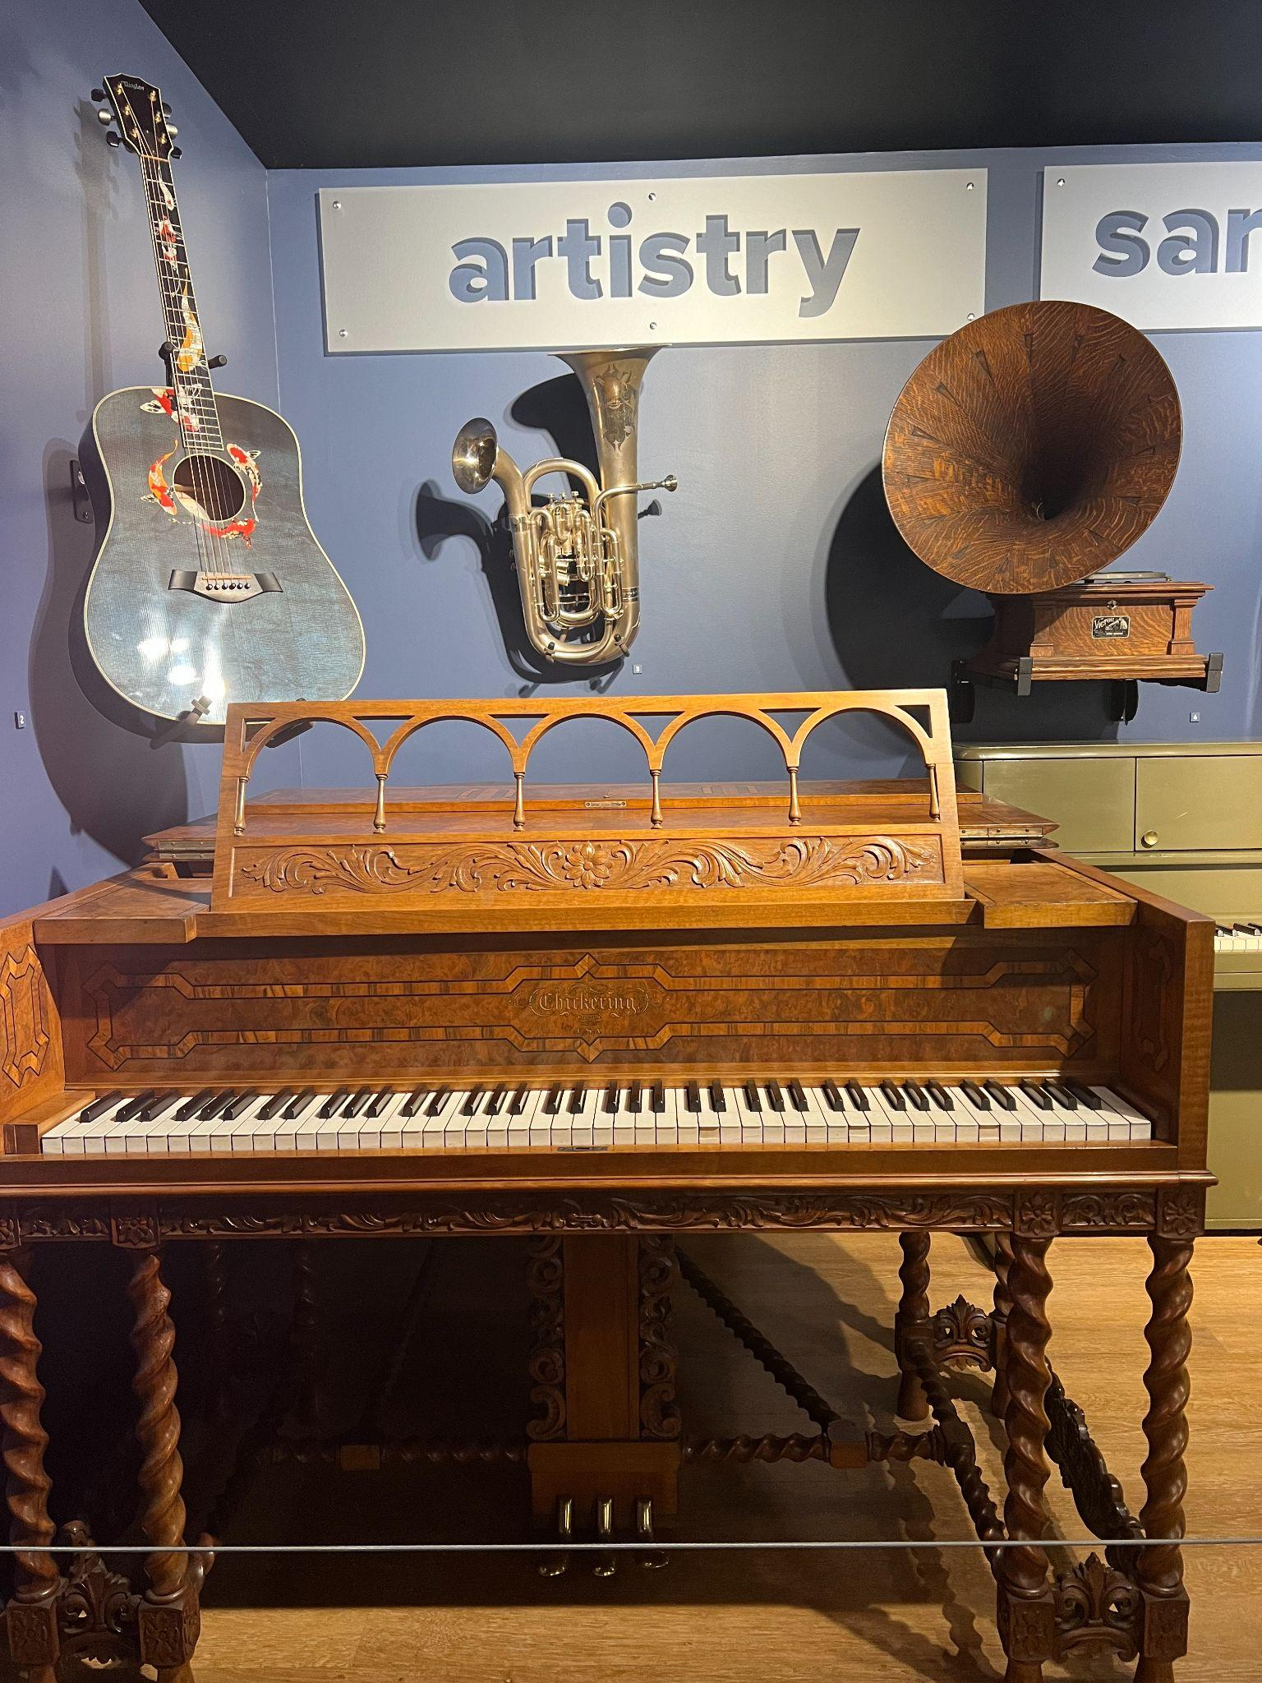
Beyond the Instruments:
Artistry
A musical instrument is a tool for musical expression. However, it’s almost always much more than that.
Some instruments are layered further with the intention of being visual works of art just as much as they are functional, expressive tools.
Notes:
Beyond the Instruments: Artistry display at the Museum of Making Music

Slide 10
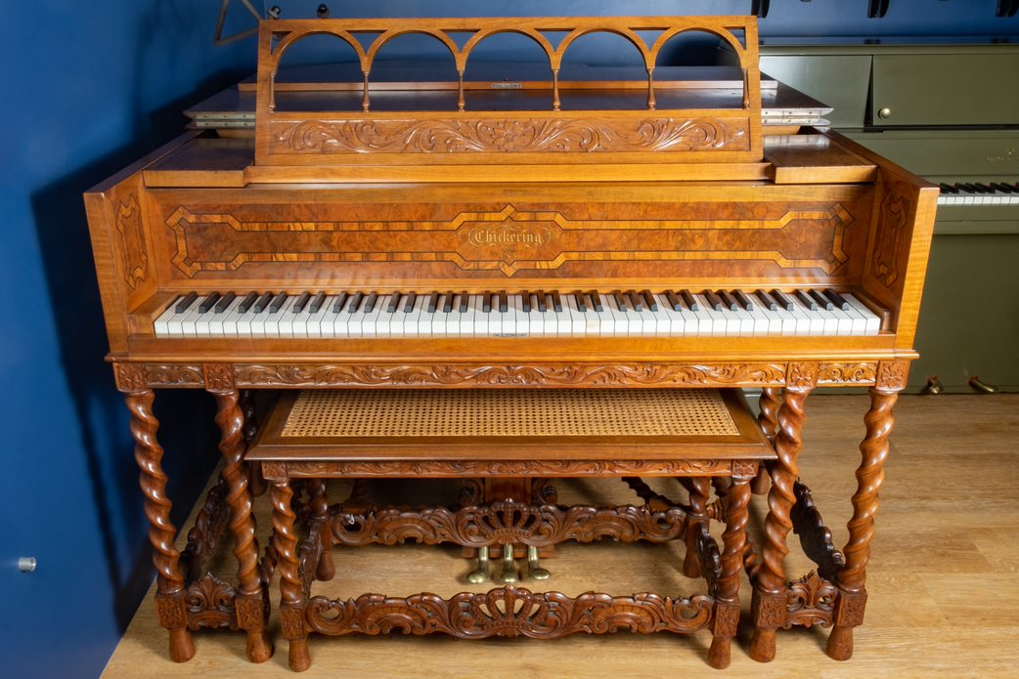
Beyond the Instruments:
Artistry
This Chickering & Sons “Anniversary” piano is part of the long tradition of art case pianos, which combine cutting edge instrument components and construction techniques with stunning visual artistry.
Notes:
Chickering & Sons Anniversary Grand Piano, c. 1914
Chickering & Sons was founded as a partner of Jonas Chickering and James Stewart in 1823 and remained a significant American manufacturer and brand of pianos until 1983. Chickering pioneered the use of single-piece cast iron plates to support the high string tension in large grand pianos and the technique of overstringing to reduce the space taken up by an instrument's strings. This ornately appointed grand piano was created as part of a series around the company's centennial.

Slide 11
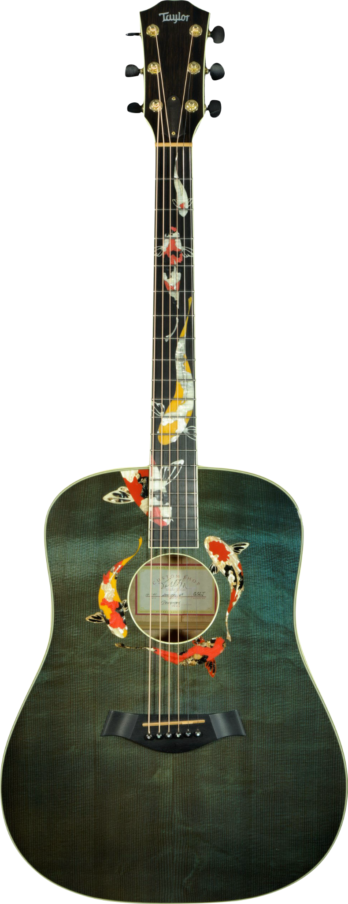
Beyond the Instruments:
Artistry
Taylor Guitars’ “Living Jewel” dreadnought guitar showcases beautiful woods treated with an aqua-colored finish and the precise application of inlaid materials to depict koi swimming along the neck and around the sound hole.
*Taylor Swift has a guitar that is this same model!
Notes:
Taylor Guitars Living Jewel Dreadnought Guitar, 2001
Part of Taylor Guitar's Gallery Series of limited, highly decorated instruments, this Living Jewel features inlaid koi fish swimming around the sound hole and up the neck. Its body, with a back of big leaf maple and a top of bearclaw spruce, is colored with a transparent aqua finish.

Slide 12
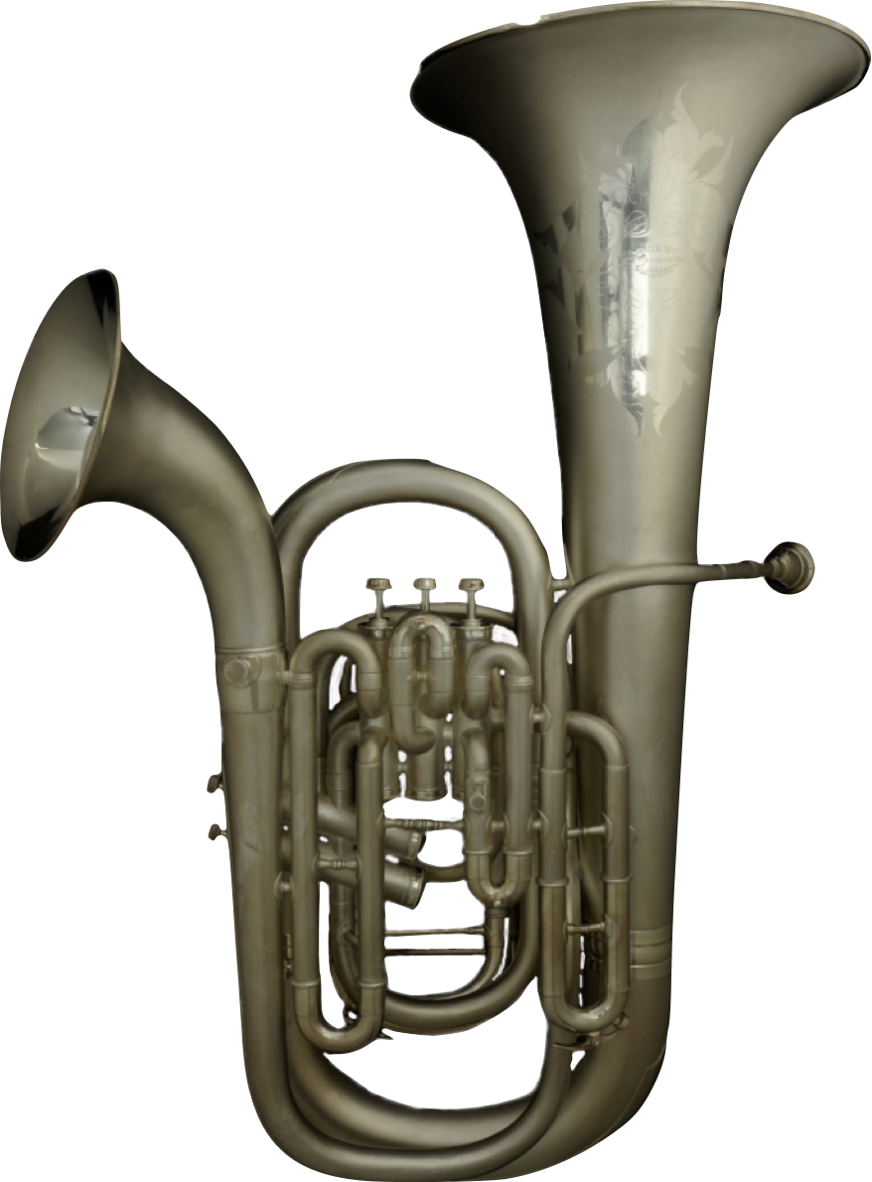
Beyond the Instruments:
Artistry
This C.G. Conn double-bell euphonium, a brass instrument, is silver-plated. Its plating is extensively engraved with intricate patterns and burnished in some sections to create a matte finish.
Notes:
C.G. Conn Double-Bell Euphonium, c. 1915
Many members of the brass instrument family have been made with more than one bell. By pressing a valve, the player changes the flow of air through the instrument (the same mechanism controls the instrument's pitch) to emerge from one bell or another. Secondary bells were typically designed to provide a different tone quality.

Slide 13
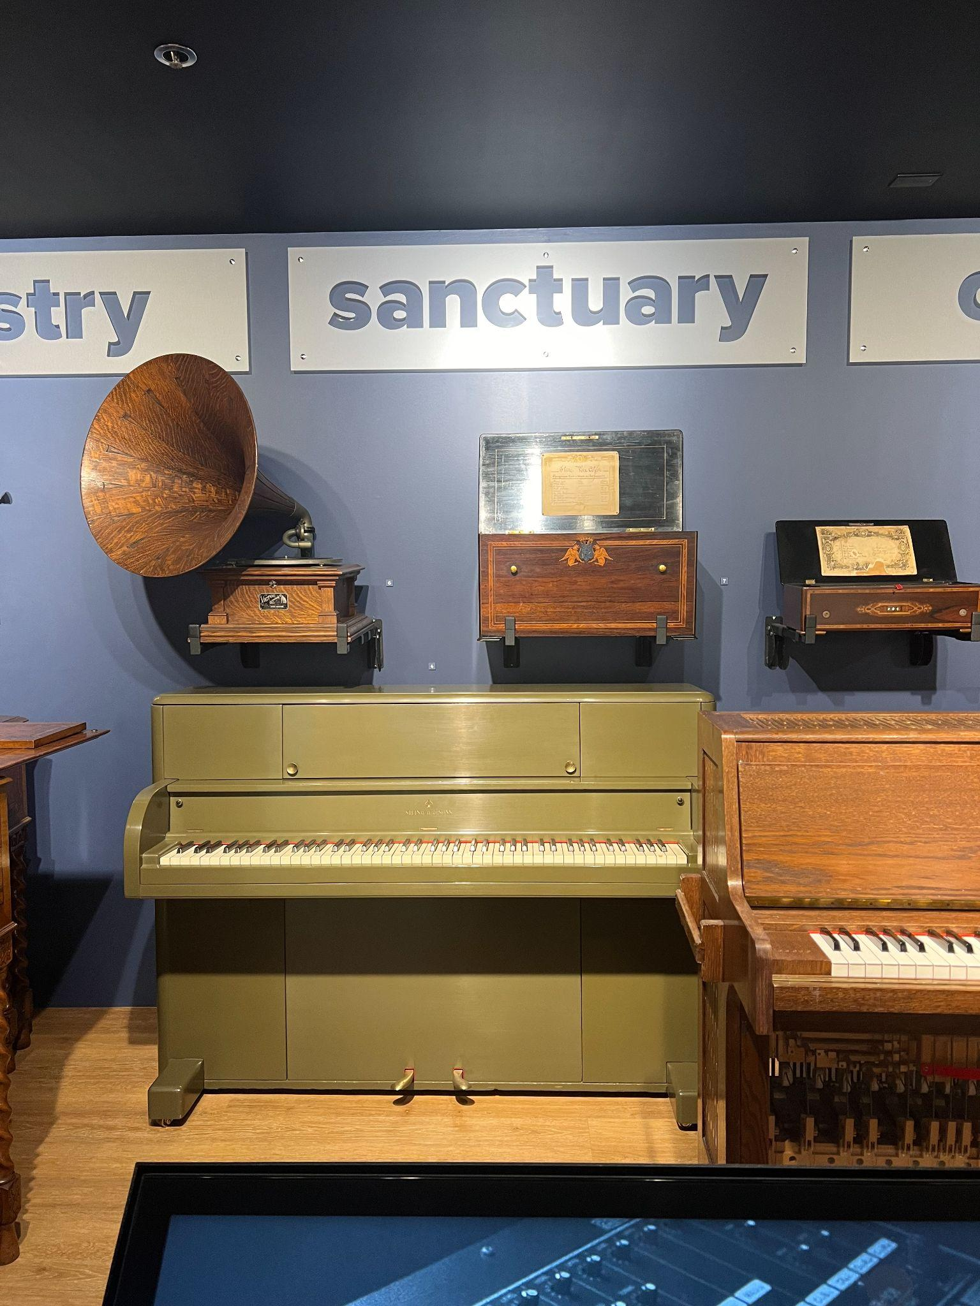
Beyond the Instruments:
Sanctuary
The sounds of specific musical instruments have the power to carry us to different places – to familiar places of comfort, mysterious and unknown realms, and anywhere in between.
Notes:
Beyond the Instruments: Sanctuary display at the Museum of Making Music

Slide 14
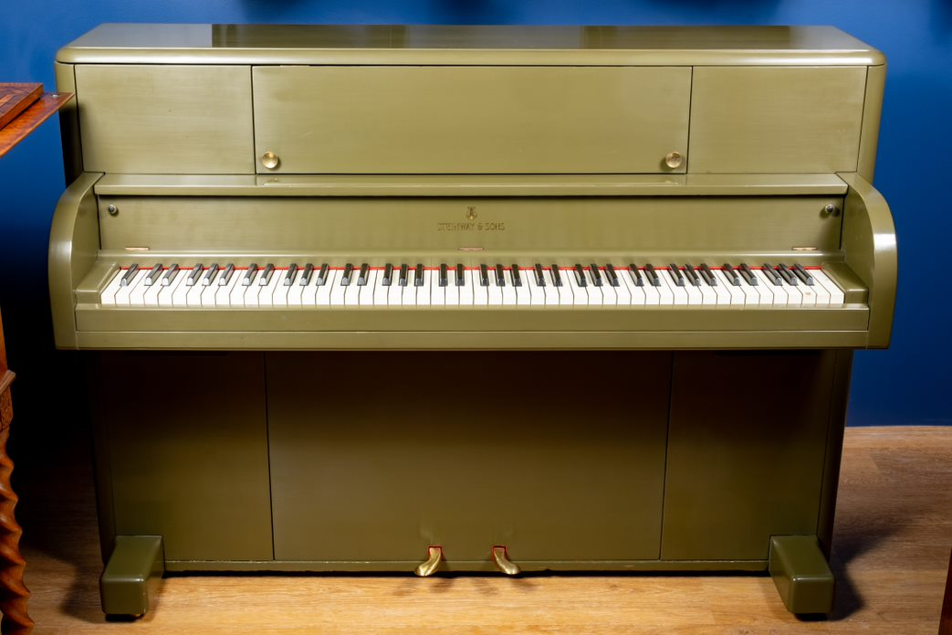
Beyond the Instruments:
Sanctuary
In times of trouble, an instrument and its sound can transport a listener to a place of sanctuary and relief. Steinway & Sons developed and manufactured the Victory Vertical piano during World War II.
By the end of the war, more than 2,000 Victory Vertical pianos were delivered in an effort to give American troops a reminder of their lives back home.
Notes:
Steinway & Sons Victory Vertical Piano, 1944
Like most other musical manufacturers during World War II, Steinway & Sons was effectively prohibited from making instruments. Its production facilities were retooled to produce troop transport gliders and coffins. However, Steinway petitioned for and was awarded a government contract to design and build pianos that could be delivered to troops overseas. These pianos were ruggedized both to withstand the harsh environments that troops might encounter near front lines and to endure being airdropped in crates. Deliveries of the pianos, available in olive, blue, and gray, began in 1942.

Slide 15
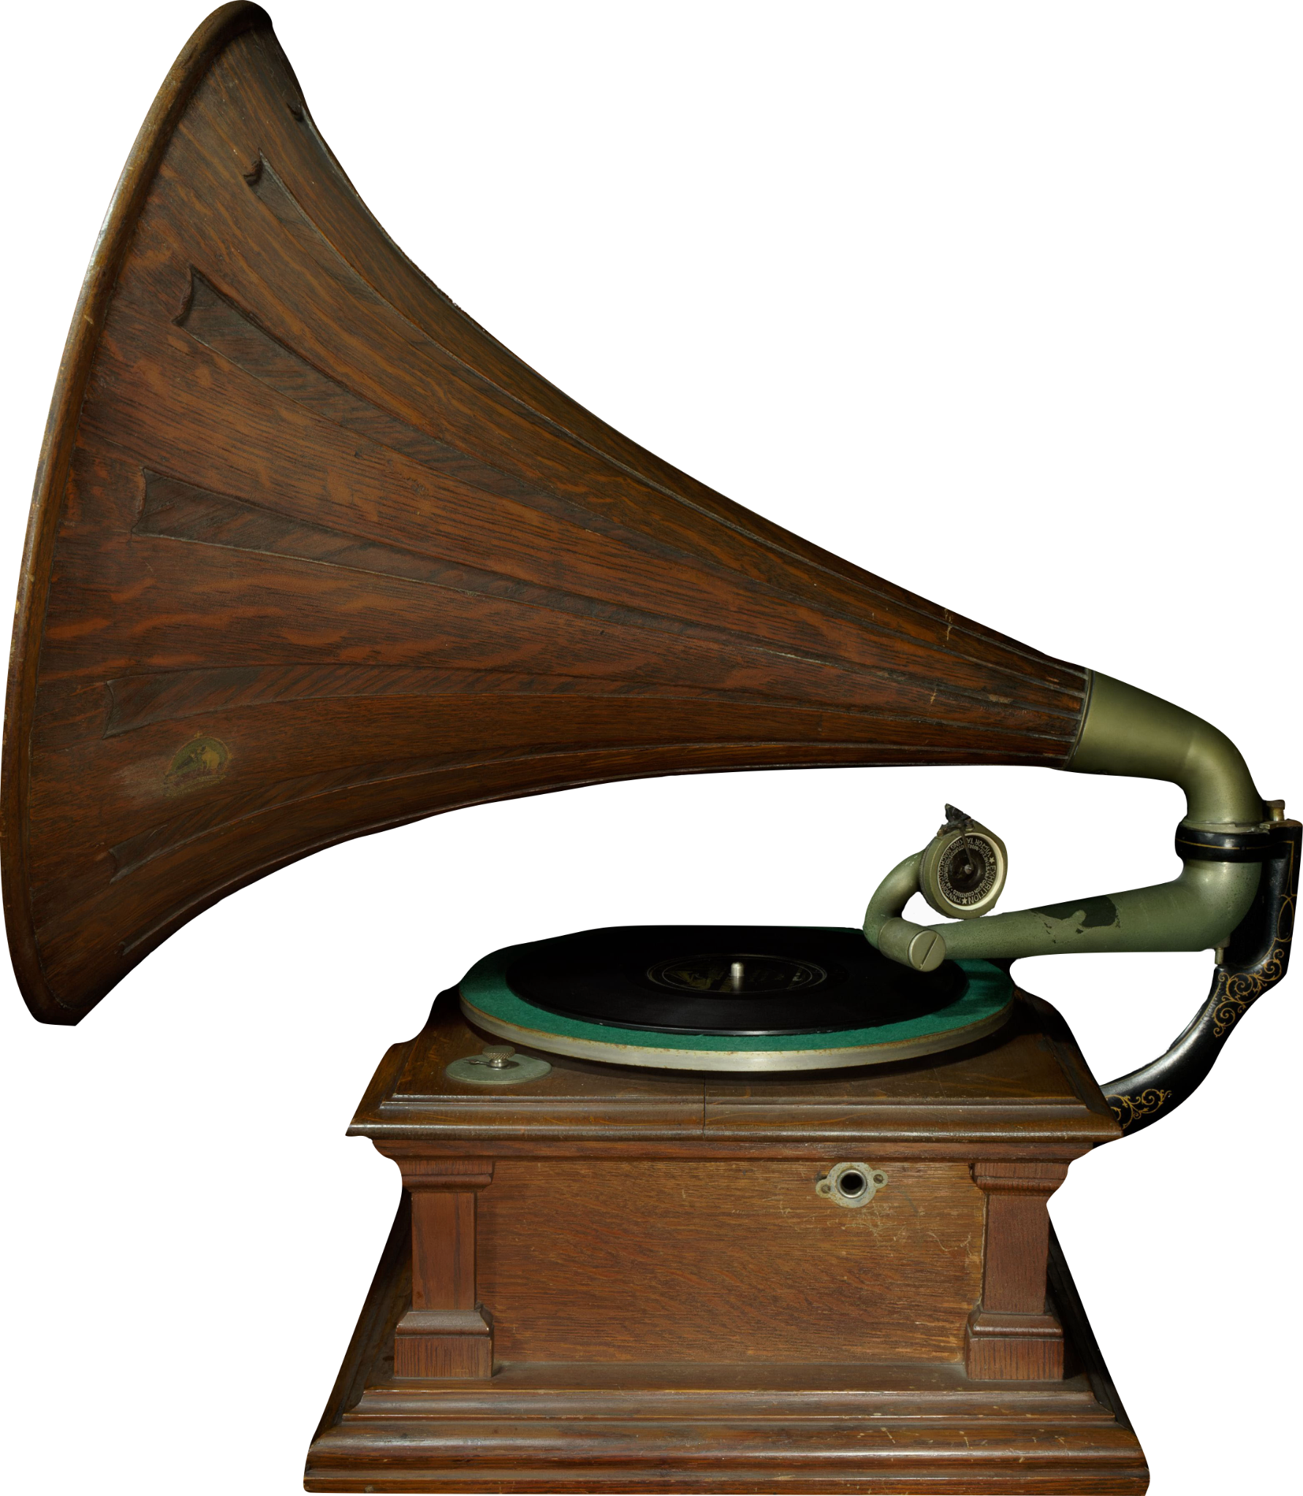
Beyond the Instruments:
Sanctuary
The introduction of recorded sound at the turn of the 20th century was met with excitement and fascination. For the first time in human history, records made it possible to hear something that happened somewhere else or at another time. The effect could transport, comfort, and surprise a listener all at once.
Notes:
The Victor Talking Machine Company’s Victor V phonograph was designed to impress with its look and sound: the large wooden “spearpoint” horn is part of an amplification mechanism that was considered among the best of its day.
Victor Talking Machine Company Victor V Phonograph, c. 1909
The Victor Talking Machine Company was founded in 1901 by Eldridge Johson, who gained experience with phonograph technology working with Emile Berliner, pioneer of the flat disc record. The company introduced a number of innovations to make records easier to manufacture and more durable. They also invested heavily in the recording of celebrity musicians and extensive marketing campaigns. Victor acquired American rights to the use of the phrase "His Master's Voice" and the accompanying image of the dog Nipper, who is depicted with a puzzled expression as he listens to the voice of his owner played through a phonograph.

Slide 16
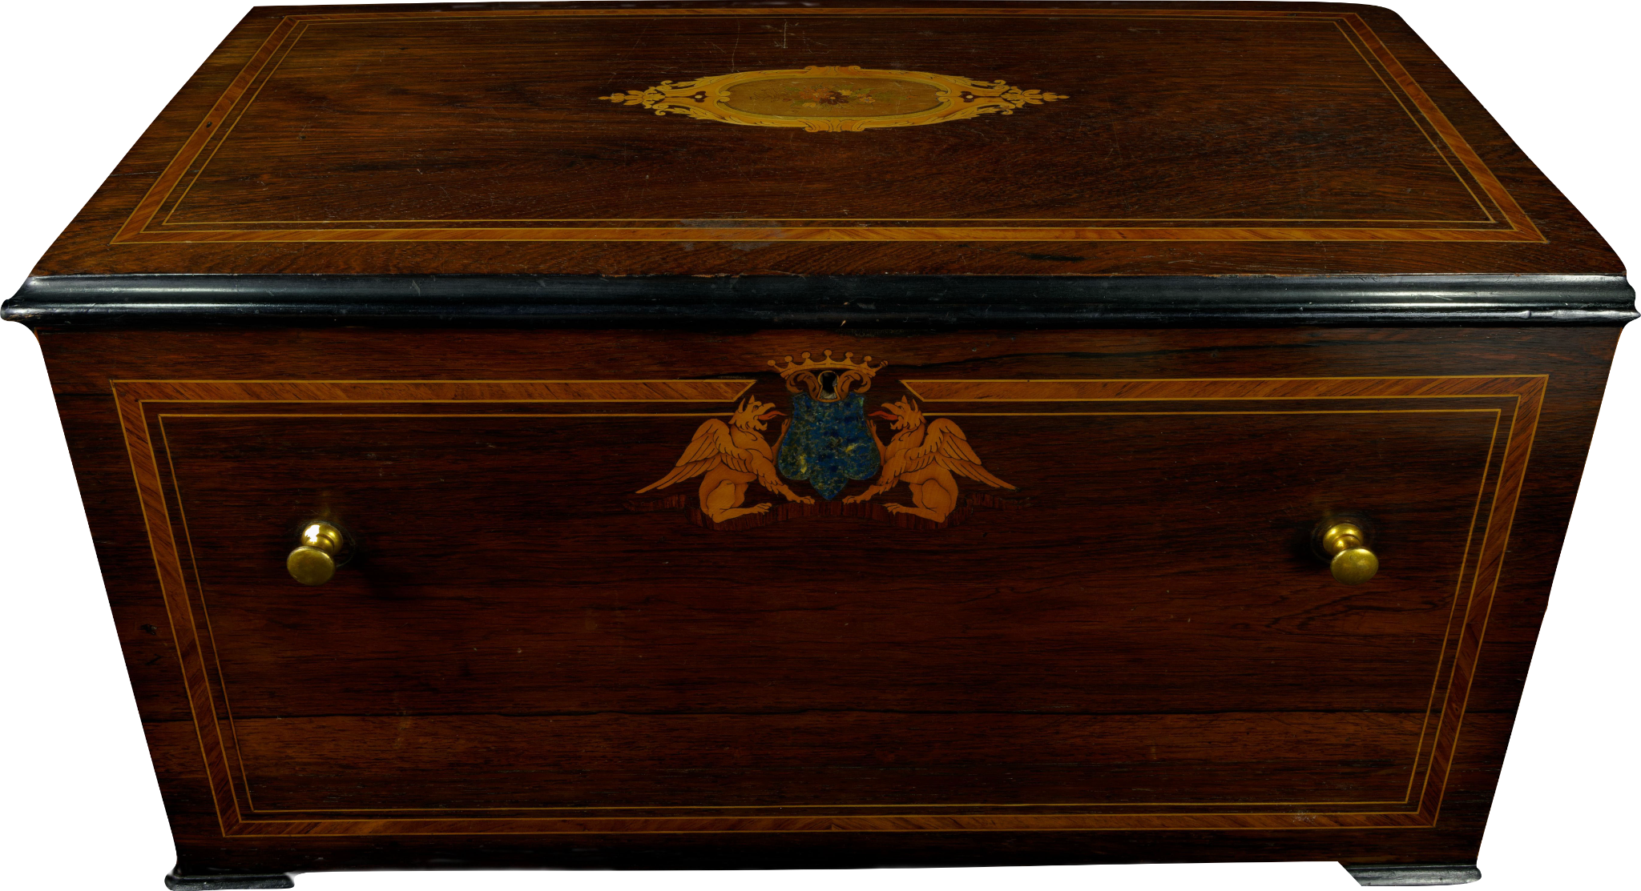
Beyond the Instruments:
Sanctuary
For some listeners, the sound of home can be heard in a music box. Though music boxes are mostly known now as small novelties, for most of the 1800s they were one of the only ways to hear music without a live performer present.
Notes:
Unknown Music Box, c. 1870
Music boxes like this one represent one of the earliest forms of musical reproduction in the home. As with their much smaller contemporary versions, these music boxes feature a rotating cylinder with an array of pins that pluck a series of tines to produce sound. Their large size enables a wide range of available notes and even the inclusion of whistling bird mechanisms, pump organs, and more. The cylinders in these music boxes can shift laterally at the end of each tune, bringing a new set of pins into alignment with the tines so that a new tune is queued. Each music box can thus play multiple tunes from a single cylinder.

Slide 17
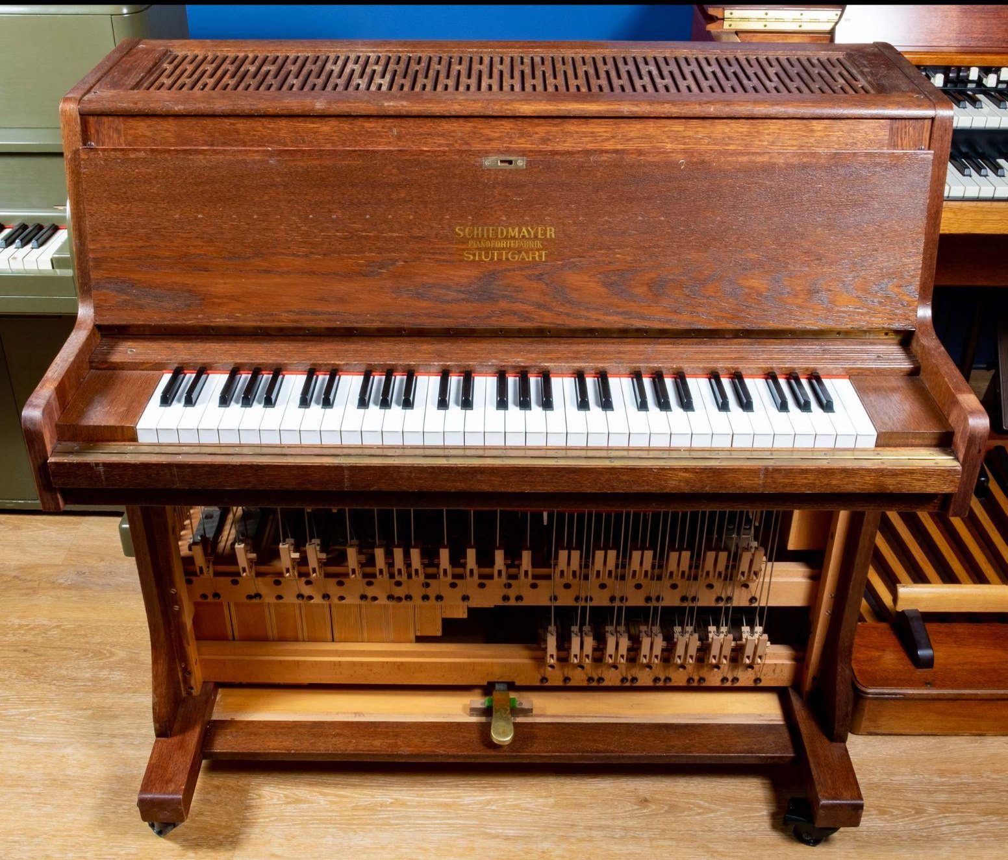
Beyond the Instruments:
Sanctuary
Other instruments can immediately take listeners to entirely new places, even when they don’t know what the instrument actually is! One such instrument is the celesta. Its ethereal bell-like tones (its name means “heavenly” in French) had one of their earliest and most enduring uses in Dance of the Sugar Plum Fairy, from Tchaikovsky’s ballet The Nutcracker.
Notes:
The celesta’s connection to fantasy and imagination has led to its inclusion in the scores for movies like Pinocchio, Willie Wonka and the Chocolate Factory, and Harry Potter and the Sorcerer’s Stone, and in the theme music for Mister Roger’s Neighborhood.
It has also been used frequently in genres like jazz, rock, and pop, often to evoke its dreamy qualities. Even though the instrument itself rarely spends time in the spotlight, its sound is recognized far and wide.
Schiedmayer Celesta Five-Octave Celesta, 1964
The celesta, invented in 1886, produces sound by striking metal plates-similar to a glockenspiel-with key-driven hammers-like a piano. Schiedmayer Celesta, the maker of this example, was founded in 1995 as a continuation of the Schiedmayer family legacy of instrument manufacturers that began in 1735. This celesta was customized by Schiedmayer for the Museum of Making Music to make the internal mechanisms under the keyboard visible.

Slide 18
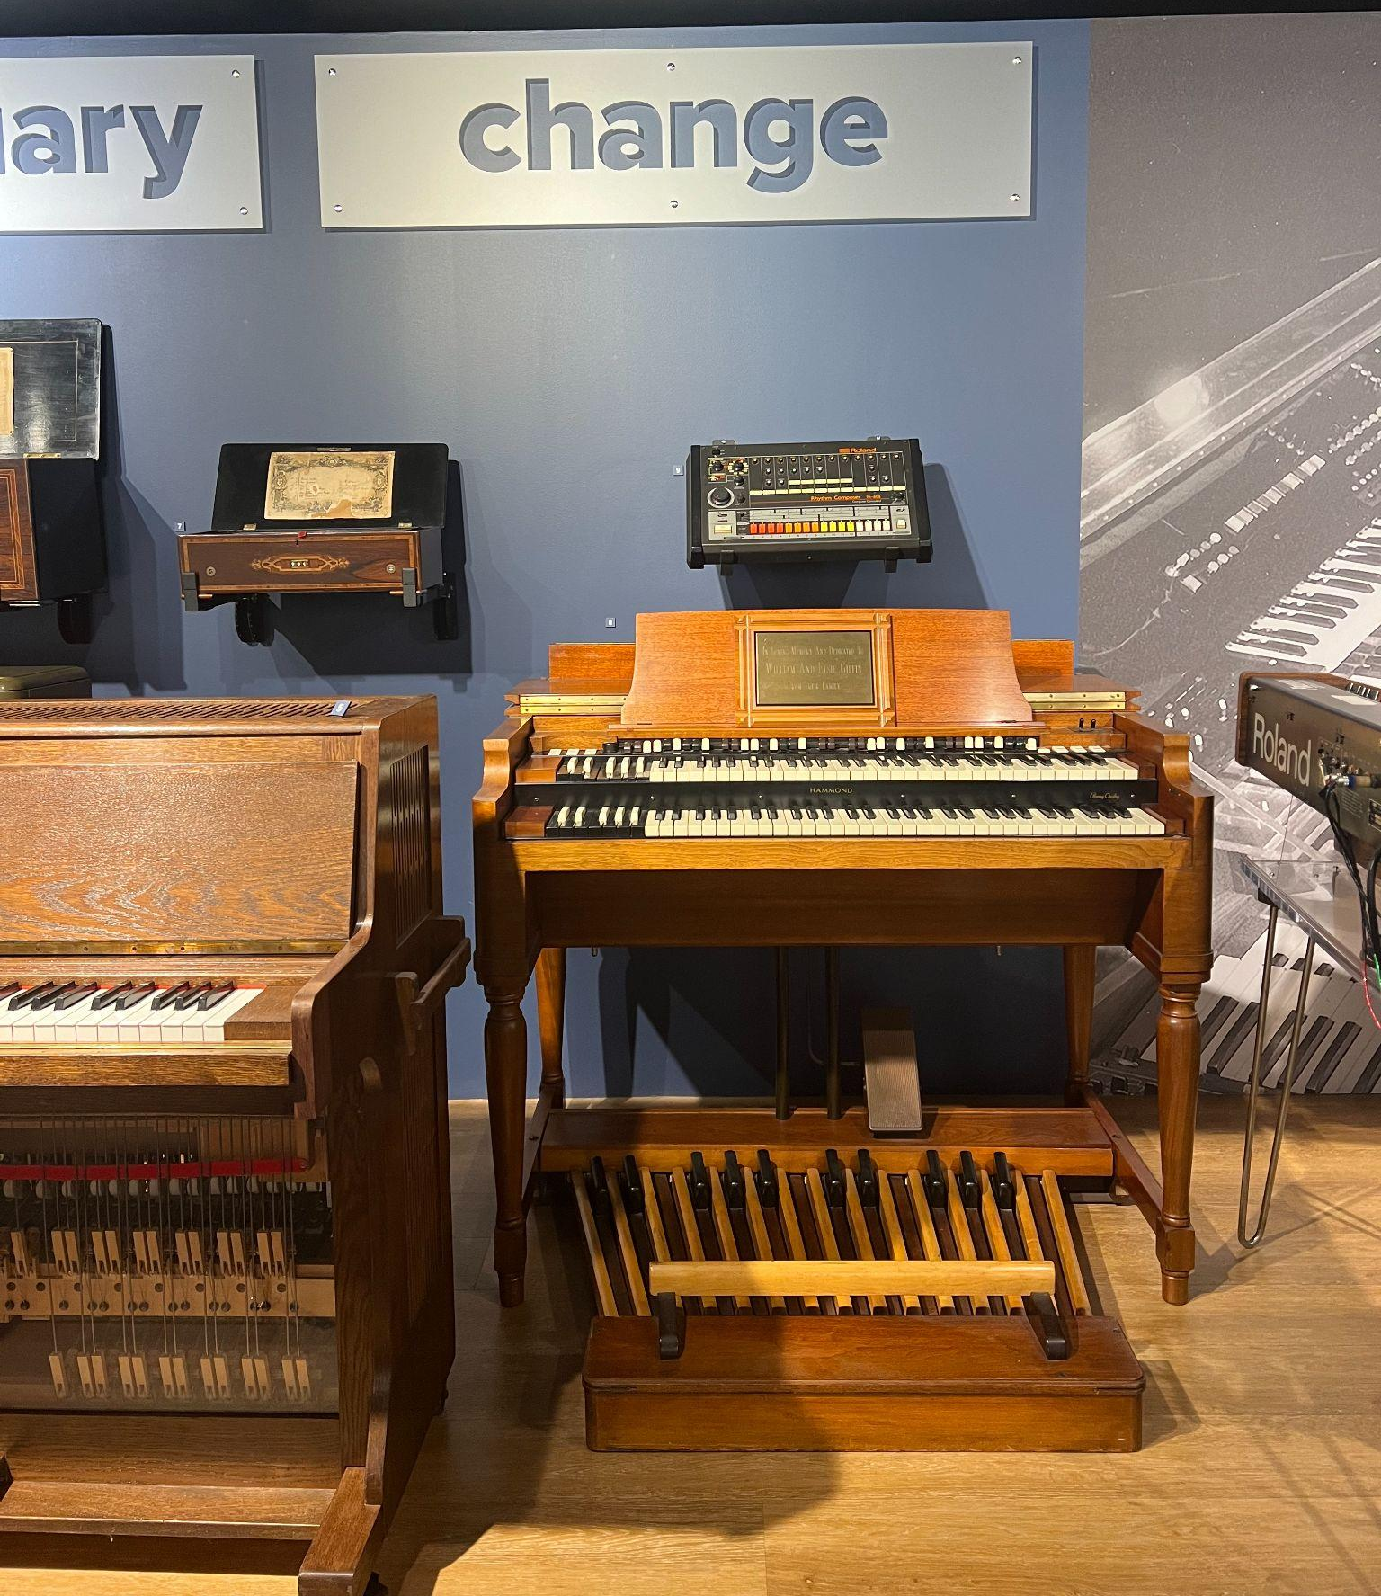
Beyond the Instruments:
Change
Musical instrument designers typically have a sense of who will use their products, and how, as they develop them. Instruments might be intended for certain types of music, or particular venues, or even for specific musicians. In some cases, though, musicians find a use for an instrument that’s beyond what it was intended, or even imagined, for.
Notes:
Beyond the Instruments: Change display at the Museum of Making Music

Slide 19
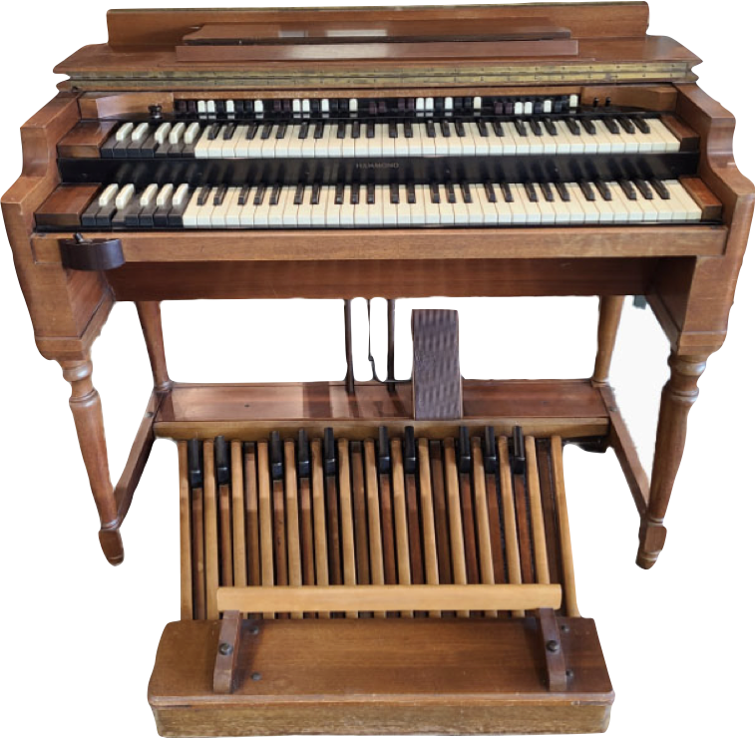
Beyond the Instruments:
Change
The Hammond Model A organ was developed for houses of worship who might be seeking the sound of a pipe organ but were constrained by budget and available space. The Model A sold in large numbers but was never pitched directly to professional musicians. Before long, though, jazz musicians and club owners began exploring the sonic potential of the organ.
Hammond Model A Organ, c. 1935

Slide 20
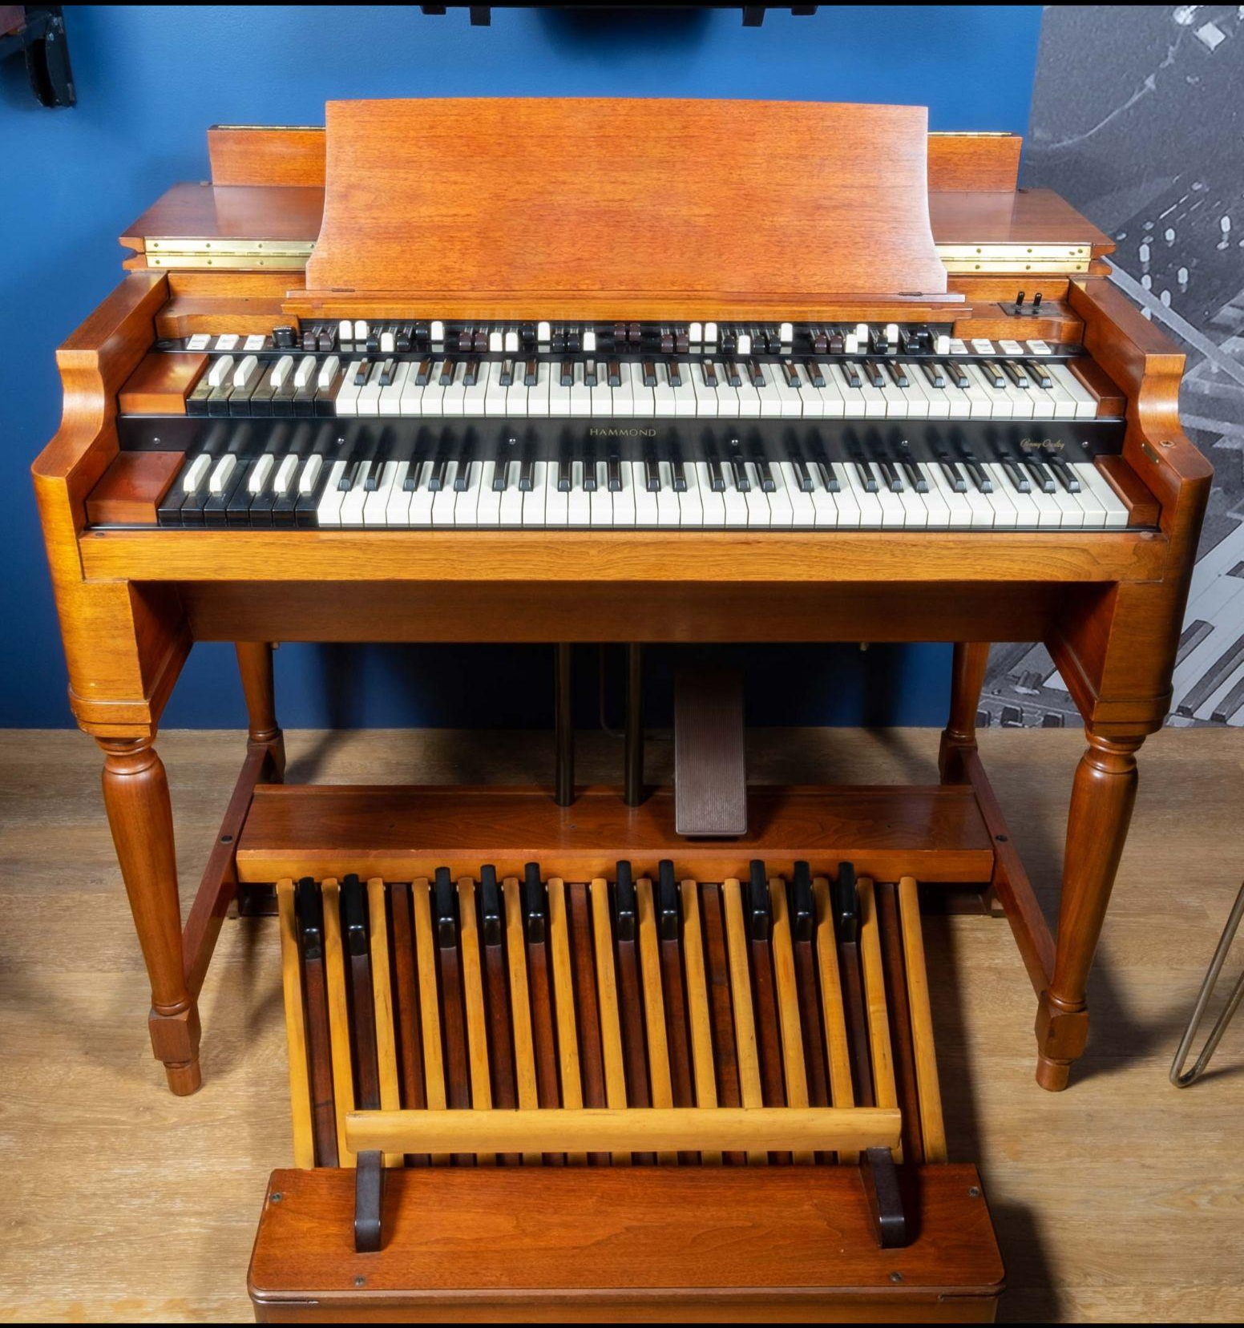
Beyond the Instruments:
Change
Though he was not the first to play jazz on an electric organ, Jimmy Smith took the instrument to new heights of artistry and popularity in the 1950s and 60s. Smith and many of the musicians he inspired–including Billy Preston, Booker T. Jones, and many more–brought significant influence from the gospel music developed in African American church contexts. Smith’s success helped to amplify those influences outward into soul, funk, rock, and jazz.
Notes:
Hammond Organ Company Model B-3 Electric Organ, 1960
The Hammond Organ Company introduced the Model B-3 in 1954 and produced it continuously until 1974. The deep "B" cabinet was first used in 1936, with successive models introducing new features. The B-3 is notable for its inclusion of "harmonic percussion," which adds a distinct percussive quality to the organ's sound. Despite being discontinued in 1974, the B-3 remains the most popular Hammond organ and is often emulated in digital instruments.

Slide 21
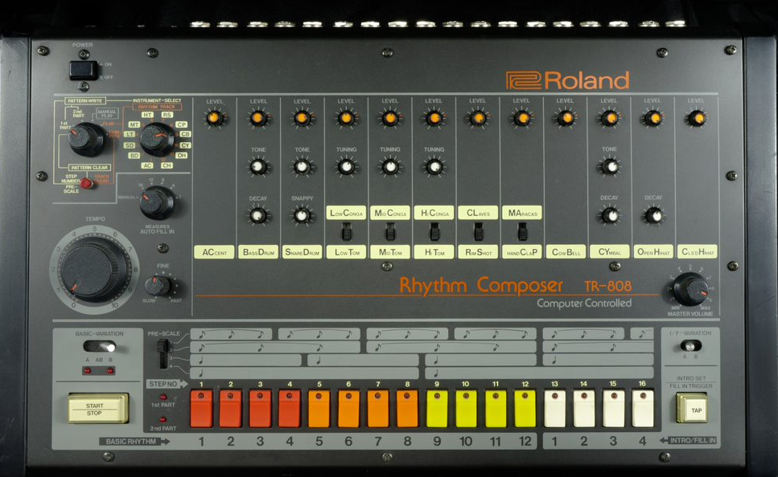
Beyond the Instruments:
Change
Roland’s TR-808 drum machine was introduced in 1980 as an affordable alternative to more expensive sample-based drum machines, but couldn’t match the sound quality of the more expensive instruments.
The instrument’s affordability and futuristic sound attracted young musicians. Almost immediately, these innovative musicians used the TR-808 to help drive the development of hip-hop, techno, electronica, acid house, and many related genres. It was used extensively by musicians like Run-DMC, Public Enemy, the Beastie Boys, and Talking Heads.
The “808,” as it’s now commonly known, has been used on more hit records than any other drum machine and remains extremely popular today.
Notes:
Roland Corporation TR-808 Rhythm Composer, 1980
Roland’s TR-808 drum machine was introduced in 1980 as an affordable alternative to more expensive sample-based drum machines, particularly for musicians who just needed drums for demonstration purposes. By using synthesized sounds, the TR-808 could meet a lower price point but couldn’t match the sound quality of instruments like the Linn LM-1. After being discontinued in 1983, the TR-808 could be found on the used market for a fraction of its original price. Underground musicians pioneering the genres of hip hop and electronic dance music flocked to the instrument, both for its price and its unique sound. It was used extensively in the years following its introduction by musicians like Afrika Bambaataa, Run-DMC, Public Enemy, the Beastie Boys, and Talking Heads. The “808,” as it’s now commonly known, has been used on more hit records than any other drum machine and remains extremely popular today.

Slide 22
Just like instruments can have special meaning, musicians can use instruments and lyrics to bring attention to important topics and inspire positive actions.

Slide 23
This Land is Your Land
Woody Guthrie wrote this familiar song in 1940 as a symbol of social justice and inclusivity.
What instrument is he playing to accompany the lyrics?
“This Land is Your Land”

Slide 24
Create Your Own Song for Change
Brainstorm a topic you care about and develop song lyrics for an area you’d like to see changed.
Write your lyrics in your worksheet.

Slide 25
Consider a Career in Music!
What careers are related to the lesson we just completed?
Music Engineer
Instrument Manufacturer
Songwriter
Performer
Composer

