Slide 2
Musical Globe Trotters

Slide 3
Lesson Objectives
Identify the mandolin.
Articulate the mandolin’s journey to the U.S.
Perform a memory game to demonstrate how songs and stories travel.

Slide 4
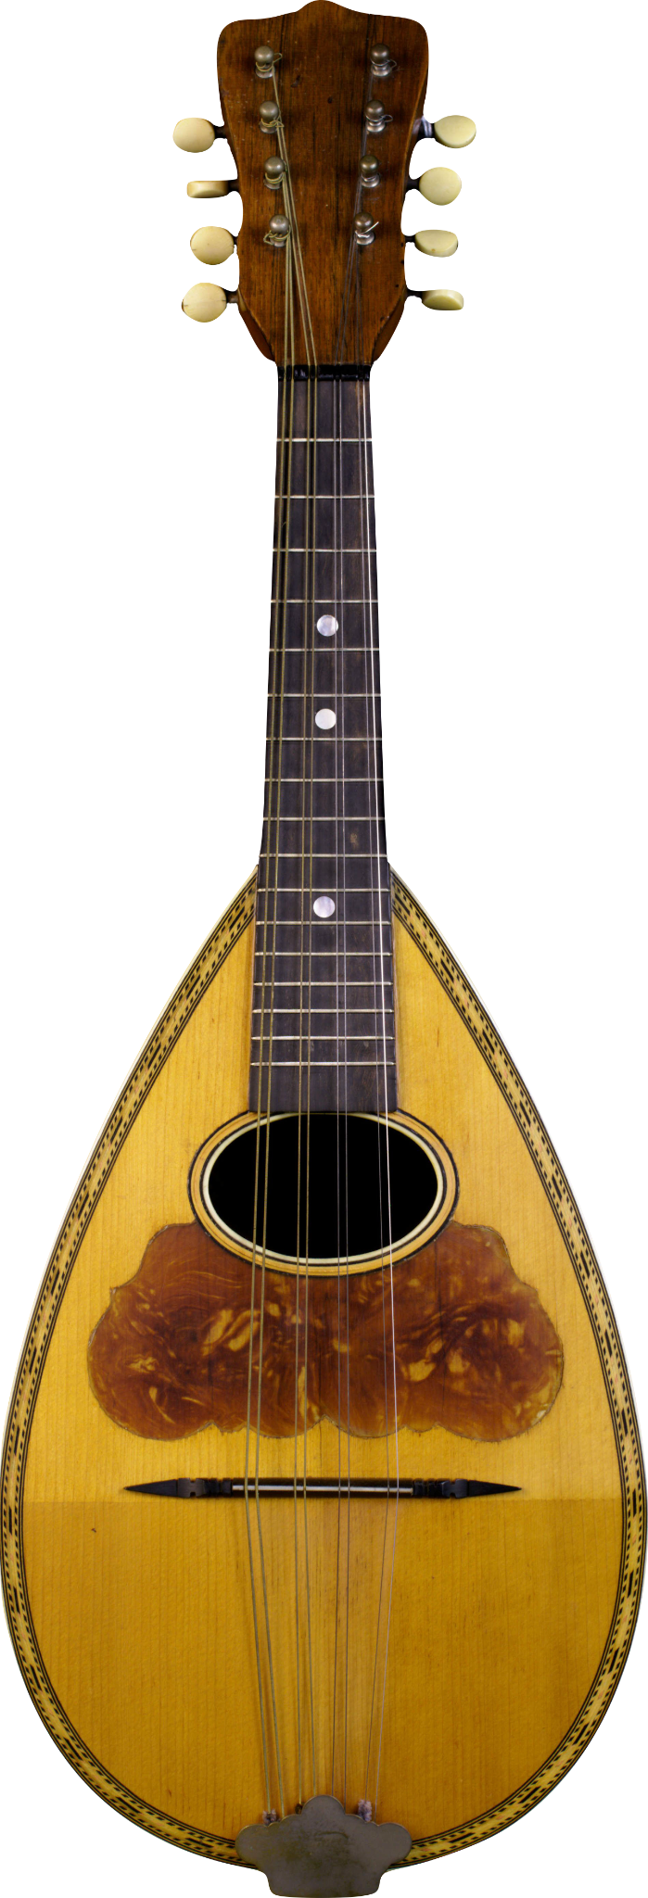
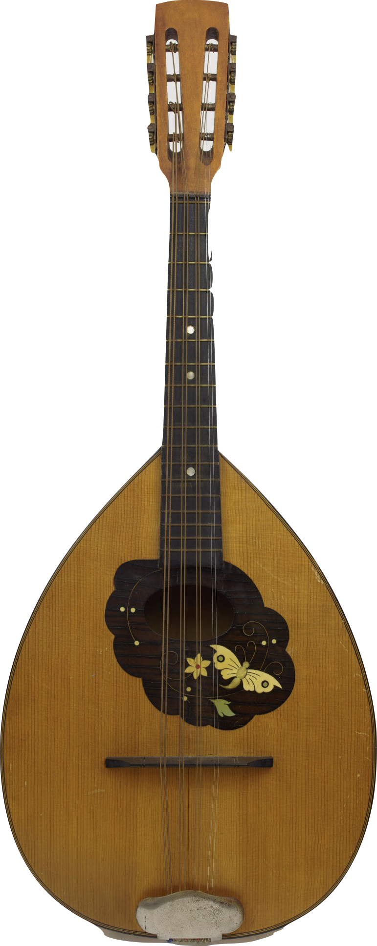
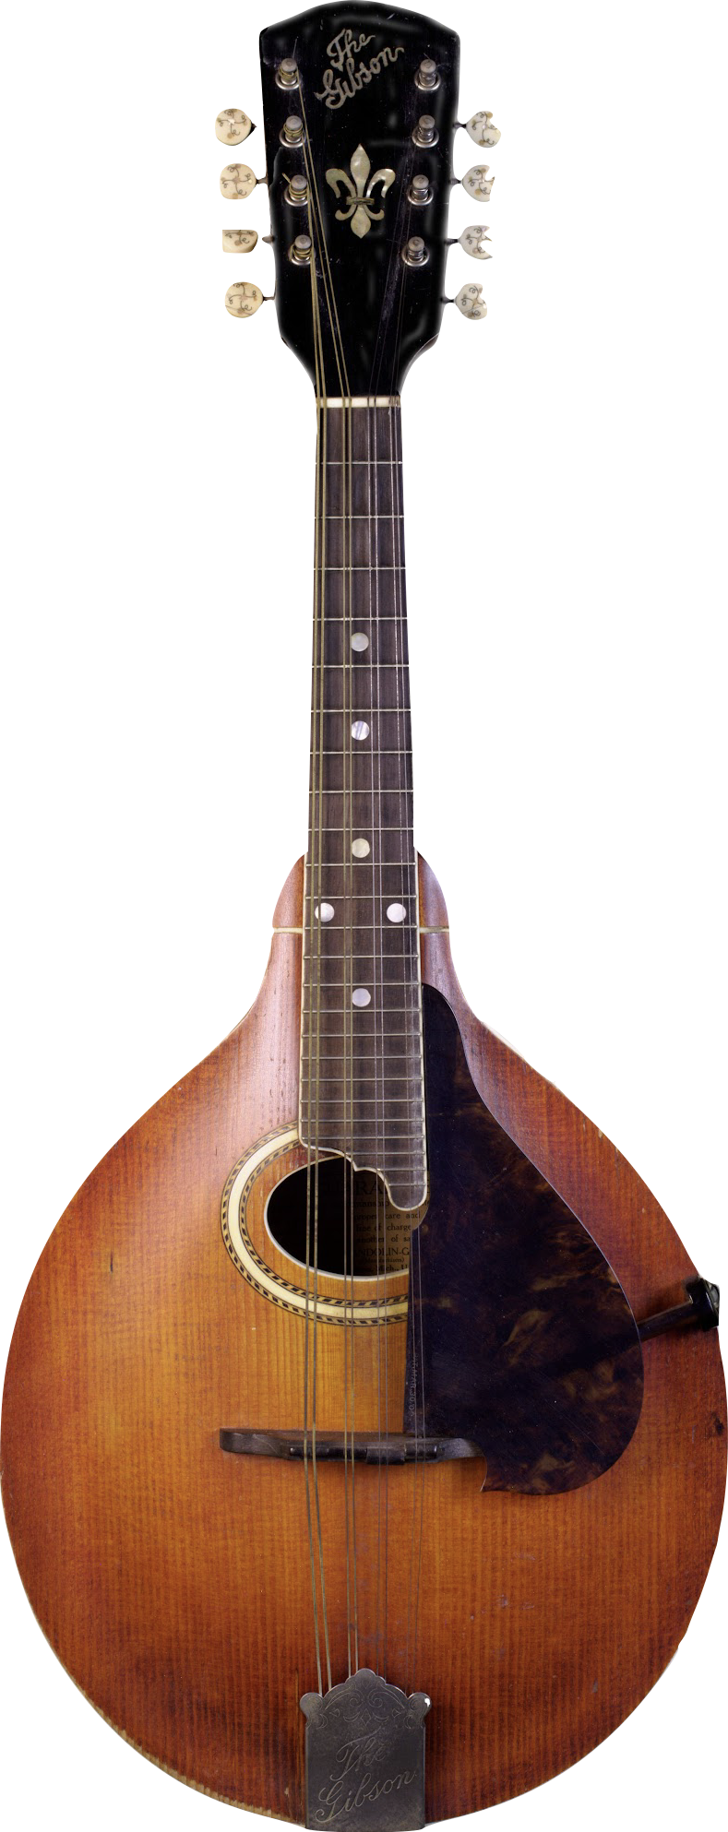
What is the name of these instruments?
Notes:
Washburn Bowlback Mandolin c.1898
These mandolins are typical of the Neapolitan style of mandolin made in the USA between the turn of the 20th century and the 1920s. The Washburn’s bowl is made with nine ribs, while the Lyon & Healy’s is made with 15.
Unknown Octave Mandolin, 1900s
The mandolin craze of the late 19th and early 20th centuries saw the rise of mandolin orchestras – collections of musicians playing different instruments in the mandolin family. This typically included the mandolin, mandola, octave mandolin, and mandocello. The octave mandolin, appropriately, is tuned one octave below the mandolin. This particular instrument features a flat back, a style popular with German makers in the latter 19th century.
3. Gibson Mandolin-Guitar A-4 Mandolin
Drawing directly from Orville Gibson's 1898 patent for an entirely new style of mandolin, the A model represents a dramatic departure from existing mandolin design. Instead of a deeply rounded, ribbed back and a canted top, the A introduced a carved top and back with much shallower rounding. Gibson instruments were named by their style and level of finish; this A-4 represents the most elaborate model available in the A style at the time.

Slide 5
Today, we will learn about the mandolin and how it traveled around the world!
Notes:
Unknown Octave Mandolin, 1900s
The mandolin craze of the late 19th and early 20th centuries saw the rise of mandolin orchestras – collections of musicians playing different instruments in the mandolin family. This typically included the mandolin, mandola, octave mandolin, and mandocello. The octave mandolin, appropriately, is tuned one octave below the mandolin. This particular instrument features a flat back, a style popular with German makers in the latter 19th century.

Slide 6
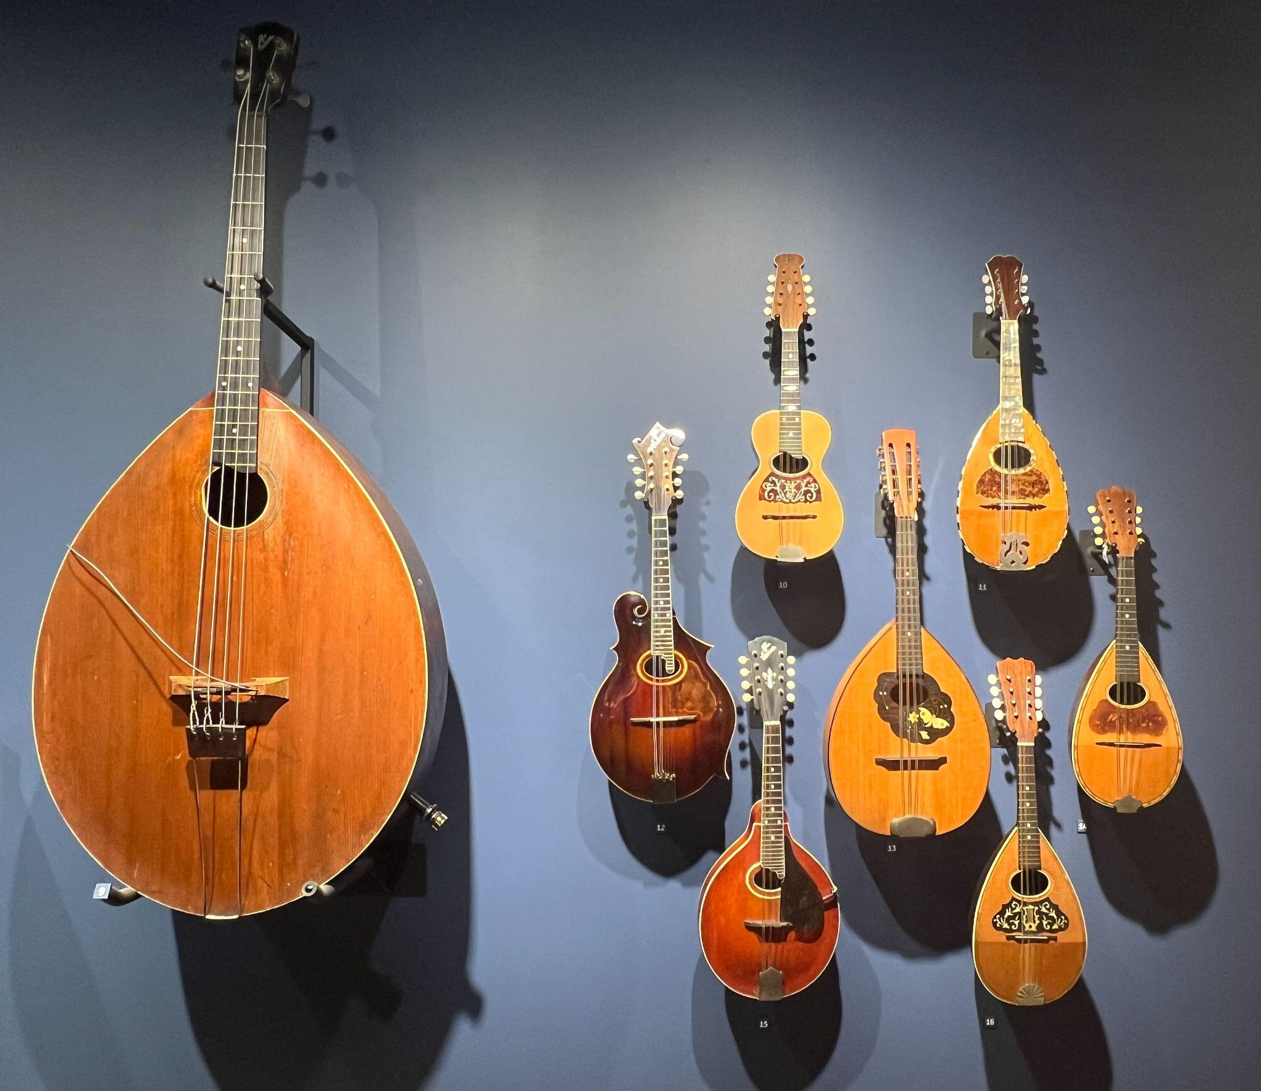
These are
mandolins
from the
Museum of
Making Music.

Slide 7
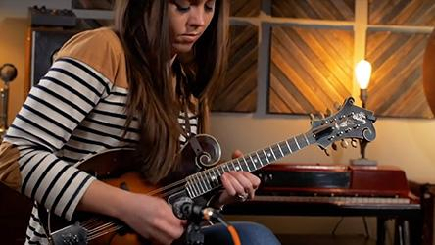
Watch and Respond:Sierra Hull
Notes:
What does it remind you of? How would you describe the sound? How would you describe the look of the instrument?

Slide 9
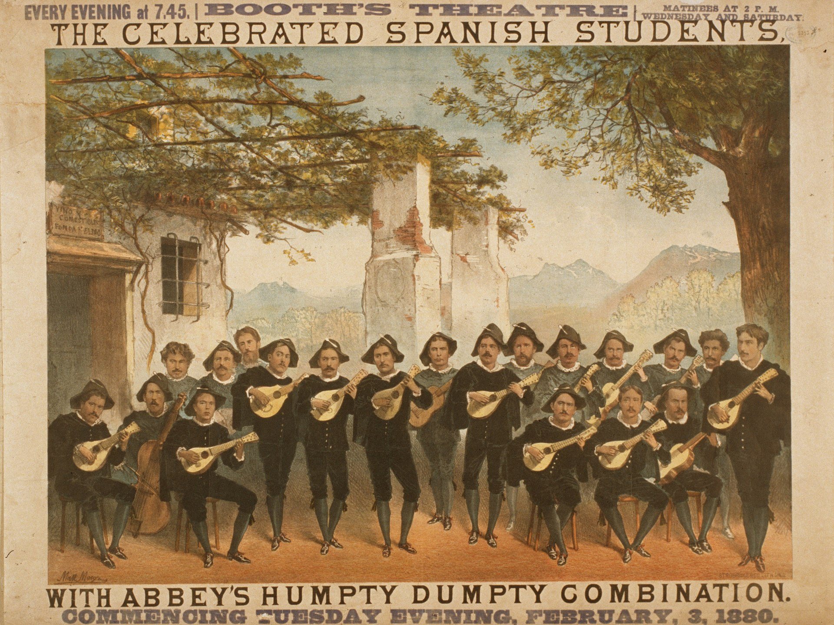
The Mandolin's Journey
In the 1800s, the mandolin first came to the U.S. through a group of Spanish students that were touring on a similar instrument called a bandurria.

Slide 10
Seizing on the popularity of the Spanish Students, mandolin groups that were already established in the U.S. which were mostly made up of Italian immigrants, toured the country and drove the instrument to incredible popularity.
As a result, instrument makers produced mandolins in the “bowlback” style, and mandolin orchestras were formed all over the country.
Notes:
Washburn Bowlback Mandolin c.1898
These mandolins are typical of the Neapolitan style of mandolin made in the USA between the turn of the 20th century and the 1920s. The Washburn’s bowl is made with nine ribs, while the Lyon & Healy’s is made with 15.

Slide 11
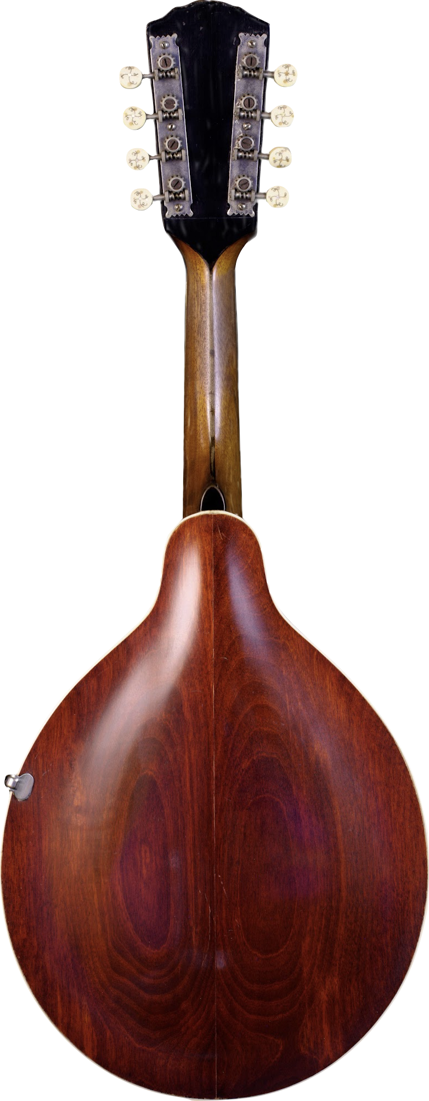
In the early 1900s, Orville Gibson created a new type of mandolin with a flat back, and soon after, this style took over!
It is very popular in bluegrass and country music today.
Notes:
Gibson Mandolin-Guitar A-4 Mandolin
Drawing directly from Orville Gibson's 1898 patent for an entirely new style of mandolin, the A model represents a dramatic departure from existing mandolin design. Instead of a deeply rounded, ribbed back and a canted top, the A introduced a carved top and back with much shallower rounding. Gibson instruments were named by their style and level of finish; this A-4 represents the most elaborate model available in the A style at the time.

Slide 12
Mandolin Styles:
Let’s look at the differences
A bowlback mandolin is comprised of several strips (9-50) of hardwood formed to shape a deep bowl.
This mandolin from 1898 has 38 strips!
A flat back mandolin has a back that is flat or slightly arched.
Notes:
Wm. Lewis Tomaso Mandolin
Made by John Brandt for the Wm. Lewis Company of Chicago, this mandolin is ornately decorated with mother of pearl and ivory. Its bowl is constructed from 38 narrow ribs.
Gibson Mandolin-Guitar A-4 Mandolin
Drawing directly from Orville Gibson's 1898 patent for an entirely new style of mandolin, the A model represents a dramatic departure from existing mandolin design. Instead of a deeply rounded, ribbed back and a canted top, the A introduced a carved top and back with much shallower rounding. Gibson instruments were named by their style and level of finish; this A-4 represents the most elaborate model available in the A style at the time.

Slide 13
Why do instruments change?
Instruments change over time for many reasons, and musicians and instrument makers are closely connected. Musicians need instrument makers to provide their tools for expression, and makers need musicians to evaluate, critique, and give voice to their work.
In the case of mandolins, the flat back mandolins have a brighter tone and a punchy resonance which works better with the styles of music it is used for today.

Slide 14
Let's play a game to show how
things can change over time!
Notes:
explain that they are going to be creating a chant that will change as it moves around the circle. Moving clockwise, each student will speak to the steady beat:
“I love _(favorite food)___ I eat it for _(favorite meal)____”
The next S replies “_(first student)___loves _(first student’s answers)____and I love ______, I eat it for _______”
As the chant moves throughout the circle, students attempt to gradually perform faster and faster until they reach the end, trying not to “drop a beat.”

Slide 15
Consider a Career in Music!
What careers are related to the lesson we just completed?
Instrument Manufacturer
Performer
Product Design
Marketing
Luthier
Factory Floor Manager
Distributor

