Slide 2
My Home Studio

Slide 3
Lesson Objectives
Understand the impact the Internet has on Music Development
Use a DAW to experience a Home Studio set-up
Collaborate and Create a 16-24 bar composition using Live Loops or a Loop Library
Access Live Loops or Loops
Select a genre of preference
Sample and Record
Write and Record a lyric (optional)

Slide 4
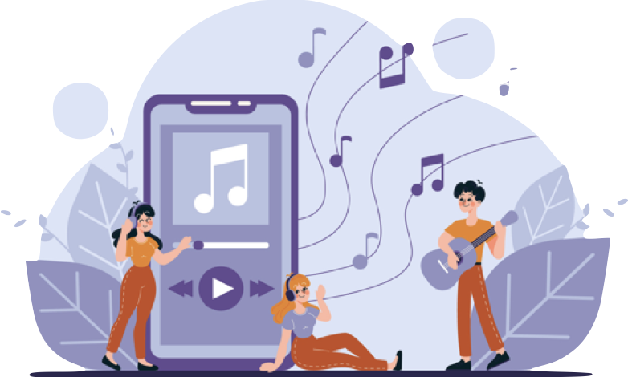
Today, we are going to learn about how
technology affects music making.
The development of the internet revolutionized our ability to connect and collaborate with others. This, paired with an explosion of digital music technology, changed the nature of music production.

Slide 5
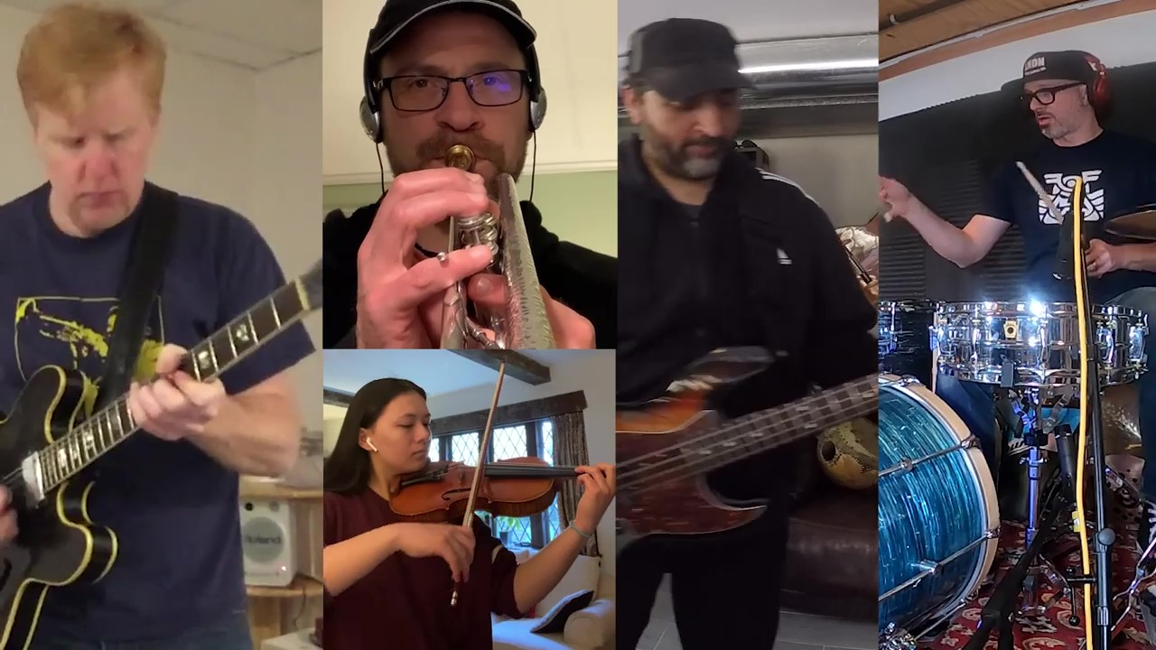
First, let's watch:

Slide 7
Now, let’s reflect:
What stood out to you about this performance?
What did you find different about this performance from other music performances you have experienced?
How do you think this was made?
What else did you find interesting?

Slide 8
What is a home studio? How did it come about?
What is it like to experience recording in one?
Let's dig into some history about the distribution and sale of musical products like instruments, recording equipment, etc.
Before the internet (can you imagine that?), musical products were primarily sold in physical stores.
Once the internet came about, musical product retailers began to experiment with websites, which at the beginning were mostly informational.

Slide 9
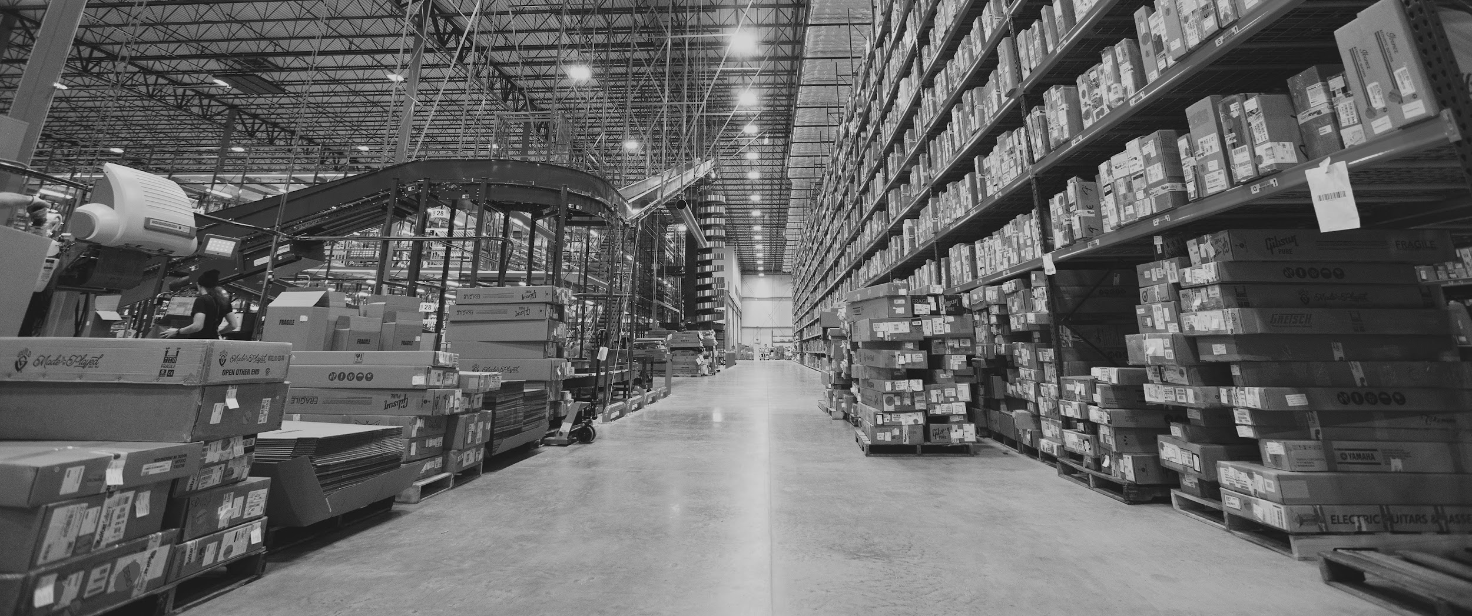
Embracing Online Sales
Some retailers began to sell huge catalogues of products entirely online as they grew the mail-order model - an extensive catalogue of products, supported by trained salespeople and centralized warehouses.
Notes:
Sweetwater Sound distribution center in Ft. Wayne, Indiana, 2020
Photo courtesy of Sweetwater Sound

Slide 10
Other businesses reimagined what retail on the internet could be, and launched platforms for use by other retailers and even individuals.
Companies like Reverb.com, specifically targeted musical products, and launched with the purpose of getting used instruments out of closets and into the hands of other musicians.

Slide 11
Any Music, Anytime,
Anywhere
In the 1990s, 2000s, and 2010s, there was an explosion of new musical styles and popularization of types of music pioneered in previous decades.
Hip hop, dance and electronic music, pop, rock, country, soul and R&B all remained popular.

Slide 12
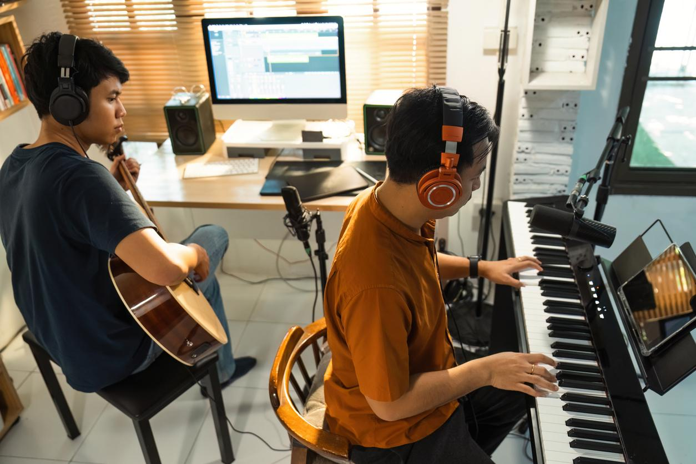
Internet collaboration
While much of this explosion in creativity and diversity began before the adoption of the internet, the ability for musicians to hear almost any song from almost any genre and to collaborate with nearly anyone else across the globe by using home studio equipment, led to the emergence of entirely new kinds of music.

Slide 13
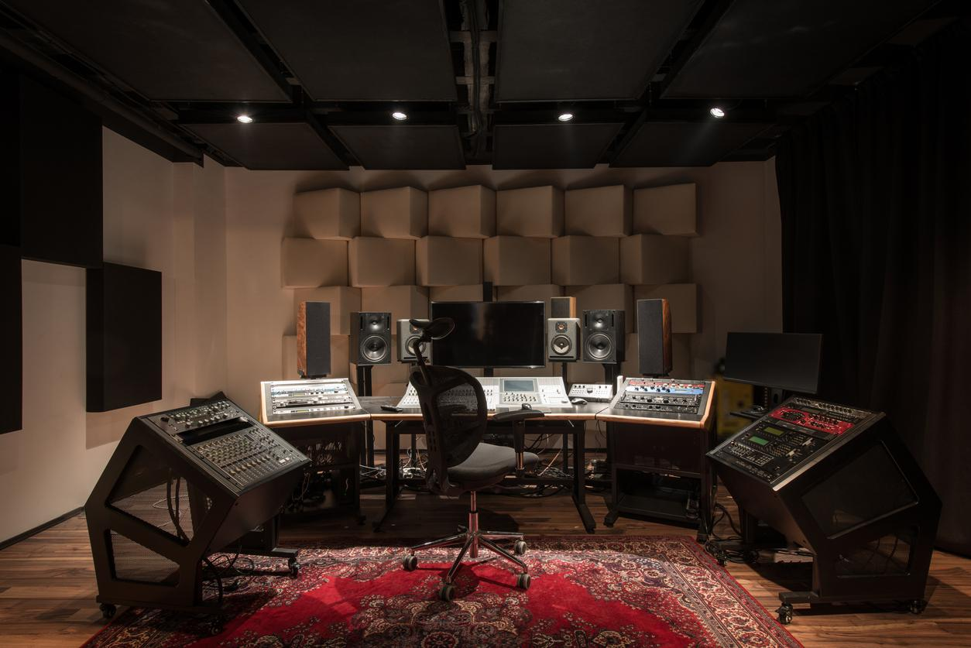
Music in a Studio
Along with this diversification of musical styles, there became a need for more - and more flexible - recording studios. This drove an explosion of the “pro audio” market, which included mixers, microphones, recording devices, speakers, acoustic treatment, and live sound equipment. Studios could be professional operations of all sizes or could be home-based setups.

Slide 14
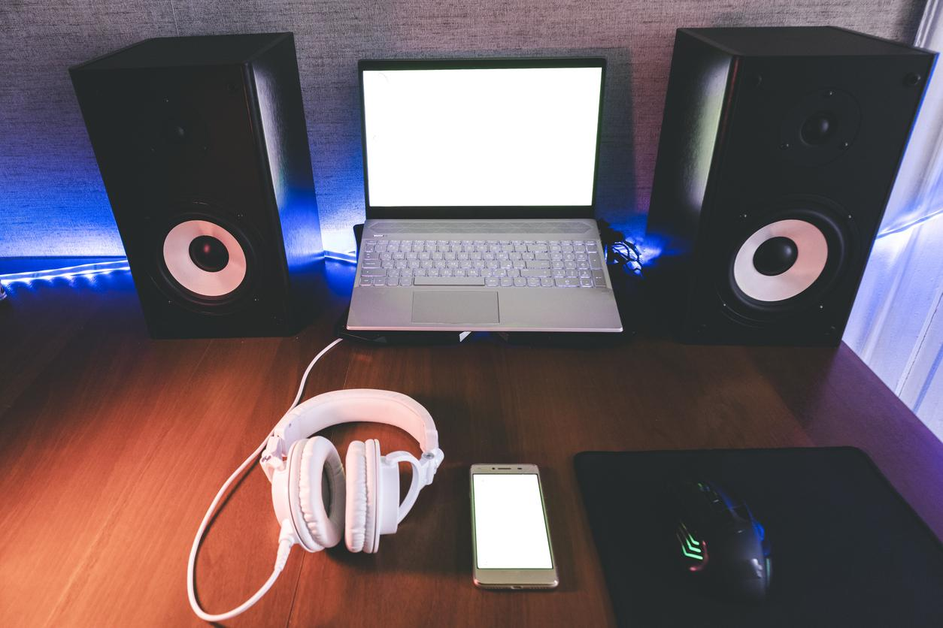
What exactly is a home studio?
A laptop and pair of speakers in the corner of your bedroom is considered a home studio. However, they can be far more elaborate.

Slide 15
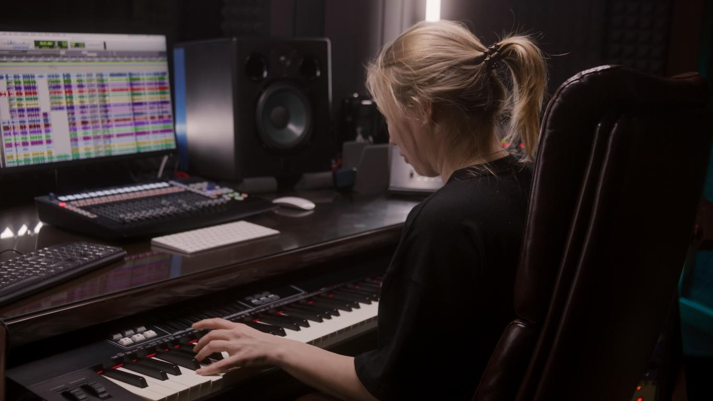
DAW
DAW stands for Digital Audio Workstation, which is used to create, record and edit audio (or sounds) that we can develop into music.

Slide 16
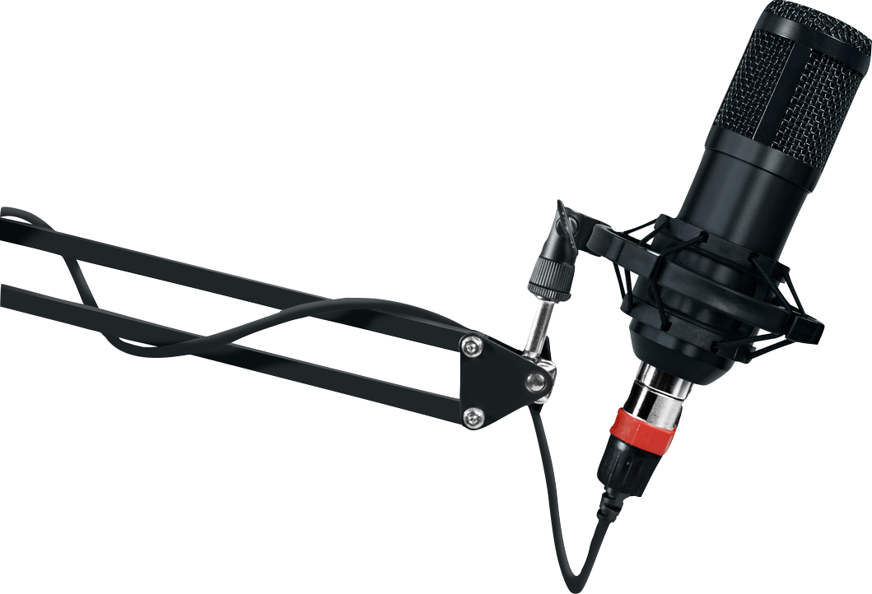
Microphone
A microphone is an amplifying device used to take our audible sound and digitize it inside of a DAW for recording purposes.

Slide 17
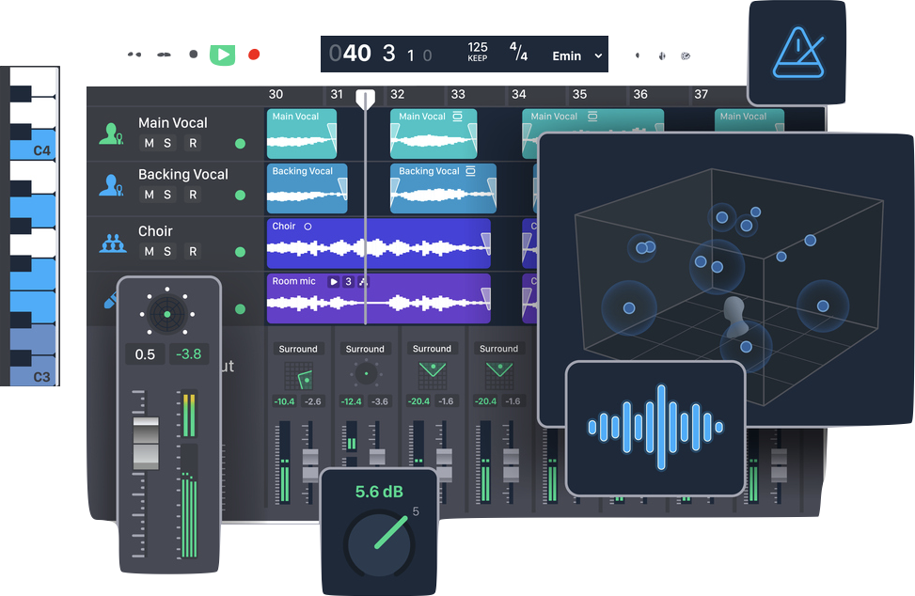
Music Editing
Have you ever listened to a song and wanted to add your own sounds, or change what you were hearing?

Slide 18
Let’s find some samples we can edit.

Slide 19
Music Engineers
That’s you!
Record a 16-24 measure song using a live loop combination of your choice, with your own original lyrics.
Use your worksheet to write your lyrics, and then record them over your loop combination.

Slide 20
Music Creation Workshop

Slide 21
Share Your Creation

Slide 22
Consider a Career in Music!
What careers are related to the lesson we just completed?
Artist
Composer
Music Technology Educator
Music Engineer
Digital Sound Effects: Movies
Music Producer
Songwriter
Film Composer

